Slide 1
International Macro and Finance
Eco553
Lecture 03: International Monetary
Markus K. Brunnermeier
Princeton University
Based on
Brunnermeier and Sannikov (2019):
International Monetary System: A Risk Perspective

Slide 2
Question
When can a country can have its own currency/safe asset?
  Money/gov. debt as store of value with different risk profile
Fragility
When will a country be “dollarized”/lose its “safe asset status”?
When will there be a sudden stop of a currency?
What’s are the US monetary policy spillover effects?
Does it “sandwich” EMDE’s monetary policy?
Dilemma vs. Trilemma
Integrated Policy Framework
  MoPo, Capital Controls, MacroPru, Fiscal Policy

Slide 3
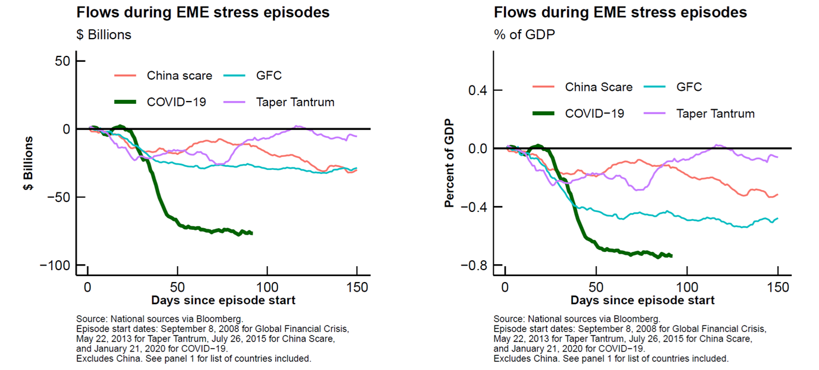
Sudden Stop and Capital outflows
March 2020: record outflow
April 2020: stabilization

Slide 4
Outline
Money/Safe Asset and frictions
  Consumption smoothing across states
    Idiosyncratic shocks: Incomplete markets a la Bewley/BruSan
    Country-wide shocks: Costly
  consumption smoothing across time
    Save in safe asset/currency after positive shocks, spend after negative
Two currencies/safe assets: international $ and local peso ₱
Main Results
  ₱ -value and interest rate endogenous, ∩-shaped in idiosyncratic risk
  Currency competition: $ instead ₱ of used for idio risk insurance
  Sudden stops:
    From $-borrowing to saving in $s capital outflows
    Sharp ₱ devaluations
  US monetary policy spillovers are large even with policy response
Notes:
There is the old idea of money and frictions, and idiosyncratic risk and capital flows

Slide 5
Safe Assets
Asset Price = E[PV(cash flows)] + E[PV(service flows)]
dividends/interest
  Service flows/convenience yield
  Collateral: relax constraints (Lagrange multiplier)
  Safe asset: [good friend analogy]
        When one needs funds, one can sell at stable price
        … since others buy
        Partial insurance through retrading - market liquidity!
  Money (narrow): relax double-coincidence of wants
  Higher Asset Price = lower expected return
Problem: safe asset + money status might burst like a bubble
  Multiple equilibria: [safe asset tautology]
Financial
assets
Collateral
assets
Safe assets
Money
Covariance
with economy

Slide 6
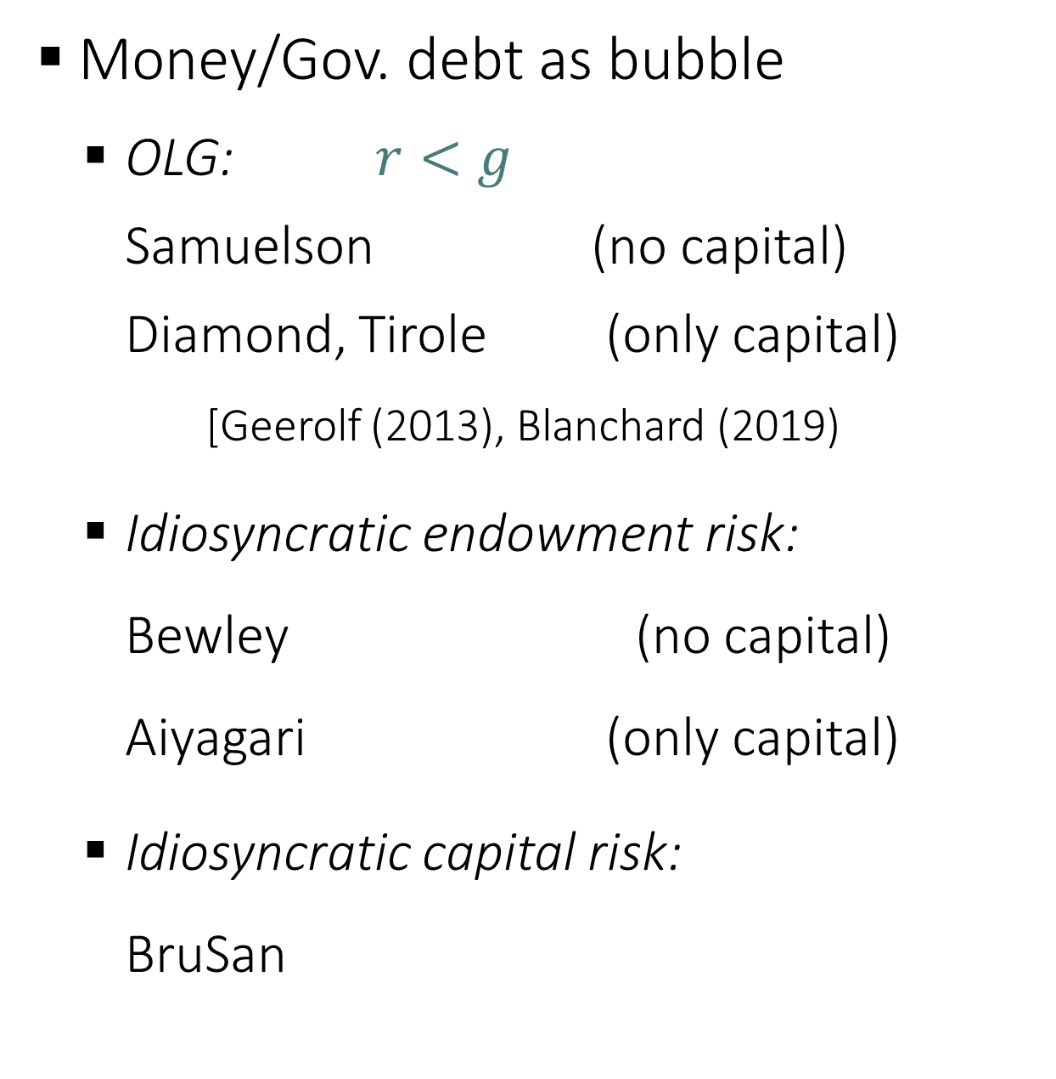
Related literature
Money/Gov. debt as bubble
  OLG: $r<g$
  Samuelson (no capital)
  Diamond, Tirole (only capital)
  [Geerolf (2013), Blanchard (2019)
  Idiosyncratic endowment risk:
  Bewley (no capital)
  Aiyagari (only capital)
  Idiosyncratic capital risk:
  BruSan
Brunnermeier Sannikov
  The I Theory of Money
  Optimal inflation rate
  “FTPL with a bubble” (with S. Merkel)
  An Integrated Policy Framework:
  A Safe Asset Perspective

Slide 7
Models on Money as Store of Value
\Friction | OLG | Incomplete Markets + idiosyncratic risk
Risk | deterministic | endowment risk borrowing constraint | return risk
Only money | Samuelson | Bewley
 |  |  | “I Theory without I”
With capital | Diamond | Aiyagari
Risk tied up with
Individual capital
Brunnermeier-Sannikov
(AER PP 2016)

Slide 8
Some Literature
Money/public debt as insurance against undiversifiable idio-risk:
  Bewley (1980) (money), Aiyagari & McGratten (1997) (public debt)
The I Theory of Money
  Brunnermeier & Sannikov (2016)
Countries with different idio-risk, global imbalances/capital flows:
  Mendoza, Quadrini & Ruis-Roll (2000), Angeletos
Response to transitory shocks, cts time
  Kray-Ventura (2000)
Public debt as a safe store of value (tax smoothing)
  Angeletos, Collar & Dellas (2016)
Capital controls and flexibility of monetary policy & Trilemma
  Mundell (1963), Fleming (1962)

Slide 9
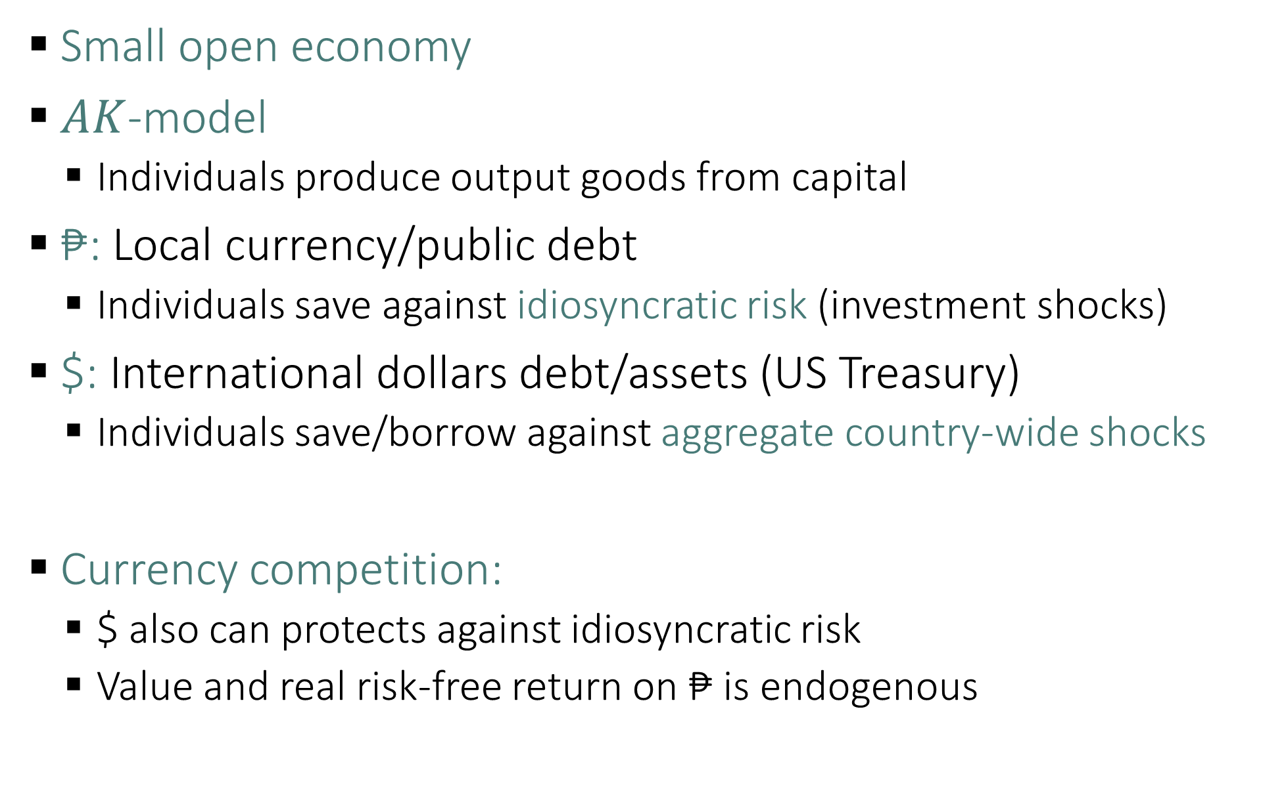
Model Outline
Small open economy
$AK$-model
  Individuals produce output goods from capital
₱: Local currency/public debt
  Individuals save against idiosyncratic risk (investment shocks)
$: International dollars debt/assets (US Treasury)
  Individuals save/borrow against aggregate country-wide shocks
Currency competition:
  $ also can protects against idiosyncratic risk
  Value and real risk-free return on ₱ is endogenous

Slide 10
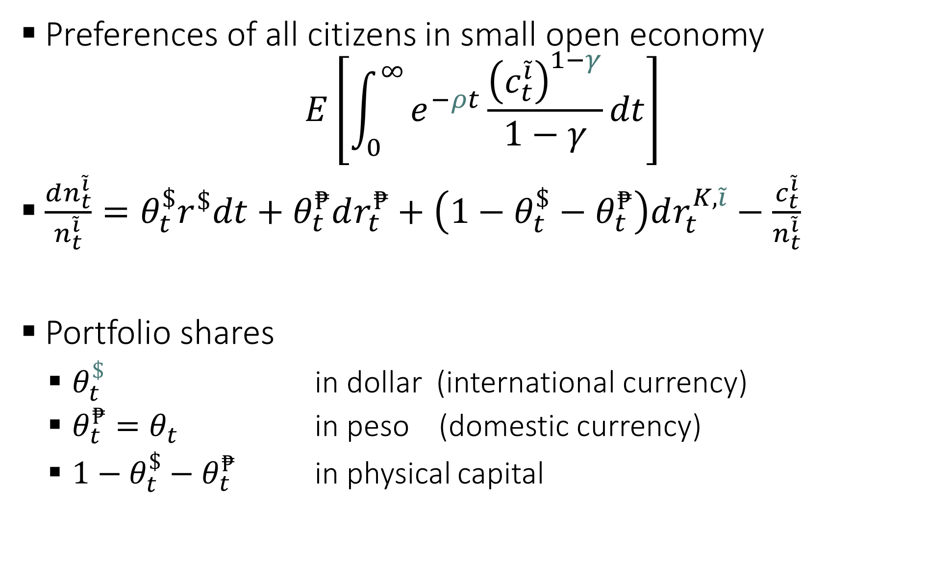
Model Setup of SOE
Preferences of all citizens in small open economy
$$E\left[\int_{0}^{∞}{e^{−ρt}\frac{{\left(c_{t}^{\tilde{i}}\right)}^{1−γ}}{1−γ}dt}\right]$$
$\frac{dn_{t}^{\tilde{i}}}{n_{t}^{\tilde{i}}}=θ_{t}^{\$}r^{\$}dt+θ_{t}^{₱}dr_{t}^{₱}+\left(1−θ_{t}^{\$}−θ_{t}^{₱}\right)dr_{t}^{K,\tilde{i}}−\frac{c_{t}^{\tilde{i}}}{n_{t}^{\tilde{i}}}$
Portfolio shares
  $θ_{t}^{\$}$ in dollar (international currency)
  $θ_{t}^{₱}=θ_{t}$ in peso (domestic currency)
  $1−θ_{t}^{\$}−θ_{t}^{₱}$ in physical capital

Slide 11
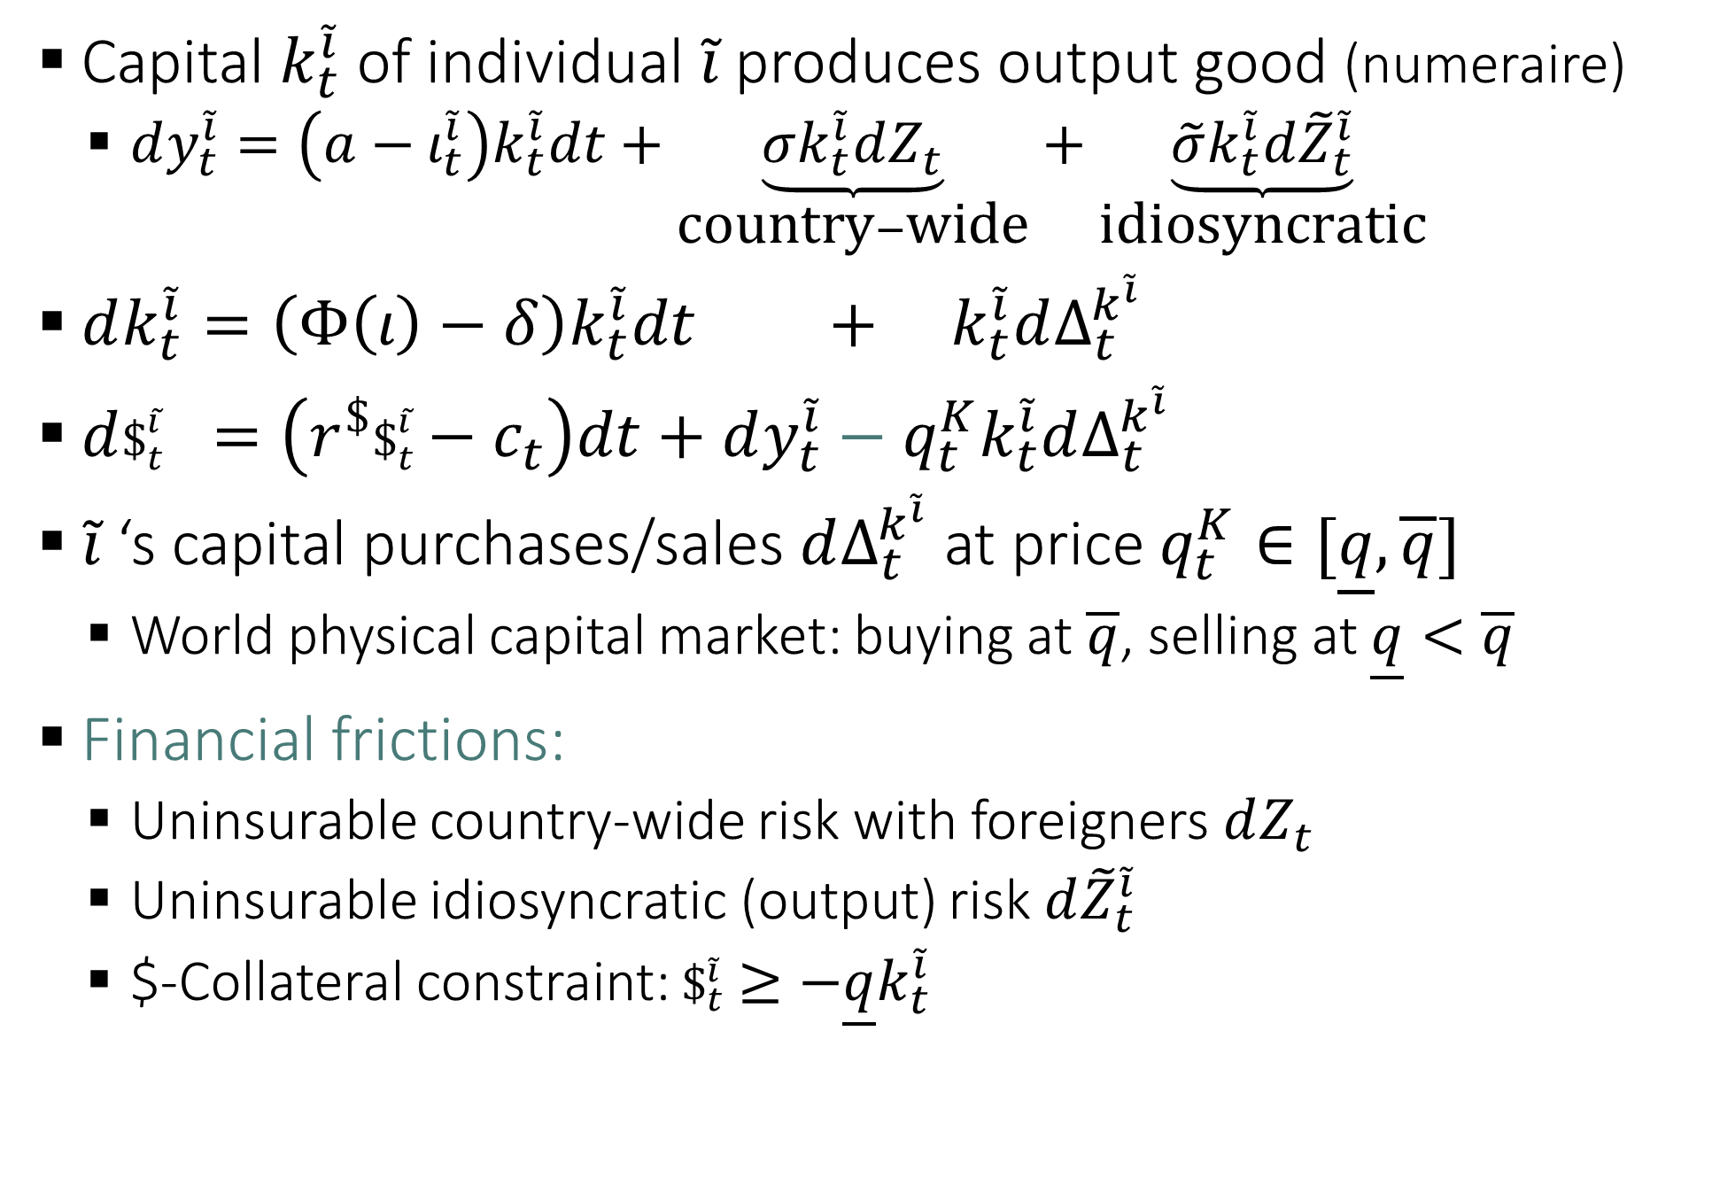
Model Setup of SOE
Capital $k_{t}^{\tilde{i}}$ of individual $\tilde{i}$ produces output good (numeraire)
  $dy_{t}^{\tilde{i}}=\left(a−ι_{t}^{\tilde{i}}\right)k_{t}^{\tilde{i}}dt+\underset{\text{country}−\text{wide}}{\underbrace{σk_{t}^{\tilde{i}}dZ_{t}}}+\underset{\text{idiosyncratic}}{\underbrace{\tilde{σ}k_{t}^{\tilde{i}}d{\tilde{Z}}_{t}^{\tilde{i}}}}$
$dk_{t}^{\tilde{i}}=\left(Φ\left(ι\right)−δ\right)k_{t}^{\tilde{i}}dt + k_{t}^{\tilde{i}}dΔ_{t}^{k^{\tilde{i}}}$
$d\$_{t}^{\tilde{i}}$ $=\left(r^{\$}\$_{t}^{\tilde{i}}−c_{t}\right)dt+dy_{t}^{\tilde{i}}−q_{t}^{K}k_{t}^{\tilde{i}}dΔ_{t}^{k^{\tilde{i}}}$
$\tilde{i}$‘s capital purchases/sales $dΔ_{t}^{k^{\tilde{i}}}$at price $q_{t}^{K}∈[\underline{q},\overline{q}]$
  World physical capital market: buying at $\overline{q}$, selling at $\underline{q}<\overline{q}$
Financial frictions:
  Uninsurable country-wide risk with foreigners $dZ_{t}$
  Uninsurable idiosyncratic (output) risk $d{\tilde{Z}}_{t}^{\tilde{i}}$
  $-Collateral constraint: $\$_{t}^{\tilde{i}}$ $≥−\underline{q}k_{t}^{\tilde{i}}$

Slide 12
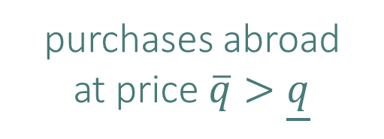



Aggregate State Variables & Assets
Capital production
$$Φ’ > 0, Φ’’ ≤ 0$$
capital sales
abroad at price $q$
purchases abroad
at price $\overline{q}>\underline{q}$
$dK_{t}=\left(Φ\left(ι\right)−δ\right)K_{t}dt −K_{t}d{\underline{Δ}}_{t}^{K} + K_{t}d{\overline{Δ}}_{t}^{K}$
$d\$_{t}=\left(r^{\$}\$_{t}−C_{t}\right)dt+\left(\underline{q}K_{t}d{\underline{Δ}}_{t}^{K}−\overline{q}K_{t}d{\overline{Δ}}_{t}^{K}\right)+dY_{t}$
$ν_{t}K_{t}≔\$_{t}$ (dollar holding, incl. T-Bonds) (=numeraire)
  $dν_{t}=ν_{t}\left(r^{\$}−Φ\left(ι_{t}\right)+δ\right)dt+\left(a−ι_{t}\right)dt−ζ_{t}dt+σdZ_{t}$
  $+(\underline{q}+ν_{t})d{\underline{Δ}}_{t}^{K}−(\overline{q}+ν_{t})d{\overline{Δ}}_{t}^{K}$
$q_{t}^{₱}K_{t}$= real value of (domestic) currency
  $dr^{M}=\underset{=:g_{t}}{\underbrace{(Φ\left(ι\right)−δ)}}dt−{\hat{μ}}^{₱}dt$
$q_{t}^{K}K_{t}$= value of physical capital
  Country-wide risk $σ/q_{t}$ , idiosyncratic risk $\tilde{σ}/q_{t}^{K}$
  $dr_{t}^{K}=\underset{dividend yield}{\underbrace{\frac{a−ι_{t}}{q_{t}^{K}}dt+\frac{σ}{q_{t}^{K}}dZ_{t}+\frac{\tilde{σ}}{q_{t}^{K}}d{\tilde{Z}}_{t}}}+\underset{capital gains}{\underbrace{(Φ\left(ι\right)−δ)dt}}+\underset{seigniorage}{\underbrace{\frac{q_{t}^{₱}}{q_{t}^{K}}{\hat{μ}}^{₱}dt}}$

Slide 13

Aggregate State Variables & Assets
Capital production
$$Φ’ > 0, Φ’’ ≤ 0$$
capital sales
abroad at price $q$
purchases abroad
at price $\overline{q}>\underline{q}$
$dK_{t}=\left(Φ\left(ι\right)−δ\right)K_{t}dt −K_{t}d{\underline{Δ}}_{t}^{K} + K_{t}d{\overline{Δ}}_{t}^{K}$
$d\$_{t}=\left(r^{\$}\$_{t}−C_{t}\right)dt+\left(\underline{q}K_{t}d{\underline{Δ}}_{t}^{K}−\overline{q}K_{t}d{\overline{Δ}}_{t}^{K}\right)+dY_{t}$
$ν_{t}K_{t}≔\$_{t}$ (dollar holding, incl. T-Bonds) (=numeraire)
  $dν_{t}=ν_{t}\left(r^{\$}−Φ\left(ι_{t}\right)+δ\right)dt+\left(a−ι_{t}\right)dt−ζ_{t}dt+σdZ_{t}$
  $+(\underline{q}+ν_{t})d{\underline{Δ}}_{t}^{K}−(\overline{q}+ν_{t})d{\overline{Δ}}_{t}^{K}$
$q_{t}^{₱}K_{t}$= real value of (domestic) currency
  $dr^{M}=\underset{=:g_{t}}{\underbrace{(Φ\left(ι\right)−δ)}}dt−{\hat{μ}}^{₱}dt$
$q_{t}^{K}K_{t}$= value of physical capital
  Country-wide risk $σ/q_{t}$ , idiosyncratic risk $\tilde{σ}/q_{t}^{K}$
  $dr_{t}^{K}=\underset{dividend yield}{\underbrace{\frac{a−ι_{t}}{q_{t}^{K}}dt+\frac{σ}{q_{t}^{K}}dZ_{t}+\frac{\tilde{σ}}{q_{t}^{K}}d{\tilde{Z}}_{t}}}+\underset{capital gains}{\underbrace{(Φ\left(ι\right)−δ)dt}}+\underset{seigniorage}{\underbrace{\frac{q_{t}^{₱}}{q_{t}^{K}}{\hat{μ}}^{₱}dt}}$

Slide 14
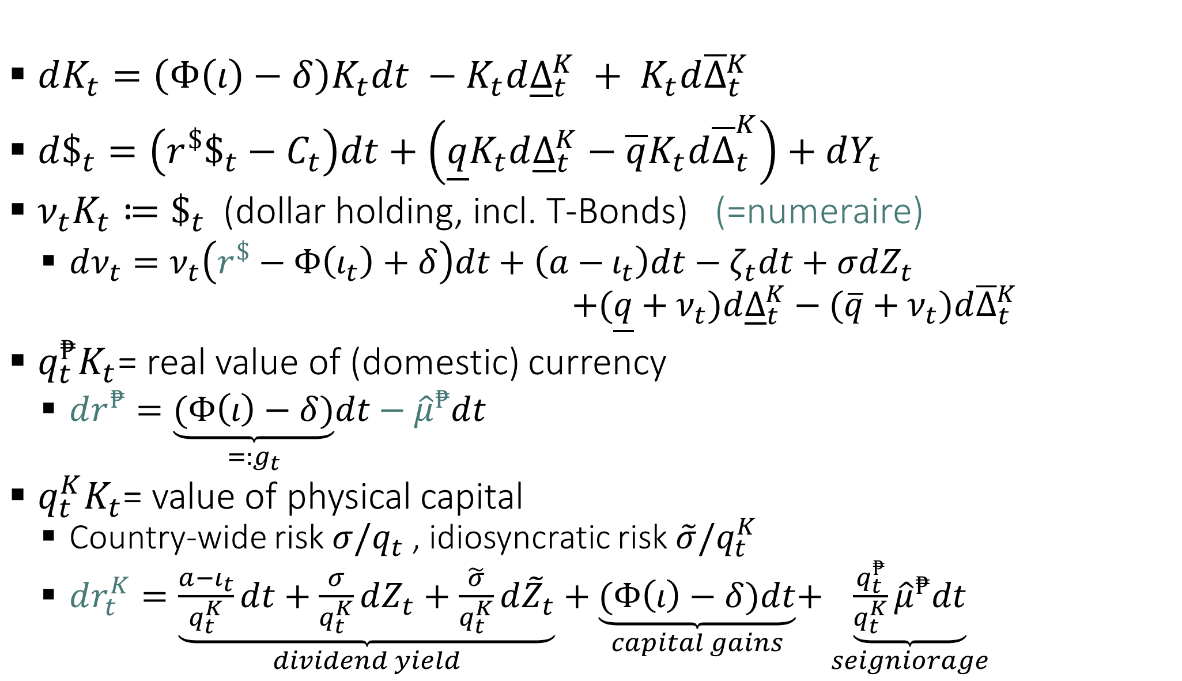
Aggregate State Variables & Assets
Capital production
$$Φ’ > 0, Φ’’ ≤ 0$$
capital sales
abroad at price $q$
purchases abroad
at price $\overline{q}>\underline{q}$
$dK_{t}=\left(Φ\left(ι\right)−δ\right)K_{t}dt −K_{t}d{\underline{Δ}}_{t}^{K} + K_{t}d{\overline{Δ}}_{t}^{K}$
$d\$_{t}=\left(r^{\$}\$_{t}−C_{t}\right)dt+\left(\underline{q}K_{t}d{\underline{Δ}}_{t}^{K}−\overline{q}K_{t}d{\overline{Δ}}_{t}^{K}\right)+dY_{t}$
$ν_{t}K_{t}≔\$_{t}$ (dollar holding, incl. T-Bonds) (=numeraire)
  $dν_{t}=ν_{t}\left(r^{\$}−Φ\left(ι_{t}\right)+δ\right)dt+\left(a−ι_{t}\right)dt−ζ_{t}dt+σdZ_{t}$
  $+(\underline{q}+ν_{t})d{\underline{Δ}}_{t}^{K}−(\overline{q}+ν_{t})d{\overline{Δ}}_{t}^{K}$
$q_{t}^{₱}K_{t}$= real value of (domestic) currency
  $dr^{₱}=\underset{=:g_{t}}{\underbrace{(Φ\left(ι\right)−δ)}}dt−{\hat{μ}}^{₱}dt$
$q_{t}^{K}K_{t}$= value of physical capital
  Country-wide risk $σ/q_{t}$ , idiosyncratic risk $\tilde{σ}/q_{t}^{K}$
  $dr_{t}^{K}=\underset{dividend yield}{\underbrace{\frac{a−ι_{t}}{q_{t}^{K}}dt+\frac{σ}{q_{t}^{K}}dZ_{t}+\frac{\tilde{σ}}{q_{t}^{K}}d{\tilde{Z}}_{t}}}+\underset{capital gains}{\underbrace{(Φ\left(ι\right)−δ)dt}}+\underset{seigniorage}{\underbrace{\frac{q_{t}^{₱}}{q_{t}^{K}}{\hat{μ}}^{₱}dt}}$

Slide 15
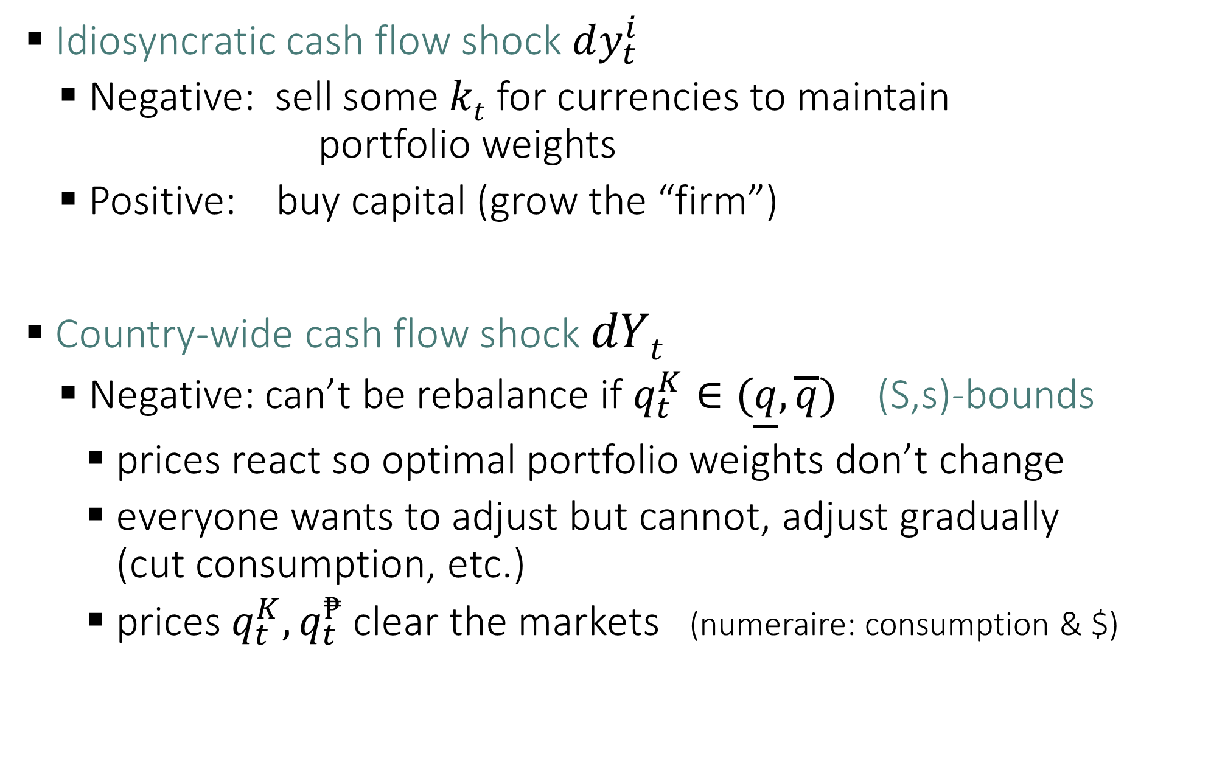
Rebalancing of individual
Idiosyncratic cash flow shock $dy_{t}^{i}$
  Negative: sell some $kt$ for currencies to maintain
  portfolio weights
  Positive: buy capital (grow the “firm”)
Country-wide cash flow shock $dYt$
  Negative: can’t be rebalance if $q_{t}^{K}∈(\underline{q},\overline{q})$ (S,s)-bounds
    prices react so optimal portfolio weights don’t change
    everyone wants to adjust but cannot, adjust gradually
    (cut consumption, etc.)
    prices $q_{t}^{K}, q_{t}^{₱}$clear the markets (numeraire: consumption & $)

Slide 16
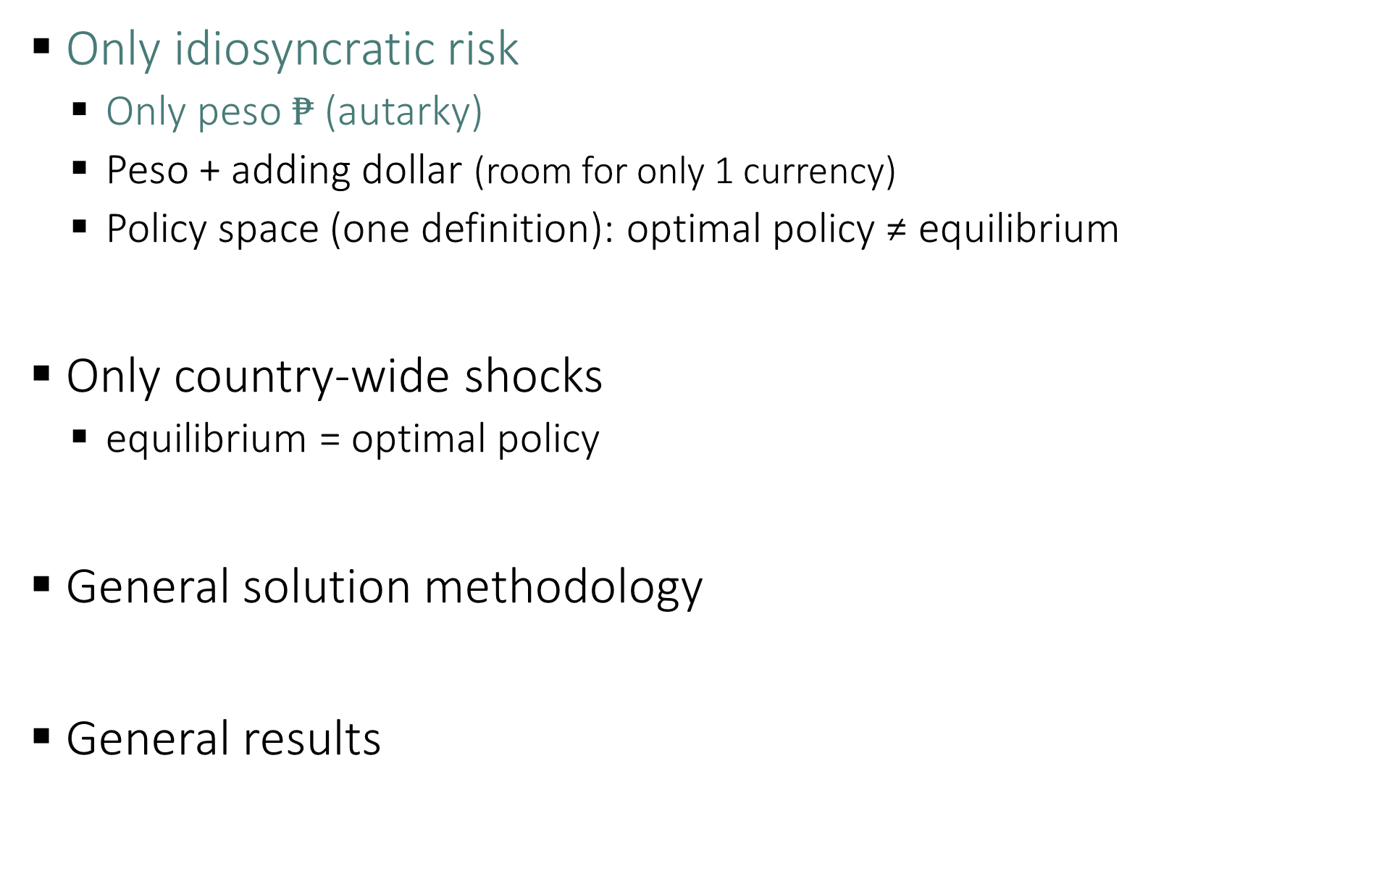
Roadmap
Only idiosyncratic risk
  Only peso $₱$ (autarky)
  Peso + adding dollar (room for only 1 currency)
  Policy space (one definition): optimal policy ≠ equilibrium
Only country-wide shocks
  equilibrium = optimal policy
General solution methodology
General results

Slide 17
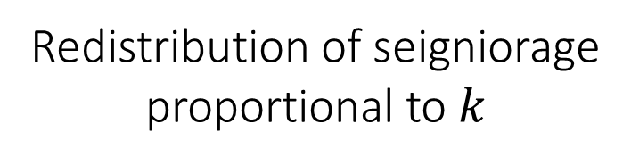
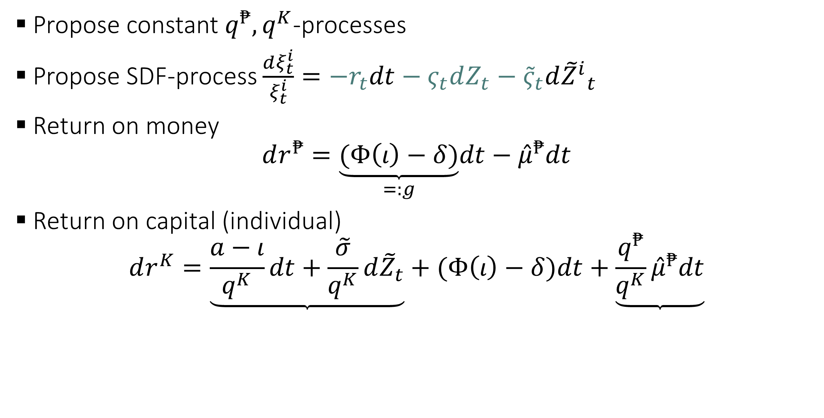
Solve for steady state
Propose constant $q^{₱},q^{K}$-processes
Propose SDF-process $\frac{dξ_{t}^{i}}{ξ_{t}^{i}}=−r_{t}dt−ς_{t}dZ_{t}−{\tilde{ς}}_{t}d{{\tilde{Z}}^{i}}_{t}$
Return on money
$$dr^{₱}=\underset{=:g}{\underbrace{(Φ\left(ι\right)−δ)}}dt−{\hat{μ}}^{₱}dt$$
Return on capital (individual)
$$dr^{K}=\underset{}{\underbrace{\frac{a−ι}{q^{K}}dt+\frac{\tilde{σ}}{q^{K}}d{\tilde{Z}}_{t}}}+(Φ\left(ι\right)−δ)dt+\underset{}{\underbrace{\frac{q^{₱}}{q^{K}}{\hat{μ}}^{₱}dt}}$$
Dividend yield
Redistribution of seigniorage
proportional to $k$

Slide 18

Idio risk only & Peso only (& $γ=1$)
Optimal Choices Market Clearing
Optimal investment rate
  $φι_{t}=q_{t}^{K}−1$
Optimal consumption
  $\frac{c_{t}}{n_{t}}=ρ⇒C=ρ\left(q_{t}^{₱}+q_{t}^{K}\right)K_{t} =\left(a−ι_{t}\right)K_{t}$
Optimal portfolio
  $1−θ=\frac{\left(a−ι\right)q^{K}}{{\tilde{σ}}^{2}}+\frac{{\hat{μ}}^{₱}q/(p+q)}{{\tilde{σ}}^{2}}$ $=\frac{q^{K}K_{t}}{\left(q^{K}+q^{₱}\right)K_{t}}=:1−θ$

Slide 19


Idio risk only & Peso only (& $γ=1$)
Optimal Choices
Optimal investment rate
  $φι_{t}=q_{t}^{K}−1$
Optimal consumption
  $\frac{c}{n}=ρ⇒C=ρ\left(p+q\right)K_{t}$
Optimal portfolio
  $1−θ=\frac{\left(a−ι\right)q^{K}}{{\tilde{σ}}^{2}}+\frac{{\hat{μ}}^{₱}q/(p+q)}{{\tilde{σ}}^{2}}$
$\max_{ι_{t}^{i}}\left\{r_{t}^{k^{i}}\right\}$
$\max_{ι_{t}^{i}}\left\{\frac{a−ι_{t}^{i}}{q_{t}^{K}}dt+\left(Φ\left(ι_{t}^{i}\right)−δ\right)dt+..\right\}$
$\frac{1}{q_{t}^{K}}=Φ′(ι_{t}^{\tilde{i}})$ Tobin’s $q$
All agents $ι_{t}^{\tilde{i}}=ι_{t}$
Special functional form:
  $$Φ\left(ι_{t}\right)=\frac{1}{φ}\log{(φι_{t}+1)}$$
  $$⇒φι_{t}=q_{t}^{K}−1$$

Slide 20

Idio risk only & Peso only (& $γ=1$)
Optimal Choices
Optimal investment rate
  $φι_{t}=q_{t}^{K}−1$
Optimal consumption
  $\frac{c_{t}}{n_{t}}=ρ⇒C=ρ\left(q_{t}^{₱}+q_{t}^{K}\right)K_{t}$
Optimal portfolio
  $1−θ=\frac{\left(a−ι\right)q^{K}}{{\tilde{σ}}^{2}}+\frac{{\hat{μ}}^{₱}q/(p+q)}{{\tilde{σ}}^{2}}$

Slide 21


Idio risk only & Peso only (& $γ=1$)
Optimal Choices
Optimal investment rate
  $φι_{t}=q_{t}^{K}−1$
Optimal consumption
  $\frac{c_{t}}{n_{t}}=ρ⇒C=ρ\left(q_{t}^{₱}+q_{t}^{K}\right)K_{t}$
Optimal portfolio
  $1−θ_{t}=\frac{\left(a−ι_{t}\right)q_{t}^{K}}{{\tilde{σ}}^{2}}+\frac{{\hat{μ}}^{₱}q_{t}^{K}(q^{₱}+q_{t}^{K})}{{\tilde{σ}}^{2}}$
$E\left[r_{t}^{K}\right]=r_{t}^{f}+\tilde{ς}{{\tilde{σ}}_{t}}^{r^{K}}$
${{\tilde{σ}}_{t}}^{r^{K}}=\tilde{σ}/q_{t}^{K}$
With log-utility
Price of idio risk ${\tilde{ς}}_{t}=\frac{\left(1−θ_{t}\right)\tilde{σ}}{q_{t}^{K}}$
Hence, $1−θ_{t}=\frac{E\left[r_{t}^{K}\right]−r^{f}}{{\left(\tilde{σ}/q_{t}^{K}\right)}^{2} }$
Recall
$$E\left[r_{t}^{K}\right]−r_{t}^{f}=\frac{a−ι_{t}}{q_{t}^{K}}+\frac{{\hat{μ}}^{₱}(q_{t}^{₱}+q_{t}^{K})}{q_{t}^{K}}$$

Slide 22

Idio risk only & Peso only (& $γ=1$)
Optimal Choices Market Clearing
Optimal investment rate
  $φι_{t}=q_{t}^{K}−1$
Optimal consumption
  $\frac{c_{t}}{n_{t}}=ρ⇒C=ρ\left(q_{t}^{₱}+q_{t}^{K}\right)K_{t} =\left(a−ι_{t}\right)K_{t}$
Optimal portfolio
  $1−θ_{t}=\frac{\left(a−ι_{t}\right)q_{t}^{K}}{{\tilde{σ}}^{2}}+\frac{{\hat{μ}}^{₱}q_{t}^{K}(q^{₱}+q_{t}^{K})}{{\tilde{σ}}^{2}}$ $=\frac{q^{K}K_{t}}{\left(q^{K}+q^{₱}\right)K_{t}}=:1−θ$

Slide 23




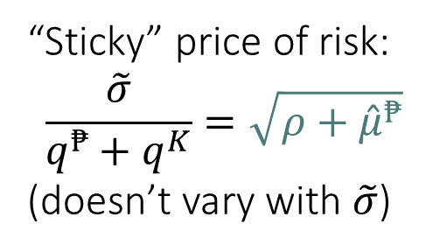


Idio risk only & Peso only (& $γ=1$)
Equilibrium (closed form for log-utility):
$q^{₱}=\frac{\tilde{σ}\left(1+φρ\right)}{\sqrt{ρ+{\hat{μ}}^{₱}}}−(1+φa)$
$q^{K}=\left(1+φa\right)−\frac{φρ\tilde{σ}}{\sqrt{ρ+{\hat{μ}}^{₱}}}$
$ι=a−\frac{ρ\tilde{σ}}{\sqrt{ρ+{\hat{μ}}^{₱}}}$
“Sticky” price of risk:
$$\frac{\tilde{σ}}{q^{₱}+q^{K}}=\sqrt{ρ+{\hat{μ}}^{₱}}$$
(doesn’t vary with $\tilde{σ}$)
$$q_{0}^{₱}$$
$$q^{₱}$$
$$q^{K}$$
$$0$$
$$\tilde{σ}$$

Slide 24
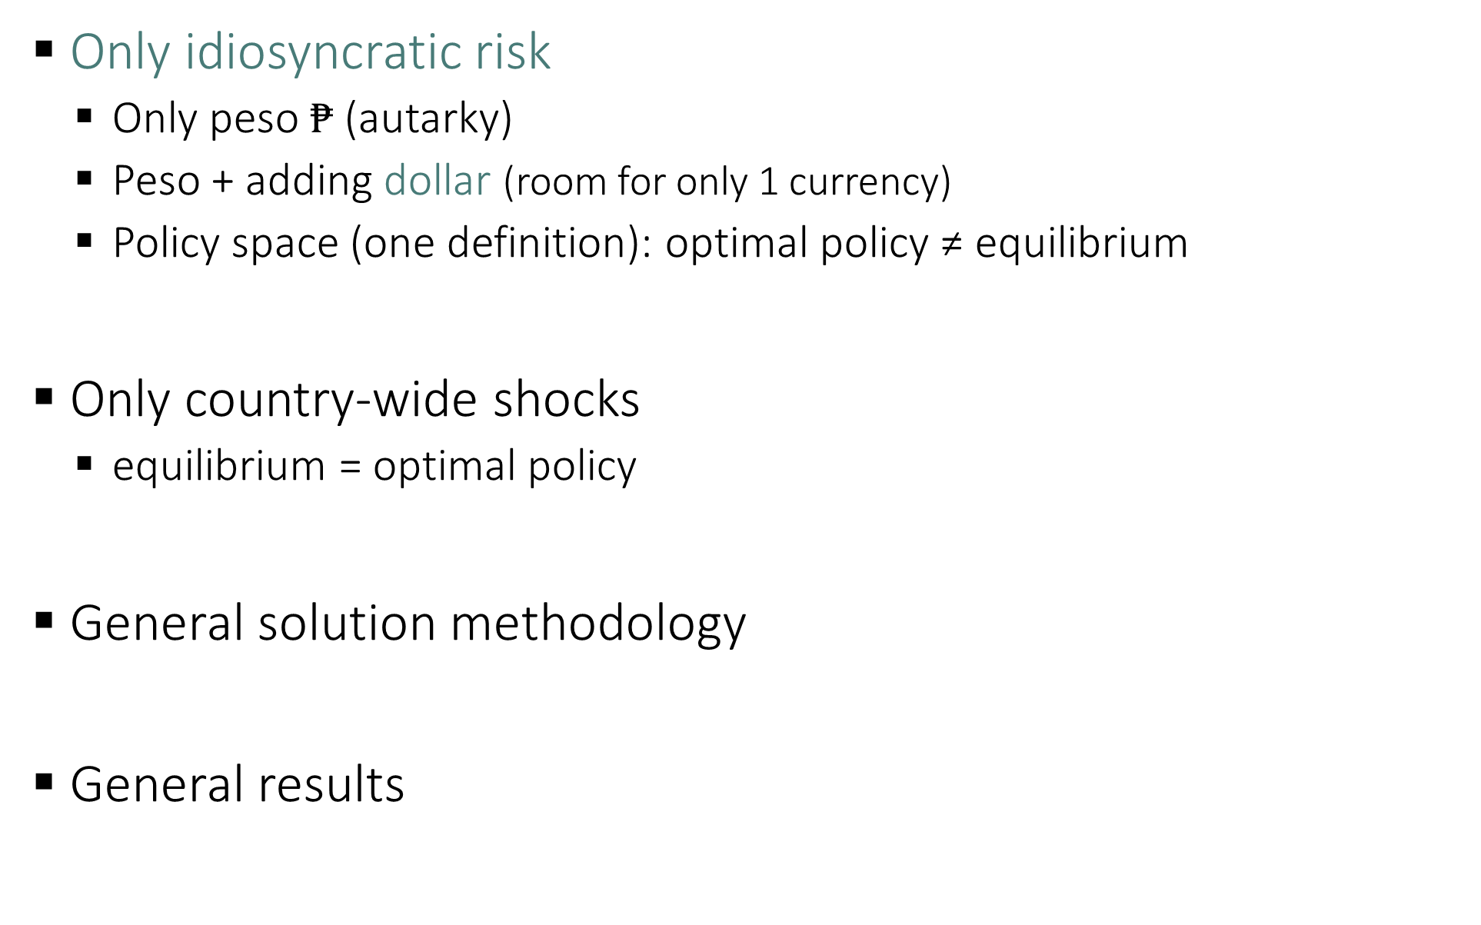
Roadmap
Only idiosyncratic risk
  Only peso $₱$ (autarky)
  Peso + adding dollar (room for only 1 currency)
  Policy space (one definition): optimal policy ≠ equilibrium
Only country-wide shocks
  equilibrium = optimal policy
General solution methodology
General results

Slide 25


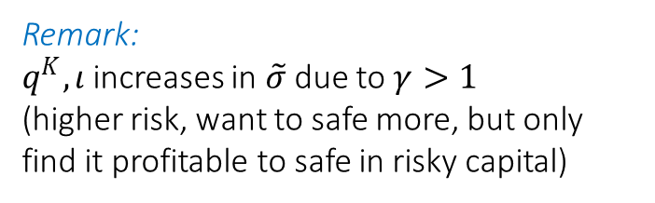





Idio risk only: When can $₱$ survive next to $
Without pesos ($q^{₱}= 0$), citizens choose btw
  $K$ and $ (up to a borrowing limit of $\underline{q}$ per unit of $K$)
higher $\tilde{σ}⇒$ higher $ν≔\$/K$ - adjust slowly to the optimal portfolio
When $Φ\left(ι\right)−δ>r^{F}$ the economy is “bubble-prone”
Bubble asset can grow at $Φ\left(ι\right)−δ$
Peso currency has value $q^{₱}K_{t}>0$ without fiscal backing
$$ρ=4\%, r^{\$}=2\%,$$
$$a=.14, γ=2$$
$$φ=2, δ=2\%$$
$$\underline{q}=.6, σ=0$$
required
Peso is
viable
$-hoar-
ding
$$Φ\left(ι\right)−δ$$
$$Φ\left(ι\right)−δ$$
Remark:
$q^{K},ι$ increases in $\tilde{σ}$ due to $γ>1$
(higher risk, want to safe more, but only find it profitable to safe in risky capital)
$$0$$
$$r^{\$}$$
$-bor-
rowing
Notes:
Discuss growth intuition. Higher risk – individuals overinvest in local assets until they can use dollars.

Slide 26

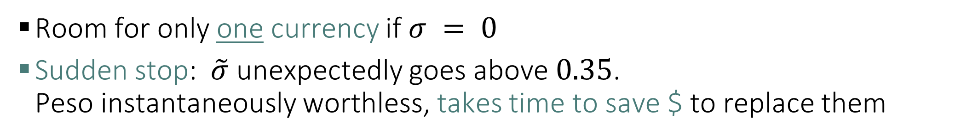



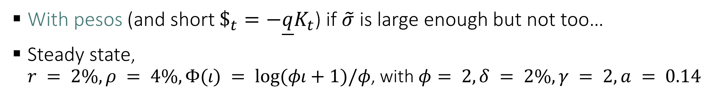

Idio risk only: When can $₱$ survive next to $
With pesos (and short $\$_{t}=−\underline{q}K_{t}$) if $\tilde{σ}$ is large enough but not too…
Steady state,
$r = 2\%, ρ = 4\%, Φ(ι) = log⁡(φι+1)/φ$, with $φ= 2, δ = 2\%, γ = 2, a = 0.14$
$₱$-holding
$-debt
$$Φ\left(ι\right)−δ$$
$$0$$
$$r^{\$}$$
$-bor-
rowing
Sudden stop
Sudden stop
Room for only one currency if $σ = 0$
Sudden stop: $\tilde{σ}$ unexpectedly goes above $0.35$.
Peso instantaneously worthless, takes time to save $ to replace them

Slide 27
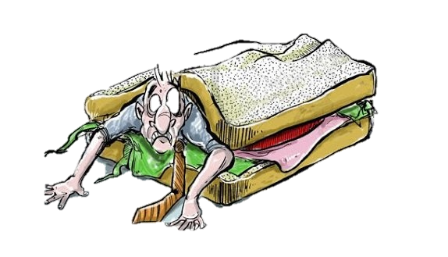

Idio risk only: When can $₱$ survive next to $
With pesos (and short $\$_{t}=−\underline{q}K_{t}$) if $\tilde{σ}$ is large enough but not too…
Steady state,
$r = 2\%, ρ = 4\%, Φ(ι) = log⁡(φι+1)/φ$, with $φ= 2, δ = 2\%, γ = 2, a = 0.14$
$$ρ=4\%, r^{\$}=2\%,$$
$$a=.14, γ=2$$
$$φ=2, δ=2\%$$
$$\underline{q}=.6, σ=0$$
$₱$-holding
$-debt
Peso is
viable
$$Φ\left(ι\right)−δ$$
$$0$$
$$r^{\$}$$
$-bor-
rowing
Sudden stop
Sudden stop
Room for only one currency if $σ = 0$
Sudden stop: $\tilde{σ}$ unexpectedly goes above $0.35$.
Peso instantaneously worthless, takes time to save $ to replace them

Slide 28
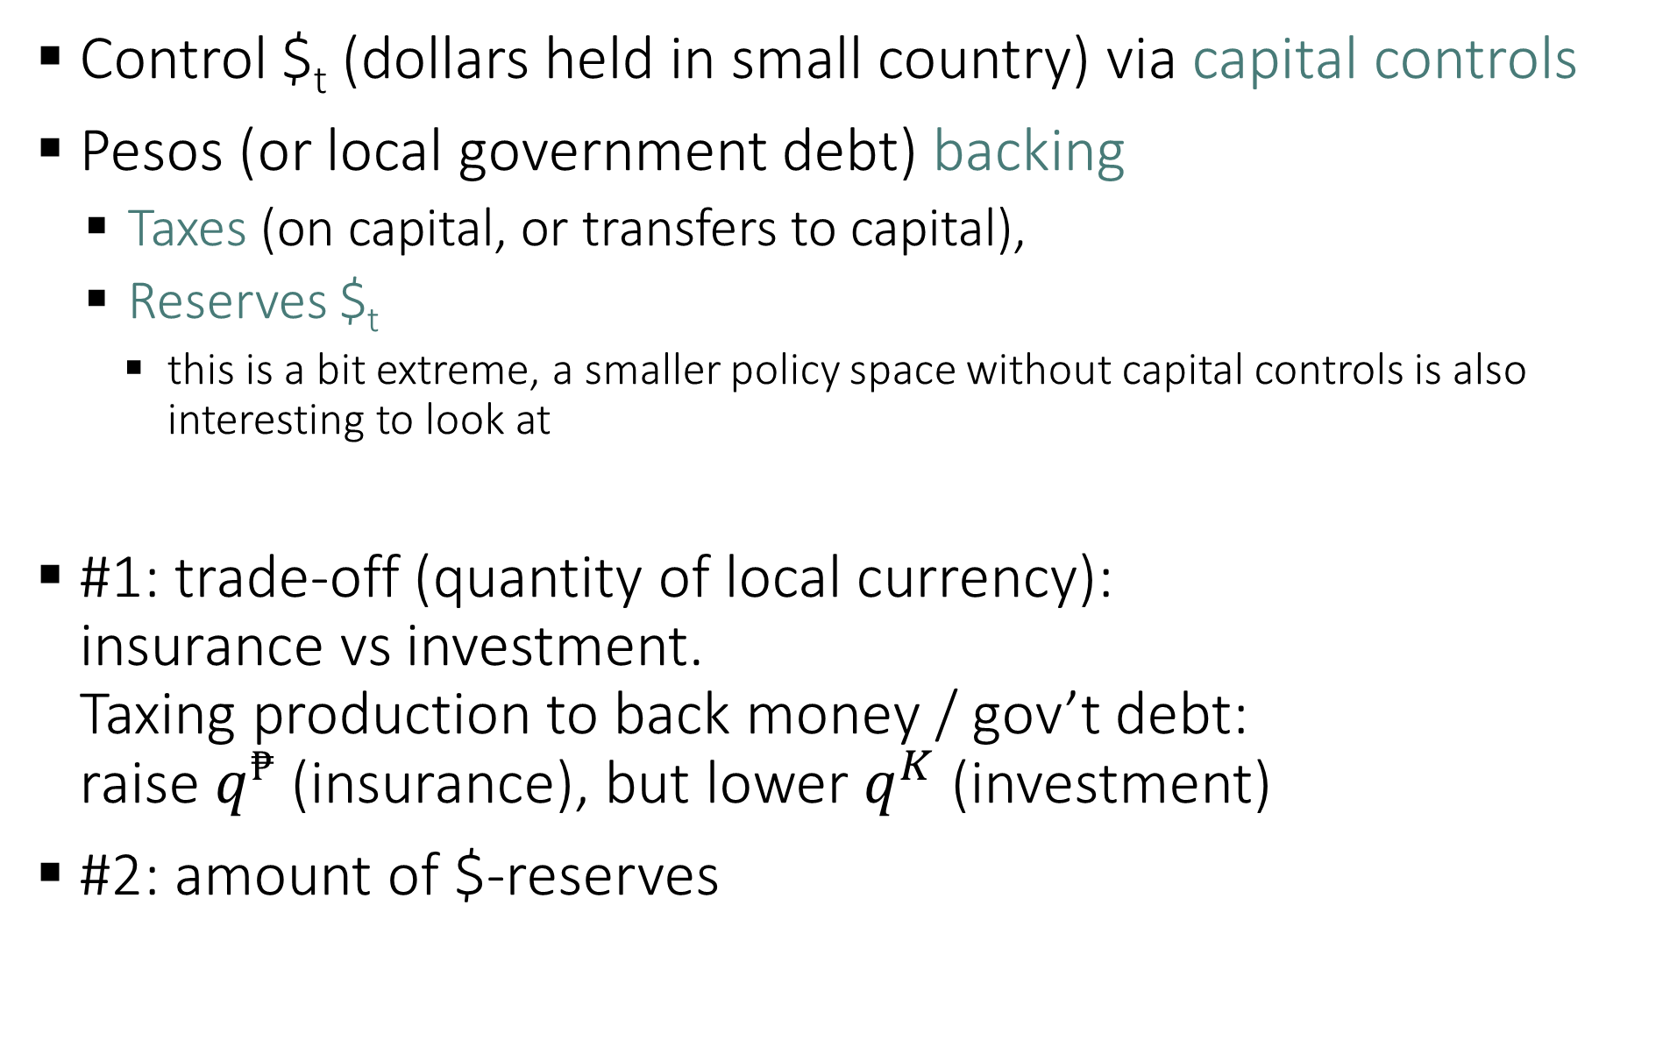
Policy space
Control $_{t} (dollars held in small country) via capital controls
Pesos (or local government debt) backing
  Taxes (on capital, or transfers to capital),
  Reserves $_{t}
    this is a bit extreme, a smaller policy space without capital controls is also interesting to look at
#1: trade-off (quantity of local currency):
insurance vs investment.
Taxing production to back money / gov’t debt:
raise $q^{₱}$ (insurance), but lower $q^{K}$ (investment)
#2: amount of $-reserves
Notes:
You can change the quantity of local currency immediately (but promising taxes) but cannot really affect the quantity of $ held in the country

Slide 29
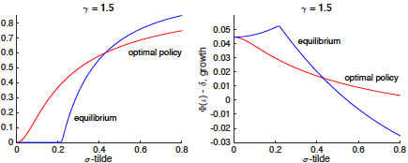
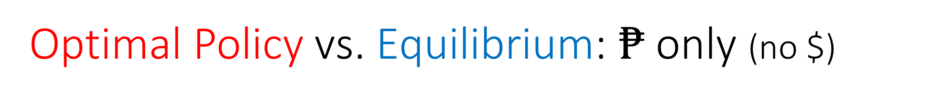
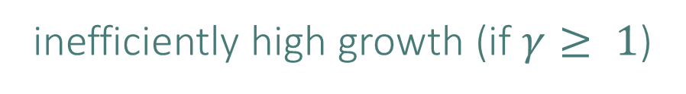
Optimal Policy vs. Equilibrium: $₱$ only (no $)
Brunnermeier and Sannikov (2016) “On the optimal inflation rate.”
money/safe asset bubble is too big
inefficiently high growth (if $γ≥ 1$)
portfolio weight on pesos
first best
improve insurance, small investment distortion
Notes:
What about with money and stocks

Slide 30
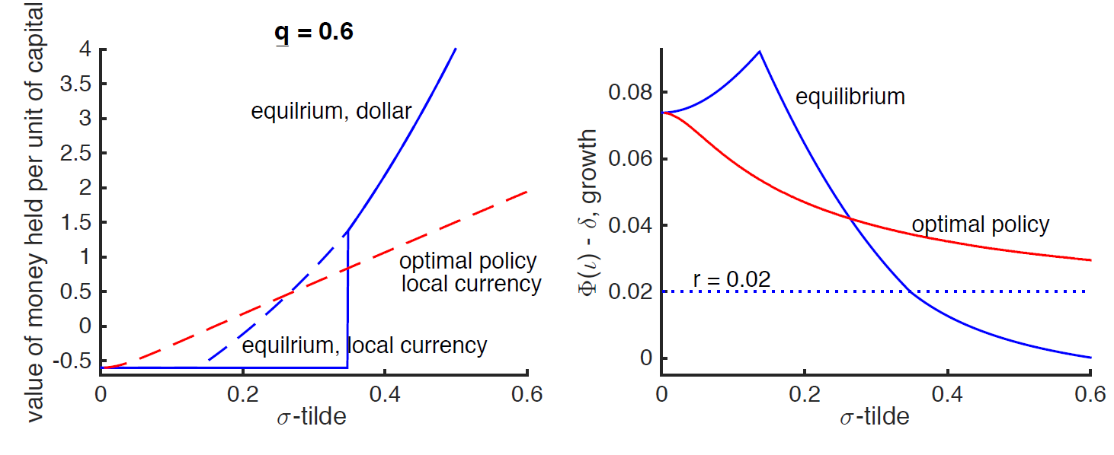
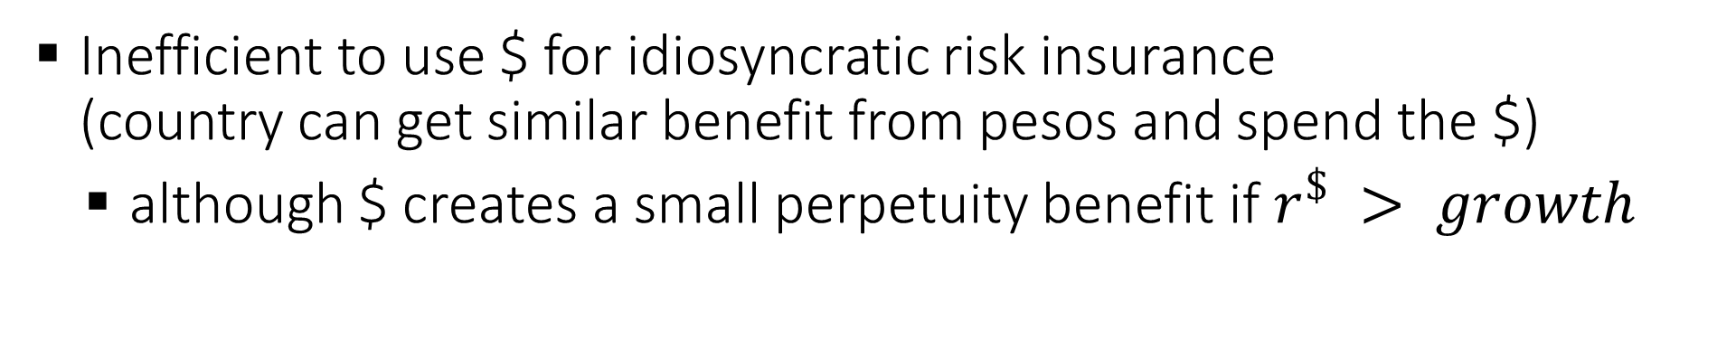
Optimal Policy vs. Equilibrium: $₱$ and $
Inefficient to use $ for idiosyncratic risk insurance
(country can get similar benefit from pesos and spend the $)
  although $ creates a small perpetuity benefit if $r^{\$} > growth$

Slide 31
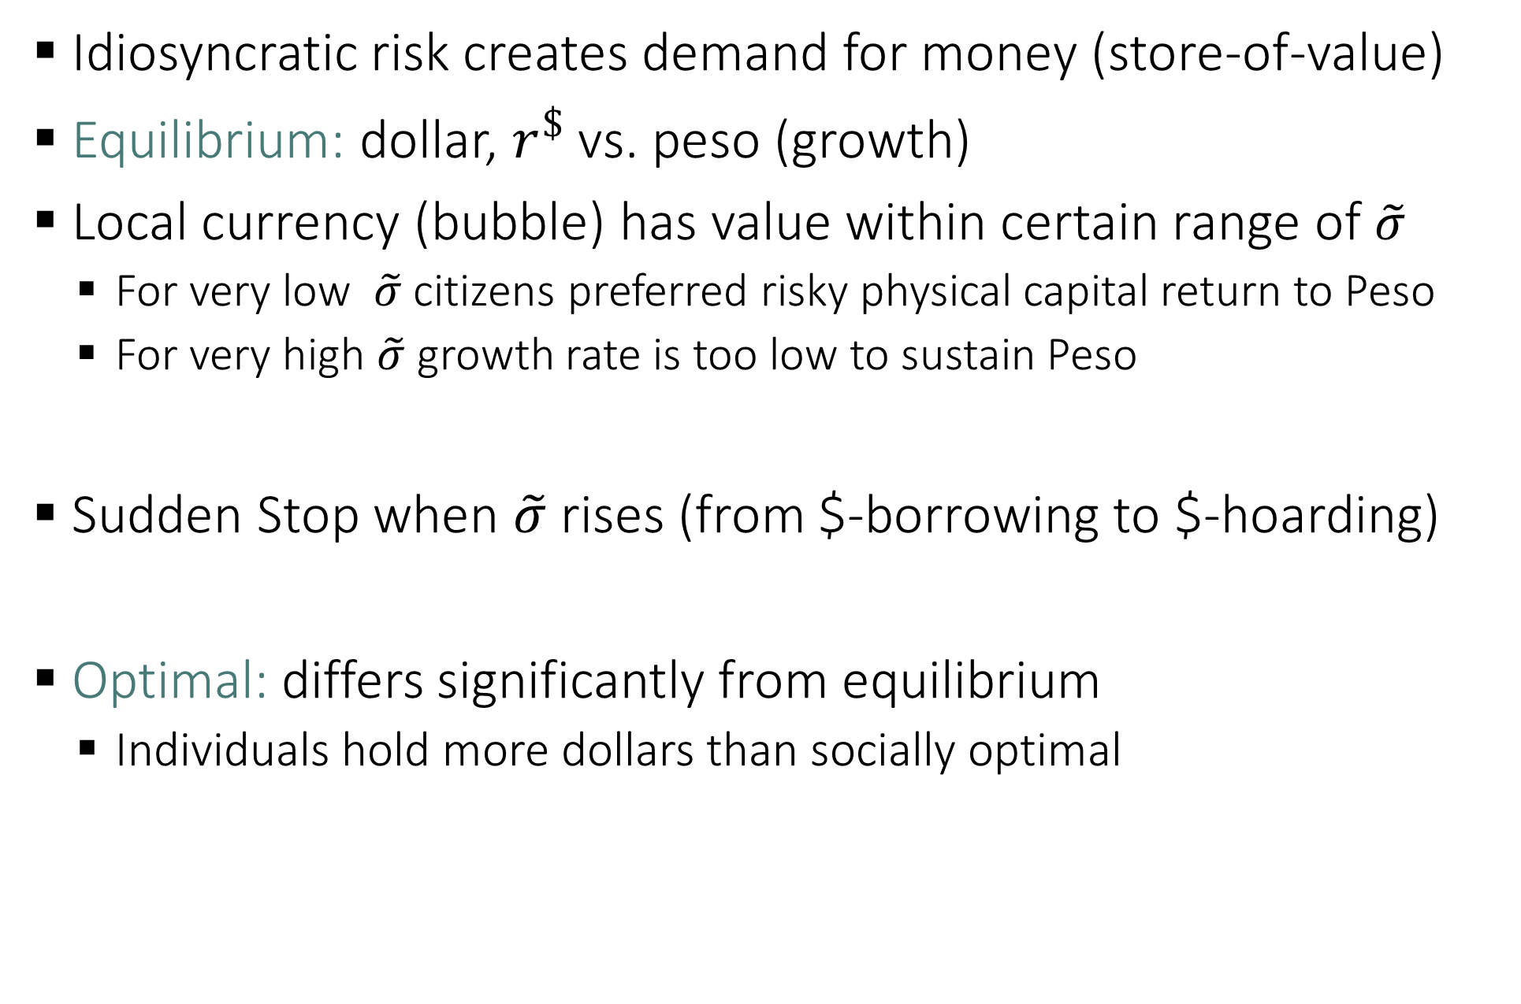
Recap
Idiosyncratic risk creates demand for money (store-of-value)
Equilibrium: dollar, $r^{\$}$ vs. peso (growth)
Local currency (bubble) has value within certain range of $\tilde{σ}$
  For very low $\tilde{σ}$ citizens preferred risky physical capital return to Peso
  For very high $\tilde{σ}$ growth rate is too low to sustain Peso
Sudden Stop when $\tilde{σ}$ rises (from $-borrowing to $-hoarding)
Optimal: differs significantly from equilibrium
  Individuals hold more dollars than socially optimal

Slide 32
Roadmap
Only idiosyncratic risk
  Only peso (autarky)
  dollar vs. peso (room for only 1 currency)
  Policy space (one definition): optimal policy ≠ equilibrium
Only country-wide shocks
  equilibrium = optimal policy
General solution methodology
General results

Slide 33
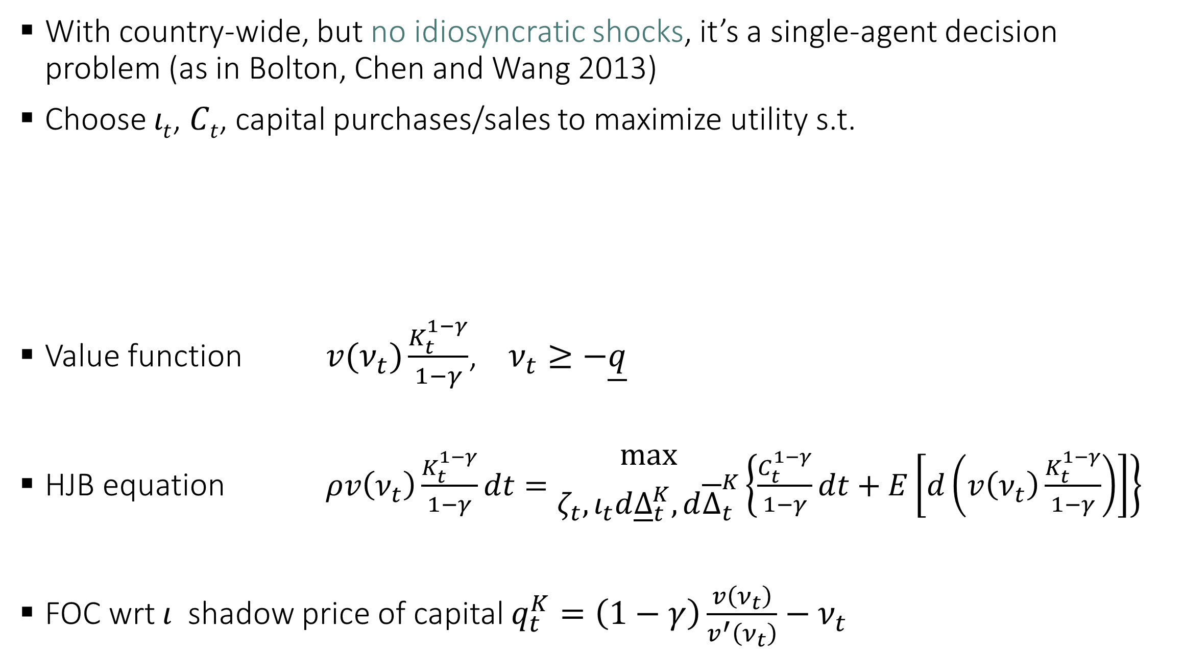
Country-wide shocks and optimal $-savings
With country-wide, but no idiosyncratic shocks, it’s a single-agent decision problem (as in Bolton, Chen and Wang 2013)
Choose $ιt$, $Ct$, capital purchases/sales to maximize utility s.t.
Value function $v(ν_{t})\frac{K_{t}^{1−γ}}{1−γ}$, $ν_{t}≥−\underline{q}$
HJB equation $ρv\left(ν_{t}\right)\frac{K_{t}^{1−γ}}{1−γ}dt=\begin{aligned}max \\ ζ_{t}, ι_{t}d{\underline{Δ}}_{t}^{K},d{\overline{Δ}}_{t}^{K}\end{aligned}\left\{\frac{C_{t}^{1−γ}}{1−γ}dt+E\left[d\left(v\left(ν_{t}\right)\frac{K_{t}^{1−γ}}{1−γ}\right)\right]\right\}$
FOC wrt $ι$ shadow price of capital $q_{t}^{K}=\left(1−γ\right)\frac{v\left(ν_{t}\right)}{v^{′}\left(ν_{t}\right)}−ν_{t}$

Slide 34
Country-wide shocks and optimal $-savings
Proposition (useful benchmark):
without idiosyncratic shocks, the equilibrium is optimal
Differences between the equilibrium and optimal policy are due to the idiosyncratic risk friction

Slide 35
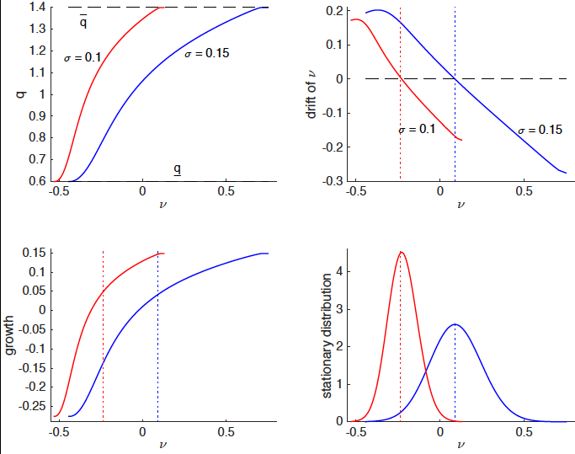
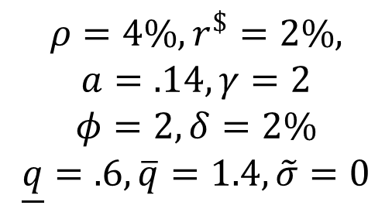
Country-wide shocks and optimal $-savings
$$ρ=4\%, r^{\$}=2\%,$$
$$a=.14, γ=2$$
$$φ=2, δ=2\%$$
$$\underline{q}=.6, \overline{q}=1.4, \tilde{σ}=0$$
Notes:
This can be proved analytically

Slide 36
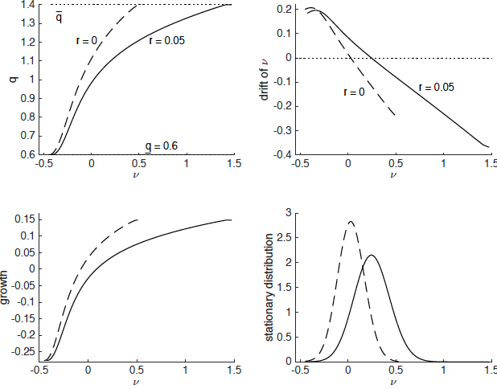
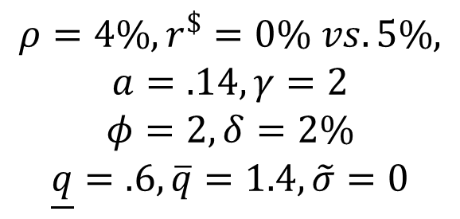
Country-wide shocks and optimal $ savings: US MoPo $r^{\$}$
$$ρ=4\%, r^{\$}=0\% vs. 5\%,$$
$$a=.14, γ=2$$
$$φ=2, δ=2\%$$
$$\underline{q}=.6, \overline{q}=1.4, \tilde{σ}=0$$
Notes:
Next, solving the full model. You’ll see a lot of algebra, details don’t really matter.
It’s a system that can be put in a computer.

Slide 37
Roadmap
Only idiosyncratic risk
  Only peso (autarky)
  dollar vs. peso (room for only 1 currency)
  Policy space (one definition): optimal policy ≠ equilibrium
Only country-wide shocks
  equilibrium = optimal policy
General solution methodology
General results

Slide 38
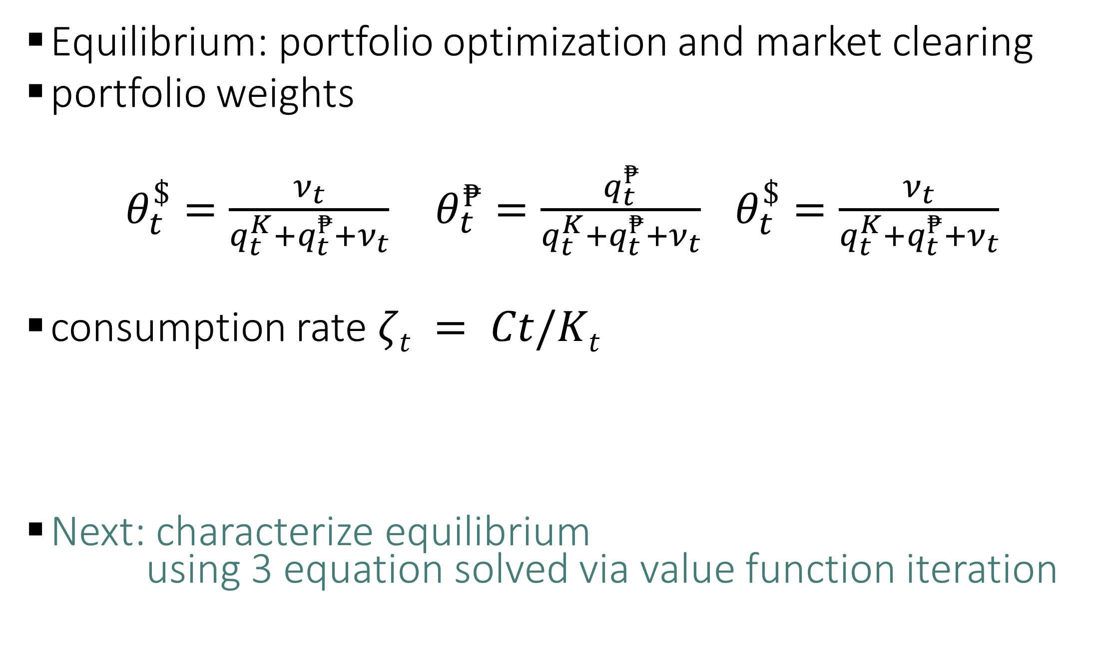
Solving the full model
Equilibrium: portfolio optimization and market clearing
portfolio weights
$θ_{t}^{\$}=\frac{ν_{t}}{q_{t}^{K}+q_{t}^{₱}+ν_{t}}$ $θ_{t}^{₱}=\frac{q_{t}^{₱}}{q_{t}^{K}+q_{t}^{₱}+ν_{t}}$ $θ_{t}^{\$}=\frac{ν_{t}}{q_{t}^{K}+q_{t}^{₱}+ν_{t}}$
consumption rate $ζt = Ct/Kt$
Next: characterize equilibrium
using 3 equation solved via value function iteration

Slide 39
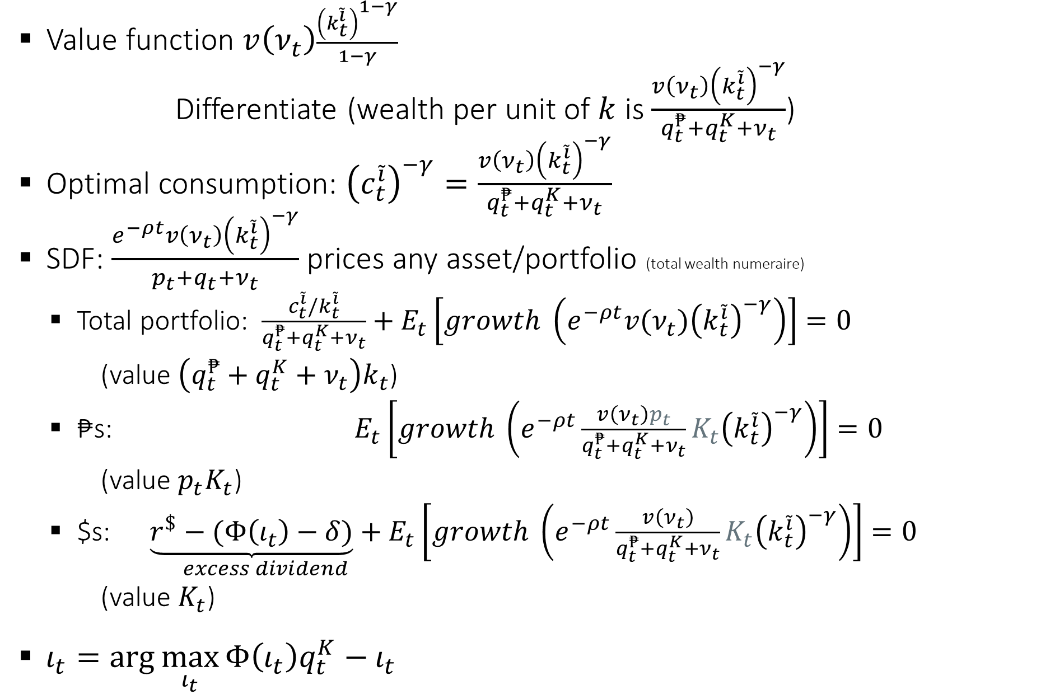
Equilibrium conditions
Value function $v\left(ν_{t}\right)\frac{{\left(k_{t}^{\tilde{i}}\right)}^{1−γ}}{1−γ}$
Differentiate (wealth per unit of $k$ is $\frac{v\left(ν_{t}\right){\left(k_{t}^{\tilde{i}}\right)}^{−γ}}{q_{t}^{₱}+q_{t}^{K}+ν_{t}}$)
Optimal consumption: ${\left(c_{t}^{\tilde{i}}\right)}^{−γ}=\frac{v\left(ν_{t}\right){\left(k_{t}^{\tilde{i}}\right)}^{−γ}}{q_{t}^{₱}+q_{t}^{K}+ν_{t}}$
SDF: $\frac{e^{−ρt}v\left(ν_{t}\right){\left(k_{t}^{\tilde{i}}\right)}^{−γ}}{p_{t}+q_{t}+ν_{t}}$ prices any asset/portfolio (total wealth numeraire)
  Total portfolio: $\frac{c_{t}^{\tilde{i}}/k_{t}^{\tilde{i}}}{q_{t}^{₱}+q_{t}^{K}+ν_{t}}+E_{t}\left[growth \left(e^{−ρt}v(ν_{t}){\left(k_{t}^{\tilde{i}}\right)}^{−γ}\right)\right]=0$
  (value $\left(q_{t}^{₱}+q_{t}^{K}+ν_{t}\right)k_{t}$)
  ₱s: $E_{t}\left[growth \left(e^{−ρt}\frac{v\left(ν_{t}\right)p_{t}}{q_{t}^{₱}+q_{t}^{K}+ν_{t}}{K_{t}\left(k_{t}^{\tilde{i}}\right)}^{−γ}\right)\right]=0$
  (value $p_{t}K_{t}$)
  $s: $\underset{excess dividend}{\underbrace{r^{\$}−(Φ\left(ι_{t}\right)−δ)}+}E_{t}\left[growth \left(e^{−ρt}\frac{v\left(ν_{t}\right)}{q_{t}^{₱}+q_{t}^{K}+ν_{t}}{K_{t}\left(k_{t}^{\tilde{i}}\right)}^{−γ}\right)\right]=0$
  (value $K_{t}$)
$ι_{t}=\arg{\max_{ι_{t}}{Φ\left(ι_{t}\right)q_{t}^{K}−ι_{t}}}$

Slide 40

Equilibrium conditions
Value function $v\left(ν_{t}\right)\frac{{\left(k_{t}^{\tilde{i}}\right)}^{1−γ}}{1−γ}$
Differentiate (wealth per unit of $k$ is $\frac{v\left(ν_{t}\right){\left(k_{t}^{\tilde{i}}\right)}^{−γ}}{q_{t}^{₱}+q_{t}^{K}+ν_{t}}$)
Optimal consumption: ${\left(c_{t}^{\tilde{i}}\right)}^{−γ}=\frac{v\left(ν_{t}\right){\left(k_{t}^{\tilde{i}}\right)}^{−γ}}{q_{t}^{₱}+q_{t}^{K}+ν_{t}}$
SDF: $\frac{e^{−ρt}v\left(ν_{t}\right){\left(k_{t}^{\tilde{i}}\right)}^{−γ}}{q_{t}^{₱}+q_{t}^{K}+ν_{t}}$ prices any asset/portfolio (total wealth numeraire)
  Total portfolio: $\frac{c_{t}^{\tilde{i}}/k_{t}^{\tilde{i}}}{q_{t}^{₱}+q_{t}^{K}+ν_{t}}+E_{t}\left[growth \left(e^{−ρt}v(ν_{t}){\left(k_{t}^{\tilde{i}}\right)}^{−γ}\right)\right]=0$
  (value $\left(q_{t}^{₱}+q_{t}^{K}+ν_{t}\right)k_{t}$)
  ₱s: $E_{t}\left[growth \left(e^{−ρt}\frac{v\left(ν_{t}\right)p_{t}}{q_{t}^{₱}+q_{t}^{K}+ν_{t}}{K_{t}\left(k_{t}^{\tilde{i}}\right)}^{−γ}\right)\right]=0$
  (value $p_{t}K_{t}$)
  $s: $\underset{excess dividend}{\underbrace{r^{\$}−(Φ\left(ι_{t}\right)−δ)}+}E_{t}\left[growth \left(e^{−ρt}\frac{v\left(ν_{t}\right)}{q_{t}^{₱}+q_{t}^{K}+ν_{t}}{K_{t}\left(k_{t}^{\tilde{i}}\right)}^{−γ}\right)\right]=0$
  (value $K_{t}$)
$ι_{t}=\arg{\max_{ι_{t}}{Φ\left(ι_{t}\right)q_{t}^{K}−ι_{t}}}$
Same form as HJB, solved by value fcn. iteration, as a system

Slide 41
Equilibrium equations: summary

Slide 42



Computation
terminal
conditions
(guess)
convergence
(prices in very
distant future
matter little for
prices today)
$$t−ε$$
$$t$$
$$T$$
time

Slide 43
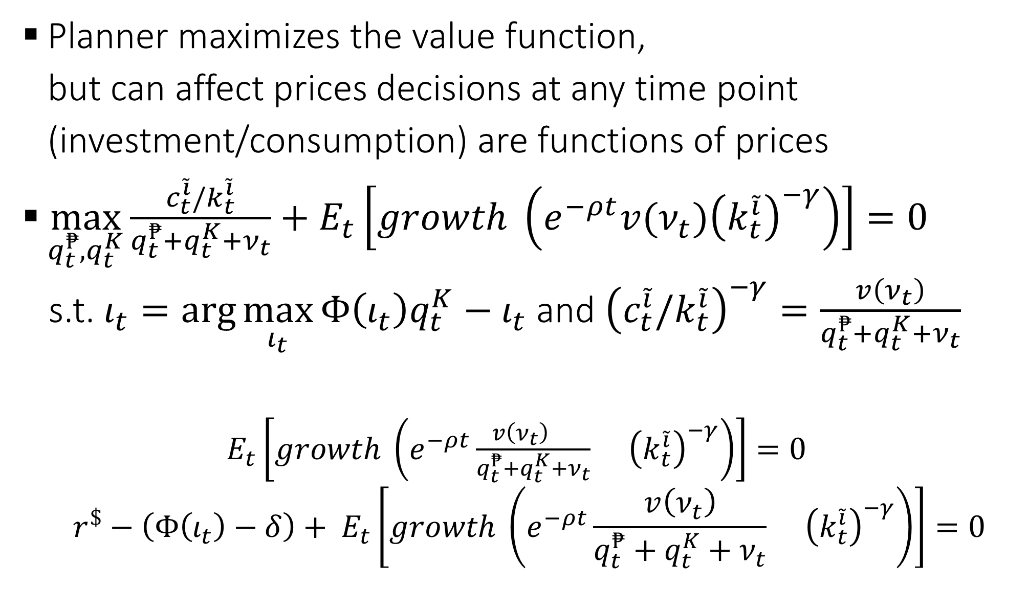
Optimal Policy
Planner maximizes the value function,
but can affect prices decisions at any time point (investment/consumption) are functions of prices
$\max_{q_{t}^{₱},q_{t}^{K}}{\frac{c_{t}^{\tilde{i}}/k_{t}^{\tilde{i}}}{q_{t}^{₱}+q_{t}^{K}+ν_{t}}+E_{t}\left[growth \left(e^{−ρt}v(ν_{t}){\left(k_{t}^{\tilde{i}}\right)}^{−γ}\right)\right]=0}$
s.t. $ι_{t}=\arg{\max_{ι_{t}}{Φ\left(ι_{t}\right)q_{t}^{K}−ι_{t}}}$ and ${\left(c_{t}^{\tilde{i}}/k_{t}^{\tilde{i}}\right)}^{−γ}=\frac{v\left(ν_{t}\right)}{q_{t}^{₱}+q_{t}^{K}+ν_{t}}$
  $E_{t}\left[growth \left(e^{−ρt}\frac{v\left(ν_{t}\right)q_{t}^{₱}}{q_{t}^{₱}+q_{t}^{K}+ν_{t}}{K_{t}\left(k_{t}^{\tilde{i}}\right)}^{−γ}\right)\right]=0$
  $$r^{\$}−\left(Φ\left(ι_{t}\right)−δ\right)+ E_{t}\left[growth \left(e^{−ρt}\frac{v\left(ν_{t}\right)}{q_{t}^{₱}+q_{t}^{K}+ν_{t}}{K_{t}\left(k_{t}^{\tilde{i}}\right)}^{−γ}\right)\right]=0$$

Slide 44

Policy problem
Policy maker maximizes the value function,
but can affect prices decisions at any time point (investment/consumption) are functions of prices
$$max⁡p,q$$
s.t.

Slide 45
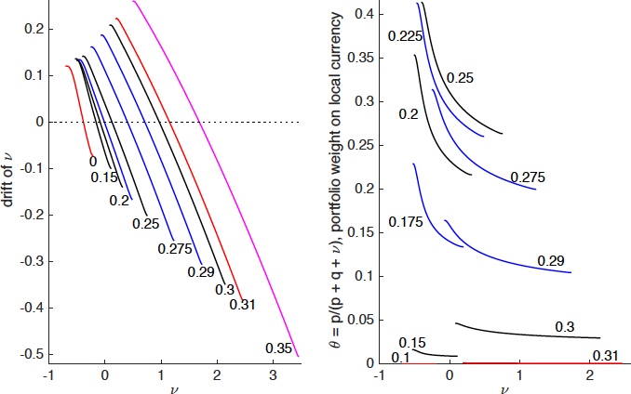
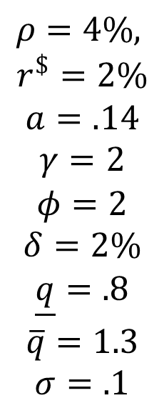
Dollar savings, Peso value as functions of $\tilde{σ}$
$$ρ=4\%,$$
$$r^{\$}=2\%$$
$$a=.14$$
$$γ=2$$
$$φ=2$$
$$δ=2\%$$
$$\underline{q}=.8$$
$$\overline{q}=1.3$$
$$σ=.1$$
Notes:
Two currencies are imperfect substitutes, portfolio weight on local currency declines as v goes up
Value of local currency is non-monotonic in \tilde\sigma
It rises slowly (local currency insures idiosyncratic risk), but falls quite fast (when dollar starts dominating)

Slide 46
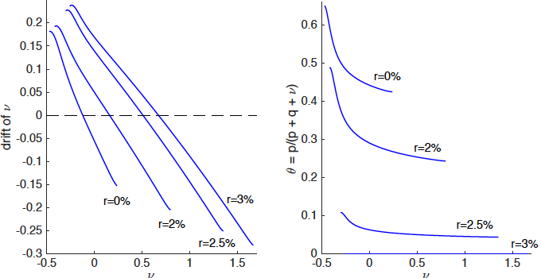
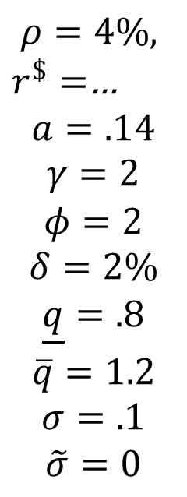
$-MoPo spillovers
$$ρ=4\%,$$
$r^{\$}=$…
$$a=.14$$
$$γ=2$$
$$φ=2$$
$$δ=2\%$$
$$\underline{q}=.8$$
$$\overline{q}=1.2$$
$$σ=.1$$
$$\tilde{σ}=0$$
Notes:
Again, there’s an interval of high sensitivity
This is the taper tantrum

Slide 47
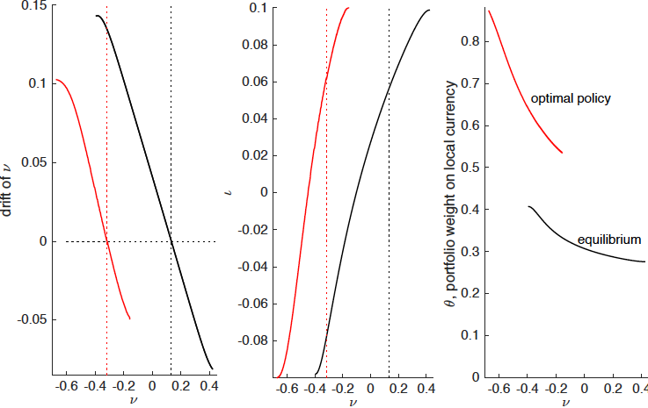

Optimal Policy vs. Equilibrium
Recall (from models
with only one type of a shock)
  optimal vs. equilibrium
  peso supply depends on $\tilde{σ}$
  individuals hold more dollars
  than socially optimal
  for $\tilde{σ}=0$, equilibrium socially optimal

Slide 48



Optimal Policy vs. Equilibrium: $-holdings mostly determined by $\tilde{σ}$
low sensitivity
to $\tilde{σ}$.
$$ρ=4\%,$$
$$r^{\$}=2\%$$
$$a=.14$$
$$γ=2$$
$$φ=2$$
$$δ=2\%$$
$$\underline{q}=.8$$
$$\overline{q}=1.2$$
$$σ=.1$$
Notes:
Dollars held in equilibrium depend on \tilde\sigma
Not a serious calibration, but welfare effect is hugely significant

Slide 49
Some other issues
Without capital controls: we haven’t solved for the optimal policy, but fiscal backing of local currency can discourage locals hoarding too many $, improve welfare partway
The assumption that idiosyncratic risk is uninsurable is easier to digest than one for country-wide risk… if that risk can be hedged (at a price), then individuals still need to hold dollars to absorb the risk they choose to retain – equilibrium should be similar (a conjecture)… but policy can also distort the amount of aggregate risk country chooses to hedge (interesting)
Policy, to be effective, has to be accompanied with restrictions (individuals can trade to undo the policy – irrelevance result)

Slide 50
Conclusions
Endogenous value of money
  local currency: insurance against idiosyncratic risk
  global currency: insurance for country-wide and idiosyncratic risk
  exchange rate is endogenous
Optimal policy
  without idiosyncratic risk, equilibrium is optimal
  optimal dollar savings increasing in σ, idiosyncratic risk matters little
Equilibrium effects
  equilibrium dollar savings are rising in idiosyncratic risk
  (render local currency worthless at some point)
  currencies are imperfect substitutes (for hedging idiosyncratic risk)
  value of local currency ∩ - shaped in idiosyncratic risk
  sudden strop: extreme from $-borrowing to the limit to $-hoarding
  Spillovers from large country’s monetary policy to small economy and the value of its currency

Slide 51
Thank you!

Slide 52

Conclusion
Endogenous value of money in 2 countries
  Local currency: better hedge for idiosyncratic risk (non-tradeable consumption)
  Global currency: hedge against ToT + export productivity shocks
  Exchange rate endogenous
Spillover effects from foreign monetary policy
Nuanced Mundell-Fleming Trilemma
  Local and global money have different risk profile (imperfect substitutes)
  $⇒$ increases MoPo space
  Too high inflation:
  local citizens substitute local currency for global currency
  $⇒$ limits MoPo space
Central Bank’s foreign reserves holding: Irrelevance Result
Optimal Monetary Policy
  Idiosyncratic risk – correct pecuniary externality (real interest rate)
  International savings

Slide 53
Foreign Currency Reserves
Irrelevance Theorem: If central bank holds global money (reserves) citizens in small country will hold accordingly less
Remarks:
  If central banks holds more $-reserves than citizens would like to hold, then agents borrow foreign currency from abroad
  If local money is worthless (without foreign reserves), then the value of local money derives only from the reserves
  If government borrows $, small country citizens will hold accordingly more $
  With fiscal backing of the local money, there are more nuances

Slide 54
Some intuition: only idiosyncratic risk…
Scale invariance ⇒ state variable ν_{t} = $_{t}/K_{t}. Portfolio weights
Overall portfolio has risk
Price of risk
.

Slide 55
Some intuition
Scale invariance ⇒ state variable ν_{t} = $_{t}/K_{t}. Portfolio weights
Overall portfolio has risk
Price of risk
.

Slide 56
Only idiosyncratic risk…
Scale invariance ⇒ state variable ν_{t} = $_{t}/K_{t}. Portfolio weights
Overall portfolio has risk
Price of risk
.

Slide 57
Motivation/Results
Two currencies, exogenous exchange rate
  Local currency: insure idiosyncratic risk (as in Bewley)
  Global $-currency: save against country-wide risk
Value of local currency ∩-shaped in idiosyncratic risk
  No idiosyncratic risk no role for local currency
  No country-wide risk no role for coexistence of 2 currencies
Dollar monetary policy has significant spillovers on SOE
UIP violation (due to risk premia)
Sudden Stop
  Increase in idiosyncratic risk or rise in $ interest rate

