Slide 1
Modern Macro, Money, and International Finance Eco 529 Lecture 12: Welfare – Optimal Policy
Markus K. Brunnermeier
Princeton University

Slide 2
The Big Roadmap: Towards the I Theory of Money
One sector model with idio risk - “The I Theory without I” (steady state focus)
Store of value
Insurance role of money within sector
Money as bubble or not
Fiscal Theory of the Price Level
Medium of Exchange Role $⇒$ SDF-Liquidity multiplier $⇒$ Money bubble
2 sector/type model with money and idio risk
Generic Solution procedure (compared to lecture 03)
Equivalence btw experts producers and intermediaries
Real debt vs. nominal debt/money
Implicit insurance role of money across sectors
I Theory
Welfare analysis
Optimal Monetary Policy and Macroprudential Policy
International Monetary Model
Previous lectures
Today
Next lectures

Slide 3
Optimal Policy
Finding the optimal policy is generally complicated, need
precise definition of policy space
analytical tools to characterize the optimum
One side: inefficiencies / tradeoffs
insurance vs. investment (one sector/type)
allocation of assets / risk (across sectors/types)
Other side: “large” policy space
controlling money growth rate
macroprudential tools / wealth redistribution
risk redistribution
Approach
Start with simple model
Add step-by-step more model elements

Slide 4
Roadmap
Expected Utility/Value function with log-utility
One sector model with stochastic idiosyncratic volatility
Two sector model
With exogenous net worth share $η$
With endogenous wealth share $η$
I theory (with two technologies)

Slide 5
Welfare with log utility
The welfare for any agent $\tilde{i}$ of type $i$
$$E\left[\int_{0}^{∞}{e^{−ρt}\log{{(c}_{t}^{\tilde{i}})}dt}\right]$$
$${\tilde{η}}_{0}^{\tilde{i}}=1,\frac{d{\tilde{η}}_{t}^{\tilde{i}}}{{\tilde{η}}_{t}^{\tilde{i}}}={\tilde{σ}}_{t}^{{\tilde{η}}^{i}}d{\tilde{Z}}_{t}^{\tilde{i}}$$
Recall from general model with log utility
$\frac{c_{t}^{\tilde{i}}}{n_{t}^{\tilde{i}}}=ρ$
$c_{t}^{\tilde{i}}=ρη_{t}^{i}\left(A\left(κ_{t}\right)−ι_{t}\right)K_{t} {\tilde{η}}_{t}^{\tilde{i}}$ using goods market clearing

Slide 6
Welfare with log utility
The welfare of any agent $\tilde{i}$ is
$$E\left[\int_{0}^{∞}{e^{−ρt}\log{{(c}_{t}^{\tilde{i}})}dt}\right]=E\left[\int_{0}^{∞}{e^{−ρt}\log{(η_{t}^{i}\left(A\left(κ_{t}\right)−ι_{t}\right)K_{t} {\tilde{η}}_{t}^{\tilde{i}}) }dt}\right]$$
$$=E\left[\int_{0}^{∞}{e^{−ρt}\log{η_{t}^{i}}dt}\right]+E\left[\int_{0}^{∞}{e^{−ρt}\log{(A\left(κ_{t}\right)−ι_{t}) }dt}\right]$$
$$+E\left[\int_{0}^{∞}{e^{−ρt}\log{K_{t}}dt}\right]+E\left[\int_{0}^{∞}{e^{−ρt}\log{{\tilde{η}}_{t}^{\tilde{i}}}dt}\right]$$
ignoring constant $\frac{\log{ρ}}{ρ}$

Slide 7
Welfare with log utility
Recall
$$\log{X_{t}}−\log{X_{0}}=\int_{0}^{t}{d\log{X_{s}}}$$
Apply to Ito’s lemma
$$d\log{X_{t}}=\left(μ_{t}^{X}−\frac{1}{2}{\left(σ_{t}^{X}\right)}^{2}−\frac{1}{2}{\left({\tilde{σ}}_{t}^{X}\right)}^{2}\right)dt+σ_{t}^{X}dZ_{t}+{\tilde{σ}}_{t}^{X}d{\tilde{Z}}_{t}$$
Plug into Expected integral
$$E\left[\int_{0}^{∞}{e^{−ρt}\log{(X_{t}) }dt}\right]=\frac{1}{ρ}\log\left(X_{0}\right)+\frac{1}{ρ}E\left[\int_{0}^{∞}{e^{−ρt}\left(μ_{t}^{X}−\frac{1}{2}{\left(σ_{t}^{X}\right)}^{2}−\frac{1}{2}{\left({\tilde{σ}}_{t}^{X}\right)}^{2}\right)dt}\right]$$

Slide 8
Welfare with log utility
The welfare of any agent $\tilde{i}$ is
$$E\left[\int_{0}^{∞}{e^{−ρt}\log{{(c}_{t}^{\tilde{i}})}dt}\right]=E\left[\int_{0}^{∞}{e^{−ρt}\log{(η_{t}^{i}\left(A\left(κ_{t}\right)−ι_{t}\right)K_{t} {\tilde{η}}_{t}^{\tilde{i}}) }dt}\right]$$
$$=E\left[\int_{0}^{∞}{e^{−ρt}\log{η_{t}^{i}}dt}\right]+E\left[\int_{0}^{∞}{e^{−ρt}\log{(A\left(κ_{t}\right)−ι_{t}) }dt}\right]$$
$$+E\left[\int_{0}^{∞}{e^{−ρt}\log{K_{t}}dt}\right]+E\left[\int_{0}^{∞}{e^{−ρt}\log{{\tilde{η}}_{t}^{\tilde{i}}}dt}\right]$$
ignoring constant $\frac{\log{ρ}}{ρ}$
$$\frac{\log{η_{0}^{i}}}{ρ}+E\left[\int_{0}^{∞}{e^{−ρt}\left(\frac{μ_{t}^{η^{i}}}{ρ}−\frac{{\left(σ_{t}^{η^{i}}\right)}^{2}}{2ρ}\right)dt}\right]$$
$$\frac{\log{K_{0}}}{ρ}+E\left[\int_{0}^{∞}{e^{−ρt}\left(\frac{Φ\left(ι_{t}\right)−δ}{ρ}−\frac{{\left(σ_{t}^{K}\right)}^{2}}{2ρ}\right)dt}\right]$$
$$−E\left[\int_{0}^{∞}{e^{−ρt}\left(\frac{{\left({\tilde{σ}}_{t}^{{\tilde{η}}^{i}}\right)}^{2}}{2ρ}\right)dt}\right]$$

Slide 9
Aside: Expected Integral
Let $X_{t}$ follows
$$\frac{{dX}_{t}}{X_{t}}=μ_{t}^{X}dt+σ_{t}^{X}dZ_{t}+{\tilde{σ}}_{t}^{X}d{\tilde{Z}}_{t}$$
Integral by parts
$$E\left[\int_{0}^{∞}{e^{−ρt}\log{X_{t}}dt}\right]=E\left[−\frac{1}{ρ}\int_{0}^{∞}{\log{X_{t}}de^{−ρt}}\right]=E\left[−\frac{1}{ρ}\left(−\log{X_{0}}−\int_{0}^{∞}{e^{−ρt}d\log{X_{t}}}\right)\right]$$
Apply to Ito’s lemma
$$d\log{X_{t}}=\left(μ_{t}^{X}−\frac{1}{2}{\left(σ_{t}^{X}\right)}^{2}−\frac{1}{2}{\left({\tilde{σ}}_{t}^{X}\right)}^{2}\right)dt+σ_{t}^{X}dZ_{t}+{\tilde{σ}}_{t}^{X}d{\tilde{Z}}_{t}$$
Plug into Expected integral
$$E\left[\int_{0}^{∞}{e^{−ρt}\log{(X_{t}) }dt}\right]=\frac{1}{ρ}\log\left(X_{0}\right)+\frac{1}{ρ}E\left[\int_{0}^{∞}{e^{−ρt}\left(μ_{t}^{X}−\frac{1}{2}{\left(σ_{t}^{X}\right)}^{2}−\frac{1}{2}{\left({\tilde{σ}}_{t}^{X}\right)}^{2}\right)dt}\right]$$

Slide 10
Welfare of Intermediaries $I$ and HH $h$
Intermediaries (Pareto weight $λ$)
$$E\left[\int_{0}^{∞}{e^{−ρt}\left(\log{η_{t}}+\log\left(A(κ) −ι_{t}\right)+\frac{Φ\left(ι_{t}\right)−δ}{ρ}−\frac{σ^{2}}{2ρ}−\frac{{\left(1−θ_{t}\right)}^{2}}{2ρ}\frac{κ^{2}φ^{2}{\tilde{σ}}^{2}}{η^{2}}\right)dt}\right]$$
Households (Pareto weight $1−λ$)
$$E\left[\int_{0}^{∞}{e^{−ρt}\left(\log\left(1−η_{t}\right)+\log\left(A(κ)−ι_{t}\right)+\frac{Φ\left(ι_{t}\right)−δ}{ρ}−\frac{σ^{2}}{2ρ}−\frac{{\left(1−θ_{t}\right)}^{2}}{2ρ}\frac{{\left(1−κ\right)}^{2}{\tilde{σ}}^{2}}{{\left(1−η\right)}^{2}}\right)dt}\right]$$

Slide 11
Roadmap
Expected Utility/Value function with log-utility
One sector model with stochastic idiosyncratic volatility
Two sector model
with exogenous net worth share $η$
With endogenous wealth share $η$
I theory (with two technologies)

Slide 12
One Sector Model with Money
Agent $\tilde{i}$’s preferences
$E\left[\int_{0}^{∞}{e^{−ρt}\log{c_{t}^{\tilde{i}}}dt}\right]$
Each agent operates one firm
Output
$$y_{t}^{\tilde{i}}=ak_{t}^{\tilde{i}}$$
Physical capital $k$
$$\frac{dk_{t}^{\tilde{i}}}{k_{t}^{\tilde{i}}}=\left(Φ\left(ι_{t}^{\tilde{i}}\right)−δ\right)dt+{\tilde{σ}}_{t}d{\tilde{Z}}_{t}^{\tilde{i}}$$
Idiosyncratic risk $\tilde{σ}$is stochastic (hence a state variable)
$$d{\tilde{σ}}_{t}=μ\left({\tilde{σ}}_{t}\right)dt+ν\left({\tilde{σ}}_{t}\right)dZ_{t}^{v}$$
e.g. CIR process
$$d{\tilde{σ}}_{t}=α\left(σ^{SS}−{\tilde{σ}}_{t}\right)dt+ν\sqrt{{\tilde{σ}}_{t}}dZ_{t}^{ν}$$
Financial Friction: Incomplete markets: Agents cannot share $d{\tilde{Z}}_{t}^{\tilde{i}}$
$$n^{\tilde{i}}$$
Net worth
$$k_{t}^{\tilde{i}}$$
$$σ=0$$

Slide 13
One Sector Model with Money
Agent $\tilde{i}$’s preferences
$E\left[\int_{0}^{∞}{e^{−ρt}\log{c_{t}^{\tilde{i}}}dt}\right]$
Each agent operates one firm
Output
$$y_{t}^{\tilde{i}}=ak_{t}^{\tilde{i}}$$
Physical capital $k$
$$\frac{dk_{t}^{\tilde{i}}}{k_{t}^{\tilde{i}}}=(Φ\left(ι_{t}^{\tilde{i}}\right)−δ)dt+{\tilde{σ}}_{t}d{\tilde{Z}}_{t}^{\tilde{i}}$$
Financial Friction: Incomplete markets: Agents cannot share $d{\tilde{Z}}_{t}^{\tilde{i}}$
Outside money/Gov. bond
$$\frac{dM_{t}}{M_{t}}=μ_{t}^{M}dt+ν_{t}^{M}dZ_{t}^{ν}.$$
State variable is $\tilde{σ}$: -- Monetary policy $μ^{M}\left({\tilde{σ}}_{t}\right),ν^{M}\left({\tilde{σ}}_{t}\right)$
A
L
A
L
A
L
A
L
Money
$$n^{\tilde{i}}$$
Net worth
$$k_{t}^{\tilde{i}}$$
$$σ=0$$

Slide 14
One Sector Model with Money
Dynamics of ${\tilde{η}}_{t}$:
$${d\tilde{η}}_{t}/{\tilde{η}}_{t}=d\left(\frac{n_{t}^{\tilde{i}}}{N_{t}^{i}}\right)/{d\tilde{η}}_{t}=\underset{{\tilde{σ}}_{t}^{{\tilde{η}}^{I}}}{\underbrace{\left(1−θ_{t}\right) {\tilde{σ}}_{t}}}d{\tilde{Z}}_{t}^{\tilde{i}}$$
Total wealth as numeraire has return $ρ$, $dr_{t}^{N}=ρdt$
Money has return
$$dr_{t}^{θ_{t}/M_{t}}=\frac{d\left(θ_{t}/M_{t}\right)}{θ_{t}/M_{t}}=\underset{μ_{t}^{θ/M}}{\underbrace{\left(μ_{t}^{θ}−μ_{t}^{M}+ν_{t}^{M}\left(ν_{t}^{M}−σ_{t}^{θ}\right)\right)}}dt+\underset{σ_{t}^{θ/M}}{\underbrace{\left(σ_{t}^{θ}−ν_{t}^{M}\right)}}d{\tilde{Z}}_{t}^{ν}$$
Money valuation (FTPL) equation
$ρ−μ_{t}^{θ/M}{=\left({\tilde{σ}}_{t}^{{\tilde{η}}^{i}}\right)}^{2}={\left(1−θ_{t}\right)}^{2} {\tilde{σ}}_{t}^{2}$
Without policy, equation
$$ρ−μ_{t}^{θ}={\left(1−θ_{t}\right)}^{2} {\tilde{σ}}_{t}^{2}$$
has a unique solution in $θ\left({\tilde{σ}}_{t}\right)∈\left(0,1\right)$(if ${\tilde{σ}}_{t}$ sufficiently large)

Slide 15
One Sector Model with Money/Gov. Bond
Recall Equilibrium
Price of physical capital
$$q_{t}^{K}=\left(1−θ_{t}\right)\frac{1+φa}{(1−θ_{t})+φρ}$$
Price of nominal capital
$$q_{t}^{M}= θ_{t} \frac{1+φa}{\left(1−θ_{t}\right)+φρ}$$
Optimal investment rate
$$ι_{t}=\frac{\left(1−θ_{t}\right)a−ρ}{\left(1−θ_{t}\right)+φρ}$$
Fraction of nominal wealth $θ_{t}$
$$1−θ_{t}=\frac{\sqrt{ρ+μ_{t}^{M}−({σ_{t}^{M})}^{2}−μ_{t}^{θ}+σ_{t}^{θ}σ_{t}^{M}}}{{\tilde{σ}}_{t}}$$

Slide 16
Optimal Policy
Welfare is
$$\frac{\log{K_{0}}}{ρ}−\frac{δ}{ρ^{2}}+E\left[\int_{0}^{∞}{e^{−ρt}\log{(A\left(κ_{t}\right)−ι_{t}) }dt}\right]$$
$$+E\left[\int_{0}^{∞}{e^{−ρt}\frac{Φ\left(ι_{t}\right)}{ρ}dt}\right]−E\left[\int_{0}^{∞}{e^{−ρt}\frac{{\left(1−θ_{t}\right)}^{2}{\tilde{σ}}_{t}^{2}}{2ρ}dt}\right]$$
$$=a$$
$$E\left[\int_{0}^{∞}{e^{−ρt}\log\left(ρ\frac{aφ+1}{ρφ+1−θ_{t}}\right)dt}\right]$$
$$\frac{1}{ρφ}E\left[\int_{0}^{∞}{e^{−ρt}\log\left(\frac{\left(aφ+1\right)\left(1−θ_{t}\right)}{ρφ+1−θ_{t}}\right)dt}\right]$$

Slide 17
Optimal Policy
Welfare is
$$\frac{\log{K_{0}}}{ρ}−\frac{δ}{ρ^{2}}+$$
$$E\left[\int_{0}^{∞}{e^{−ρt}\left[\log\left(ρ\frac{aφ+1}{ρφ+1−θ_{t}}\right)+\frac{1}{ρφ}\log\left(\frac{\left(aφ+1\right)\left(1−θ_{t}\right)}{ρφ+1−θ_{t}}\right)−\frac{{\left(1−θ_{t}\right)}^{2}{\tilde{σ}}_{t}^{2}}{2ρ}\right]dt}\right]$$
Lemma: Problem collapses to a static problem for each $t$
Let $θ^{∗}({\tilde{σ}}_{t}^{2})$ be be the maximizer of welfare (optimal policy)
$$\max_{θ_{t}}{\frac{1}{ρφ}\log\left(1−θ_{t}\right)−\frac{ρφ+1}{ρφ}\log\left(ρφ+1−θ_{t}\right)−\frac{{\left(1−θ_{t}\right)}^{2}{\tilde{σ}}_{t}^{2}}{2ρ}}$$

Slide 18
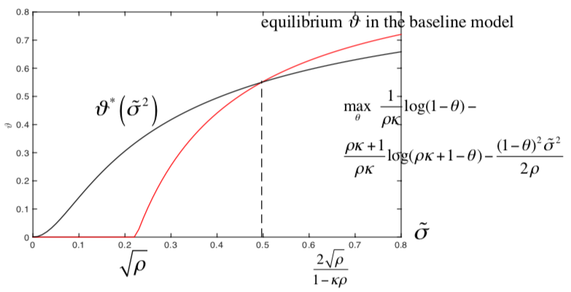
Optimal Policy
$\max_{θ}$ $\frac{1}{ρφ}\log\left(1−θ\right)−$ $$\frac{ρφ+1}{ρφ}\log\left(ρφ+1−θ\right)−\frac{{\left(1−θ\right)}^{2}{\tilde{σ}}^{2}}{2ρ}$$
Red: equilibrium $θ$ in the baseline model
Black: optimal policy $θ^{∗}$

Slide 19
Pecuniary Externality Explanation
Money growth $μ^{M}$ affects
Shadow risk-free rate
(Steady state) inflation in two ways
$$π=μ^{M}+i−\underset{g}{\underbrace{(Φ\left(ι\left(μ^{M}\right)\right)−δ)}}$$
Proposition:
For sufficiently large $\tilde{σ}$ and $φ<∞$ welfare maximizing ${μ^{M}}^{∗}>0$.
Laissez-faire Market outcome is not even constrained Pareto efficient
Economic growth rate $g$ is also higher
Growth maximizing $μ^{g∗}≥μ^{M∗}$, s.t. $p^{g∗}=0$, Tobin (1965)
Corollary: No super-neutrality of money
$i$: Super-neutrality only w.r.t. part of money growth rate that is used to pay interest on money
$μ^{M}$: Nominal money growth rate affects real economic growth by distorting portfolio choice if $φ<∞$
No price/wage rigidity, no monopolistic competition

Slide 20
Optimal Policy
If the planner can control $θ_{t}$ directly, she would set $θ_{t}=θ^{∗}({\tilde{σ}}_{t}^{2})$
$$d{\tilde{σ}}_{t}=μ^{\tilde{σ}}\left({\tilde{σ}}_{t}\right)dt+ν^{\tilde{σ}}\left({\tilde{σ}}_{t}\right)dZ_{t}^{ν}$$
$dθ_{t}=μ^{θ }\left({\tilde{σ}}_{t}\right)θ_{t}dt+ν^{θ}\left({\tilde{σ}}_{t}\right)θ_{t}dZ_{t}^{ν}$
The planner can choose instruments $μ^{M}\left({\tilde{σ}}_{t}\right),ν^{M}\left({\tilde{σ}}_{t}\right)$ to achieve any function $θ_{t}$
How to find the instruments $μ^{M}\left({\tilde{σ}}_{t}\right),ν^{M}\left({\tilde{σ}}_{t}\right)$ that achieve $θ^{∗}\left({\tilde{σ}}_{t}^{2}\right)$?
-- solving money valuation equation
$$ρ−\underset{=μ_{t}^{θ/M}}{\underbrace{(μ_{t}^{θ}+ν_{t}\left(ν_{t}−σ_{t}^{θ}\right))}}={\left(1−θ_{t}\right)}^{2} {\tilde{σ}}_{t}^{2}$$
Optimal policy is easier to find than equilibrium outcome
differentiation vs. integration (or solve PDEs)
If we choose optimal policy, risk-free rate
$$r_{t}^{F}=Φ\left(ι_{t}\right)−δ+μ_{t}^{θ/M}=ρ{−\left(1−θ_{t}^{∗}\right)}^{2}{\tilde{σ}}_{t}^{2}+Φ\left(ι_{t}\right)−δ$$
declines as ${\tilde{σ}}_{t}^{2}$ increases
Nice relationship between baseline and dynamic model

Slide 21
Optimal Policy
If the planner can control $θ_{t}$ directly, she would set $θ_{t}=θ^{∗}({\tilde{σ}}_{t}^{2})$
$$d{\tilde{σ}}_{t}=μ^{\tilde{σ}}\left({\tilde{σ}}_{t}\right)dt+ν^{\tilde{σ}}\left({\tilde{σ}}_{t}\right)dZ_{t}^{ν}$$
$dθ_{t}=μ^{θ }\left({\tilde{σ}}_{t}\right)θ_{t}dt+ν^{θ}\left({\tilde{σ}}_{t}\right)θ_{t}dZ_{t}^{ν}$
The planner can choose instruments $μ^{M}\left({\tilde{σ}}_{t}\right),ν^{M}\left({\tilde{σ}}_{t}\right)$ to achieve any function $θ_{t}$
How to find the instruments $μ^{M}\left({\tilde{σ}}_{t}\right),ν^{M}\left({\tilde{σ}}_{t}\right)$ that achieve $θ^{∗}\left({\tilde{σ}}_{t}^{2}\right)$?
-- solving money valuation equation
$$ρ−\underset{=μ_{t}^{θ/M}}{\underbrace{(μ_{t}^{θ}+ν_{t}\left(ν_{t}−σ_{t}^{θ}\right))}}={\left(1−θ_{t}\right)}^{2} {\tilde{σ}}_{t}^{2}$$
Optimal policy is easier to find than equilibrium outcome
differentiation vs. integration (or solve PDEs)
If we choose optimal policy, risk-free rate
$$r_{t}^{F}=Φ\left(ι_{t}\right)−δ+μ_{t}^{θ/M}=ρ{−\left(1−θ_{t}^{∗}\right)}^{2}{\tilde{σ}}_{t}^{2}+Φ\left(ι_{t}\right)−δ$$
declines as ${\tilde{σ}}_{t}^{2}$ increases
Nice relationship between baseline and dynamic model

Slide 22
Add-on: (To be settled later…)
1. How to find best ${μ_{t}^{M},ν}_{t}^{M}$
Step 1: Without policy (need to solve for equilibrium)
$$ρ−μ_{t}^{θ}={\left(1−θ_{t}\right)}^{2} {\tilde{σ}}_{t}^{2}$$
Step 2: we need to think of the relation of $μ_{t}^{M},ν_{t}^{M}$
using money evaluation equation find $μ_{t}^{θ/M}$ for optimal $θ^{∗}(\tilde{σ})$
$$ρ−μ_{t}^{θ/M}={\left(1−θ_{t}^{∗}\right)}^{2} {\tilde{σ}}_{t}^{2}$$
And
$$μ_{t}^{θ/M}=μ_{t}^{θ}−μ_{t}^{M}+ν_{t}^{M}\left(ν_{t}^{M}−σ_{t}^{θ}\right)$$
Need some connection of $σ_{t}^{M},μ_{t}^{M}$, such as taking $σ_{t}^{M}=σ$, risk-free?
2. plot a figure of $r_{t}^{F}$
As $θ^{∗},Φ^{∗}$ they both depends on $\tilde{σ}$, can only know it by plotting a figure…
How to interpret it? Any economics message? (any effects of the policy.) Need to see the results.

Slide 23
Roadmap
Expected Utility/Value function with log-utility
One sector model with stochastic idiosyncratic volatility
Two sector model
with exogenously fixed net worth share $η$
With endogenous wealth share $η$
I theory (with two technologies)

Slide 24
Two Switching Sector model with Exogenous wealth dist.
$$λ^{s}$$
Model Setup
Switching infinitely fast
Intermediaries
Households
$$λ^{e}$$
Agents | Intermediaries | Household
Share of agents = net worth share | $$η$$ | $$1−η$$
Idiosyncratic risk of capital | $$φ\tilde{σ}, φ∈\left(0,1\right)$$ diversification | $$\tilde{σ}$$
Output per unit of capital | $a$ the same, independently of the allocation
Policy marker can choose the money growth rate $μ_{t}^{M}$.

Slide 25
Remark
Policy-marker cannot affect the wealth shares
Welfare Pareto weights
$λ=η$ for intermediaries and
$1−λ=1−η$ for households from the setup
Optimal monetary (with or without macroprudential policy – controlling capital allocation)
Perfect commitment – Ramsey problem

Slide 26
Equilibrium capital allocation
Fraction $χ$ of risk ($κ$ of capital) is held by the intermediaries ($χ=κ$)
Capital allocation must be such that
$$\underset{idio risk of I}{\underbrace{φ{\tilde{σ}}_{t}}}\underset{I^{′}s price of idio. risk}{\underbrace{\frac{\left(1−θ\right)κφ{\tilde{σ}}_{t}}{η}}}=\underset{idio risk of h}{\underbrace{{\tilde{σ}}_{t}}}\underset{h^{′}s price of idio. risk}{\underbrace{\frac{\left(1−θ\right)(1−κ){\tilde{σ}}_{t}}{1−η}}}$$
$$⇒κ=\frac{η}{φ^{2}\left(1−η\right)+η}$$
Policy marker may try to affect $κ$…

Slide 27
Welfare of Intermediaries $I$ and HH $h$
Intermediaries (Pareto weight $λ$)
$$E\left[\int_{0}^{∞}{e^{−ρt}\left(\log{η_{t}}+\log\left(a−ι_{t}\right)+\frac{Φ\left(ι_{t}\right)−δ}{ρ}−\frac{σ^{2}}{2ρ}−\frac{{\left(1−θ_{t}\right)}^{2}}{2ρ}\frac{κ^{2}φ^{2}{\tilde{σ}}^{2}}{η^{2}}\right)dt}\right]$$
Households (Pareto weight $1−λ$)
$$E\left[\int_{0}^{∞}{e^{−ρt}\left(\log\left(1−η_{t}\right)+\log\left(a−ι_{t}\right)+\frac{Φ\left(ι_{t}\right)−δ}{ρ}−\frac{σ^{2}}{2ρ}−\frac{{\left(1−θ_{t}\right)}^{2}}{2ρ}\frac{{\left(1−κ\right)}^{2}{\tilde{σ}}^{2}}{{\left(1−η\right)}^{2}}\right)dt}\right]$$

Slide 28
Welfare
Law of large numbers: switching risk does not matter. Everyone’s wealth growth averages out to $Φ\left(ι_{t}\right)−δ$ and idiosyncratic risk exposure, to
$$η{\left({\tilde{σ}}^{I}\right)}^{2}+\left(1−η\right){\left({\tilde{σ}}^{h}\right)}^{2}={\left(1−θ\right)}^{2}\underset{{{(\tilde{σ}}^{Ave})}^{2}≔}{\underbrace{{\tilde{σ}}^{2}\left(λ\frac{κ^{2}φ^{2}}{η^{2}}+(1−λ)\frac{{\left(1−κ\right)}^{2}}{{\left(1−η\right)}^{2}}\right)}}$$
$${\tilde{σ}}^{I}=\frac{\left(1−θ\right)κφ\tilde{σ}}{η},{\tilde{σ}}^{h}=\frac{\left(1−θ\right)\left(1−κ\right)\tilde{σ}}{1−η}$$
Welfare
$$E\left[\int_{0}^{∞}{e^{−ρt}\log{(a−ι(θ)) }dt}\right]+E\left[\int_{0}^{∞}{e^{−ρt}\frac{Φ\left(ι(θ)\right)−δ}{ρ}dt}\right]−E\left[\int_{0}^{∞}{e^{−ρt}\frac{{\left(1−θ\right)}^{2}{\left({\tilde{σ}}^{Ave}\right)}^{2}}{2ρ}dt}\right]$$
Given ${\tilde{σ}}^{A}$, optimal to set $θ=θ^{∗}\left({\left({\tilde{σ}}^{Ave}\right)}^{2}\right)$.
Set $λ=η$ (Pareto weight is population share)

Slide 29
Money valuation
Money valuation equation
$$ρ−\underset{μ_{t}^{θ/M}}{\underbrace{\left(μ_{t}^{θ}−μ_{t}^{M}+ν_{t}^{M}\left(ν_{t}^{M}−σ_{t}^{θ}\right)\right)}}=\underset{{\left(1−θ_{t}\right)}^{2}{\left({{\tilde{σ}}_{t}}^{Ave}\right)}^{2}}{\underbrace{η{\left({\tilde{σ}}_{t}^{I}\right)}^{2}+\left(1−η\right){\left({\tilde{σ}}_{t}^{h}\right)}^{2}}}$$

Slide 30
Macroprudential tools
Average idiosyncratic risk of capital
$${\tilde{σ}}^{2}\left(\frac{κ^{2}φ^{2}}{η}+\frac{{\left(1−κ\right)}^{2}}{1−η}\right)$$
is minimized when
$$\frac{κφ^{2}}{η}=\frac{1−κ}{1−η}⇒κ=\frac{η}{φ^{2}\left(1−η\right)+η}$$
This is the equilibrium allocation!
Lemma: Optimal not to use macroprudential tools. assuming $λ=η$
Recall: can use $χ$ instead of $κ$
(depends on model interpretation)

Slide 31
Remarks
Same trade-off between insurance and investment
Equilibrium allocation is efficient, minimizes the cost of risk exposure
Policy space
(1) money growth and
(1) + (2) (money growth + macroprudential tools) leads to the same outcome

Slide 32
Roadmap
Expected Utility/Value function with log-utility
One sector model with stochastic idiosyncratic volatility
Two sector model
With exogenously fixed net worth share $η$
With endogenous wealth share $η$
I theory (with two technologies)

Slide 33
Endogenous law of motion of $η$
Wealth distribution can change endogenously with
risk exposure of intermediaries and households
risk premia
consumption rates
Consider the following model

Slide 34
Fixed types (no switching)
Types fixed
(no switching)
Model Setup
Intermediaries
Households
Agents | Intermediaries | Household
Welfare weights | $$λ$$ | $$1−λ$$
Wealth share | $$η$$ | $$1−η$$
Aggregate risk | $$σ$$ | $$σ$$
Idiosyncratic risk of capital | $$φ\tilde{σ}, φ∈\left(0,1\right)$$ | $$\tilde{σ}$$
Output per unit of capital | $a$ the same, independently of the allocation
You have already seen this model except here $\overline{κ}=1$
Two policy settings:
(1) money growth rate $μ_{t}^{M}$ only
(1) + (2) also choose allocation (macroprudential) and transfer wealth between group (why/how?)

Slide 35
Welfare of Intermediaries $I$ and HH $h$
Intermediaries (Pareto weight $λ$)
$$E\left[\int_{0}^{∞}{e^{−ρt}\left(\log{η_{t}}+\log\left(a−ι_{t}\right)+\frac{Φ\left(ι_{t}\right)−δ}{ρ}−\frac{σ^{2}}{2ρ}−\frac{{\left(1−θ_{t}\right)}^{2}}{2ρ}\frac{κ^{2}φ^{2}{\tilde{σ}}^{2}}{η^{2}}\right)dt}\right]$$
Households (Pareto weight $1−λ$)
$$E\left[\int_{0}^{∞}{e^{−ρt}\left(\log\left(1−η_{t}\right)+\log\left(a−ι_{t}\right)+\frac{Φ\left(ι_{t}\right)−δ}{ρ}−\frac{σ^{2}}{2ρ}−\frac{{\left(1−θ_{t}\right)}^{2}}{2ρ}\frac{{\left(1−κ\right)}^{2}{\tilde{σ}}^{2}}{{\left(1−η\right)}^{2}}\right)dt}\right]$$

Slide 36
Optimal policy: (1) MoPo + (2) MacroPru
Planner chooses $θ, κ$ and $η$ to max discount integral of
$λ\log{η_{t}}+\left(1−λ\right)\log\left(1−η_{t}\right)+\log\left(a−ι(θ_{t})\right)+\frac{Φ\left(ι(θ_{t})\right)−δ}{ρ}−\frac{σ^{2}}{2ρ}$ $−\frac{{\left(1−θ_{t}\right)}^{2}{\tilde{σ}}^{2}}{2ρ}\underset{\frac{λ\left(1−λ\right)φ^{2}}{λφ^{2}{\left(1−η\right)}^{2}+\left(1−λ\right)η^{2} }}{\underbrace{\left(λ\frac{κ^{2}φ^{2}}{η^{2}}+\left(1−λ\right)\frac{{\left(1−κ\right)}^{2}}{{\left(1−η\right)}^{2}}\right)}}$
given the optimal choice of $κ=\frac{\left(1−λ\right)η^{2}}{λφ^{2}{\left(1−η\right)}^{2}+\left(1−λ\right)η^{2} }$
not the competitive allocation (unless $η=λ$)

Slide 37
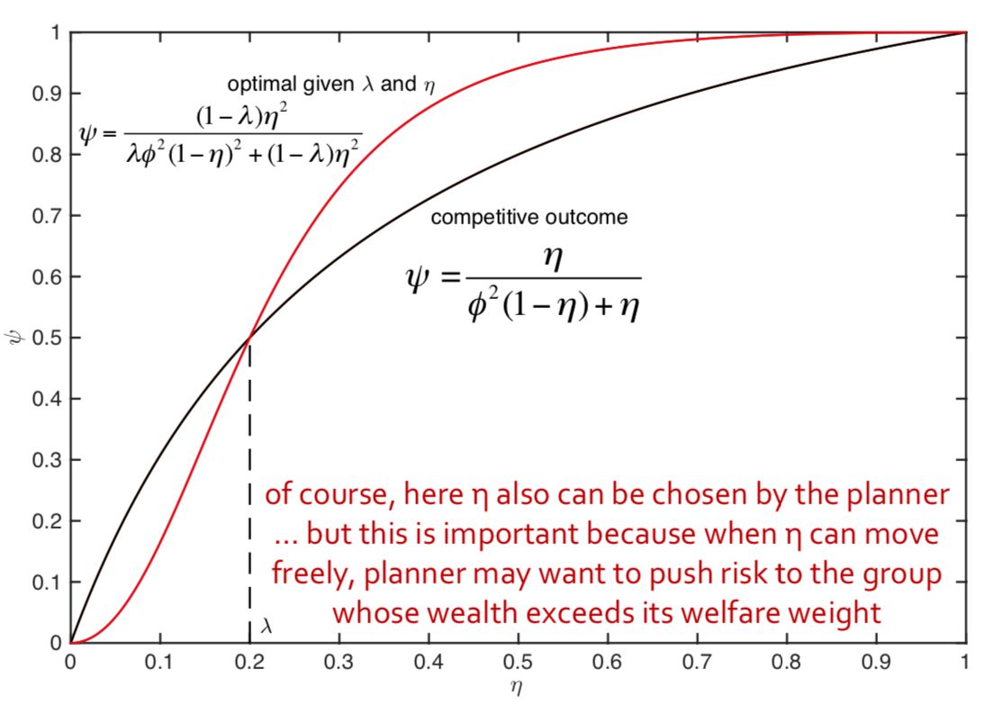
Optimal policy: (1) MoPo + (2) MacroPru
Step 1: Solve optimal $κ$ (or $χ$) for a given $η$ and $λ$
Competitive $κ$ vs. minimizing cost of risk
$$κ=\frac{\left(1−λ\right)η^{2}}{λφ^{2}{\left(1−η\right)}^{2}+\left(1−λ\right)η^{2}}$$
$$κ=\frac{η}{φ^{2}\left(1−η\right)+η}$$
$$κ$$

Slide 38
Optimal policy: (1) MoPo + (2) MacroPru
Planner chooses $θ, κ$ and $η$ to max discount integral of
$λ\log{η_{t}}+\left(1−λ\right)\log\left(1−η_{t}\right)+\log\left(a−ι(θ_{t})\right)+\frac{Φ\left(ι(θ_{t})\right)−δ}{ρ}−\frac{σ^{2}}{2ρ}$ $−\frac{{\left(1−θ_{t}\right)}^{2}{\tilde{σ}}^{2}}{2ρ}\underset{\frac{λ\left(1−λ\right)φ^{2}}{λφ^{2}{\left(1−η\right)}^{2}+\left(1−λ\right)η^{2} }}{\underbrace{\left(λ\frac{κ^{2}φ^{2}}{η^{2}}+\left(1−λ\right)\frac{{\left(1−κ\right)}^{2}}{{\left(1−η\right)}^{2}}\right)}}$
Step 2: Solve $θ_{t}=θ^{∗}\left(⋅\right)$ (having used optimal $κ_{t}$) for each given $η$
Given $κ$ and $η$, optimal to set $θ$ to
$$θ=θ^{∗}(\underset{welfare weighted average risk exposure}{\underbrace{{\tilde{σ}}^{2}\frac{λ\left(1−λ\right)φ^{2}}{λφ^{2}{\left(1−η\right)}^{2}+\left(1−λ\right)η^{2} }}})$$
given the optimal choice of $κ=\frac{\left(1−λ\right)η^{2}}{λφ^{2}{\left(1−η\right)}^{2}+\left(1−λ\right)η^{2} }$
not the competitive allocation (unless $η=λ$)

Slide 39
Optimal policy: (1) MoPo + (2) MacroPru
Step 3: Optimal $η$ (given $θ$)
let’s look at terms containing $η$
Given $κ$ and $η$,
$$\max_{η}{ \underset{concave, max at η=λ, goes to −∞ at 0 \& 1}{\underbrace{λ\log{η_{t}}+\left(1−λ\right)\log\left(1−η_{t}\right)}}−\frac{{\left(1−θ_{t}\right)}^{2}{\tilde{σ}}^{2}}{2ρ}\underset{concave, max at \frac{λφ^{2}}{λφ^{2}+1−λ }<λ }{\underbrace{\frac{λ\left(1−λ\right)φ^{2}}{λφ^{2}{\left(1−η\right)}^{2}+\left(1−λ\right)η^{2} }}}}$$
hence it is optimal to set $η>λ$ (unfortunately no closed-form expression for the optimal $η$)
push more risk onto intermediaries than they’d take under competitive outcome
relative to previous infinite switching model
it is optimal to give intermediaries more wealth, because they are more efficient at absorbing risk
overall risk is reduced and the value of money is lower (more intermediation)

Slide 40
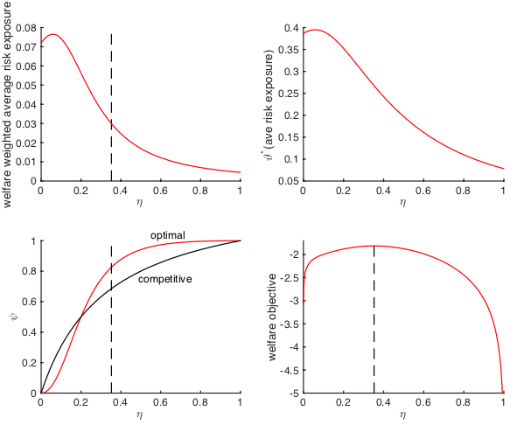
Optimizing over $η$
$$κ$$
$$ρ=.05, φ=2, \tilde{σ}=.3, φ=.5, λ=.2$$

Slide 41
Optimal policy: (1) MoPo only
Planner cannot alter competitive alloc. $κ_{t}=\frac{η_{t}}{φ^{2}\left(1−η_{t}\right)+η_{t}}$
Welfare is the discount integral of
$$λ\log{η_{t}}+\left(1−λ\right)\log\left(1−η_{t}\right)+\log\left(a−ι(θ_{t})\right)+\frac{Φ\left(ι(θ_{t})\right)−δ}{ρ}−\frac{σ^{2}}{2ρ} \\ −\frac{{\left(1−θ_{t}\right)}^{2}{\tilde{σ}}^{2}}{2ρ}\underset{\frac{λφ^{2}+\left(1−λ\right)φ^{4}}{{\left(φ^{2}\left(1−η_{t}\right)+η_{t}\right)}^{2}}}{\underbrace{\left(λ\frac{κ_{t}^{2}φ^{2}}{η_{t}^{2}}+\left(1−λ\right)\frac{{\left(1−κ_{t}\right)}^{2}}{{\left(1−η_{t}\right)}^{2}}\right)}}$$
s.t.
$$\frac{dη_{t}}{η_{t}}=\left(1−η_{t}\right)\left({\left({\tilde{σ}}_{t}^{I}\right)}^{2}−{\left({\tilde{σ}}_{t}^{h}\right)}^{2}\right)dt=\left(1−η_{t}\right)\frac{{\left(1−θ_{t}\right)}^{2}{\tilde{σ}}^{2}φ^{2}\left(1−φ^{2}\right)}{{\left(φ^{2}\left(1−η_{t}\right)+η_{t}\right)}^{2}}dt$$
Planner can not choose $κ_{t}$ or $η_{t}$ but has some control over $μ_{t}^{η}$
Now, fully dynamic problem!

Slide 42
Optimal policy: (1) MoPo only
Payoff flow: $f\left(η_{t},θ_{t}\right)=λ\log{η_{t}}+\left(1−λ\right)\log\left(1−η_{t}\right)+\frac{\log\left(1−θ_{t}\right)}{ρφ}$ $−\frac{ρφ+1}{ρφ}\log\left(ρφ+1−θ_{t}\right)−\frac{{\left(1−θ_{t}\right)}^{2}{\tilde{σ}}^{2}}{2ρ}\left(λ\frac{κ_{t}^{2}φ^{2}}{η_{t}^{2}}+\left(1−λ\right)\frac{{\left(1−κ_{t}\right)}^{2}}{{\left(1−η_{t}\right)}^{2}}\right),$
with $κ=\frac{η}{φ^{2}\left(1−η\right)+η}$
HJB equation
$$ρV\left(η\right)=\max_{θ}{f\left(η,θ\right)}+V^{′}\left(η\right)μ^{η}η+\frac{1}{2}V^{′′}\left(η\right){\left(σ^{η}η\right)}^{2}$$
Law of motion of $η$
$$\frac{dη}{η}=\left(1−η\right)\frac{{\left(1−θ\right)}^{2}{\tilde{σ}}^{2}φ^{2}\left(1−φ^{2}\right)}{{\left(φ^{2}\left(1−η\right)+η\right)}^{2}}dt+0dZ$$

Slide 43
Optimal policy: (1) MoPo only
Payoff flow: $f\left(η_{t},θ_{t}\right)=λ\log{η_{t}}+\left(1−λ\right)\log\left(1−η_{t}\right)+\frac{\log\left(1−θ_{t}\right)}{ρφ}$ $−\frac{ρφ+1}{ρφ}\log\left(ρφ+1−θ_{t}\right)−\frac{{\left(1−θ_{t}\right)}^{2}{\tilde{σ}}^{2}}{2ρ}\left(λ\frac{κ_{t}^{2}φ^{2}}{η_{t}^{2}}+\left(1−λ\right)\frac{{\left(1−κ_{t}\right)}^{2}}{{\left(1−η_{t}\right)}^{2}}\right),$
with $κ=\frac{η}{φ^{2}\left(1−η\right)+η}$
HJB equation
$$ρV\left(η\right)=\max_{θ}{f\left(η,θ\right)}+V^{′}\left(η\right)μ^{η}η+\frac{1}{2}V^{′′}\left(η\right){\left(σ^{η}η\right)}^{2}$$
Law of motion of $η$
$$\frac{dη}{η}=\left(1−η\right)\frac{{\left(1−θ\right)}^{2}{\tilde{σ}}^{2}φ^{2}\left(1−φ^{2}\right)}{{\left(φ^{2}\left(1−η\right)+η\right)}^{2}}dt+0dZ$$

Slide 44
Optimal policy: (1) MoPo only
Optimal $θ^{∗}$
HJB equation
$$\max_{θ} \frac{\log\left(1−θ\right)}{ρφ}−\frac{ρφ+1}{ρφ}\log\left(ρφ+1−θ\right)−\frac{{\left(1−θ_{t}\right)}^{2}{\tilde{σ}}^{2}}{2ρ}\left(λ\frac{κ^{2}φ^{2}}{η^{2}}+\left(1−λ\right)\frac{{\left(1−κ\right)}^{2}}{{\left(1−η\right)}^{2}}\right)+V^{′}\left(η\right){\left(1−θ_{t}\right)}^{2}\frac{η\left(1−η\right){\tilde{σ}}^{2}φ^{2}\left(1−φ^{2}\right)}{{\left(φ^{2}\left(1−η\right)+η\right)}^{2}}$$
$θ$ affects the drift of $η$, it is optimal to choose
$$θ^{∗}\left({\tilde{σ}}^{2}\left(λ\frac{κ^{2}φ^{2}}{η^{2}}+\left(1−λ\right)\frac{{\left(1−κ\right)}^{2}}{{\left(1−η\right)}^{2}}\right)−2ρV^{′}\left(η\right)\frac{η\left(1−η\right){\tilde{σ}}^{2}φ^{2}\left(1−φ^{2}\right)}{{\left(φ^{2}\left(1−η\right)+η\right)}^{2}}\right)$$
Speed up $η$ when $V^{′}>0$, slow down when $V^{′}<0$.

Slide 45
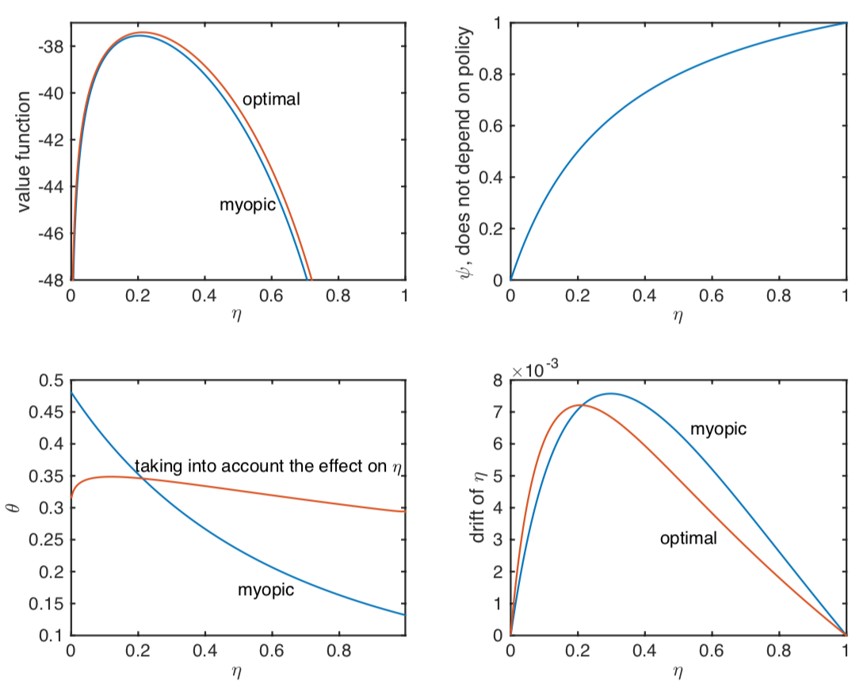
Example: using $θ$ to push $η$
$$ρ=.05, φ=2, \tilde{σ}=.3, φ=.5, λ=.2$$
$$κ$$

Slide 46
Optimal policy: (1) MoPo only
Using MoPo $θ$ to push $η$ (to recapitalize banks via risk premia)
Using screwdriver as hammer

Slide 47
Roadmap
Expected Utility/Value function with log-utility
One sector model with stochastic idiosyncratic volatility
Two sector model
With exogenously fixed net worth share $η$
With endogenous wealth share $η$
I theory (with two technologies)

Slide 48
I Theory of Money
Aim: intermediary sector is not perfectly hedged
Idiosyncratic risk that HH have to bear is time-varying
Needed: Intermediaries’ aggregate risk $≠$ aggregate risk of economy
One way to model: 2 technologies $a$ and $b$
Fundamental risk of money = of economy
Technology | $$a$$ | $$b$$
Capital share (Leontieff) | $$1−\overline{κ}$$ | $$\overline{κ}$$
Risk | $$\frac{dk_{t}}{k_{t}}=\left(⋅\right)dt+σ^{a}dZ_{t}+\tilde{σ}d{\tilde{Z}}_{t}$$ | $$\frac{dk_{t}}{k_{t}}=\left(⋅\right)dt+σ^{b}dZ_{t}+\tilde{σ}d{\tilde{Z}}_{t}$$
Intermediaries | No | $\text{Yes}\text{, }\text{reduce} \text{to}$ $φ\tilde{σ}$
Excess risk | $$−\overline{κ}σ−\frac{σ^{θ}−σ^{M}}{1−θ}$$ | $$\left(1−\overline{κ}\right)σ−\frac{σ^{θ}−σ^{M}}{1−θ}$$

Slide 49
I Theory: Balance Sheets
A
Firms $i$…
L
A
L
Households $i$…
A
L
A
L
Intermediaries
A
L
A
L
Tech. $a$
A
L
Out-Money
Money
Equity
Tech. $b$
Inside
Risky
claims
Money
Net worth
Risky
claims
Money
…
…
Net worth
Frictions:
Household cannot diversify idio risk
Limited risky claims issuance
Only nominal deposits

Slide 50
Model with Intermediaries – new policy
Model Setup
$$\frac{ⅆk_{t}}{k_{t}}=\left(Φ\left(ι_{t}\right)−δ\right)ⅆt+\underset{aggregate}{\underbrace{σⅆZ_{t}}}+\underset{idiosyncratic}{\underbrace{\tilde{σ}ⅆ{\tilde{Z}}_{t}}}$$
Intermediaries can hold equality share up to $\overline{κ}$
can diversify some idiosyncratic risk, reduce it to $φ\tilde{σ}$
Intermediaries’ wealth share $η_{t}=N_{t}/\left(\left(p_{t}+q_{t}\right)K_{t}\right)$
Welfare weights $λ$ on intermediaries, $1−λ$ on HH
Two policy settings:
(1) money growth rate $μ_{t}^{M}$ only
(1) + (2) also choose allocation (macroprudential) and transfer wealth between group (why/how?)

Slide 51
Optimal policy: (1) MoPo + (2) MacroPru
Same steps as above
Step 1: Optimal $κ=\min\left(\frac{\left(1−λ\right)η^{2}}{λφ^{2}{\left(1−η\right)}^{2}+\left(1−λ\right)η^{2} },\overline{κ}\right)$ given $η$
Step 2: Optimal $θ=θ^{∗}(\underset{\begin{aligned}welfare weighted average \\ risk exposure\end{aligned}}{\underbrace{{\tilde{σ}}^{2}\frac{λ\left(1−λ\right)φ^{2}}{λφ^{2}{\left(1−η\right)}^{2}+\left(1−λ\right)η^{2} }}})$
Step 3: Optimal $η$ (given $θ$) as a function of Pareto weight $λ$

Slide 52
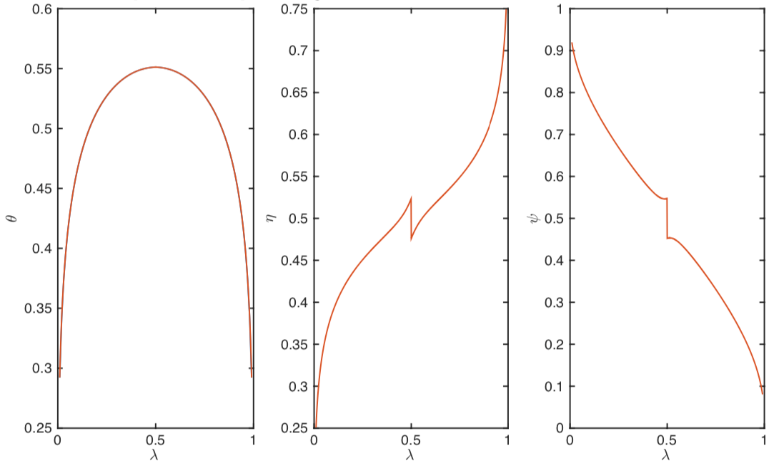
Optimal policy: (1) MoPo + (2) MacroPru
Step 3: Optimal $η$ (given $θ$) - let’s look at terms containing $η$
$$\max_{η}{ \underset{concave, max at η=λ, goes to −∞ at 0 \& 1}{\underbrace{λ\log{η_{t}}+\left(1−λ\right)\log\left(1−η_{t}\right)}}−\frac{{\left(1−θ_{t}\right)}^{2}{\tilde{σ}}^{2}}{2ρ}\frac{λ\left(1−λ\right)}{λφ^{2}{\left(1−η\right)}^{2}+\left(1−λ\right)η^{2} }}$$
For $φ=1$, the optimal policy as a as a function of $λ$ is
$$κ$$

Slide 53
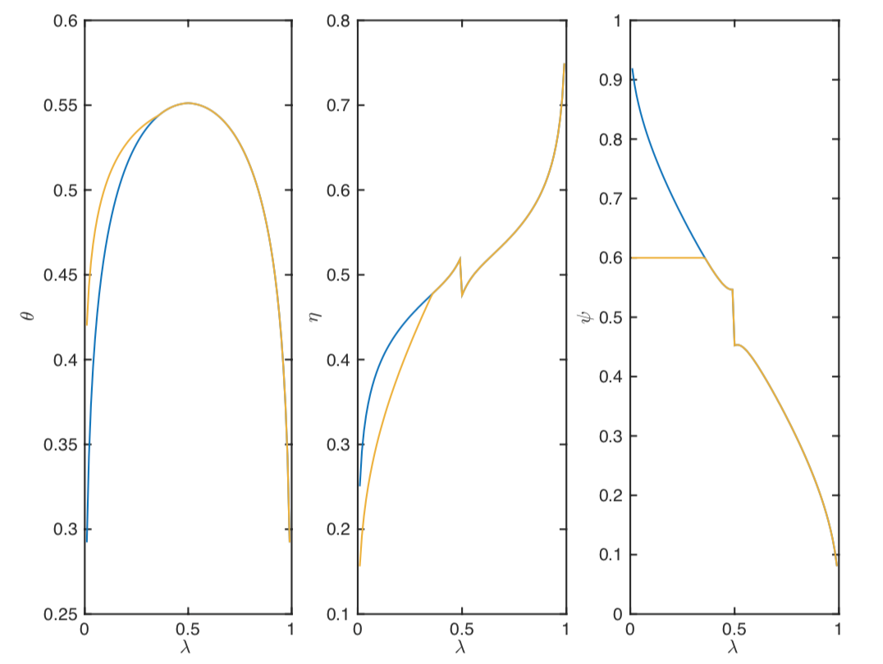
Optimal policy: (1) MoPo + (2) MacroPru
For $φ=1$, and $\overline{κ}=0.6$ (intermediaries’ risk taking is constrained)
$$κ$$

Slide 54
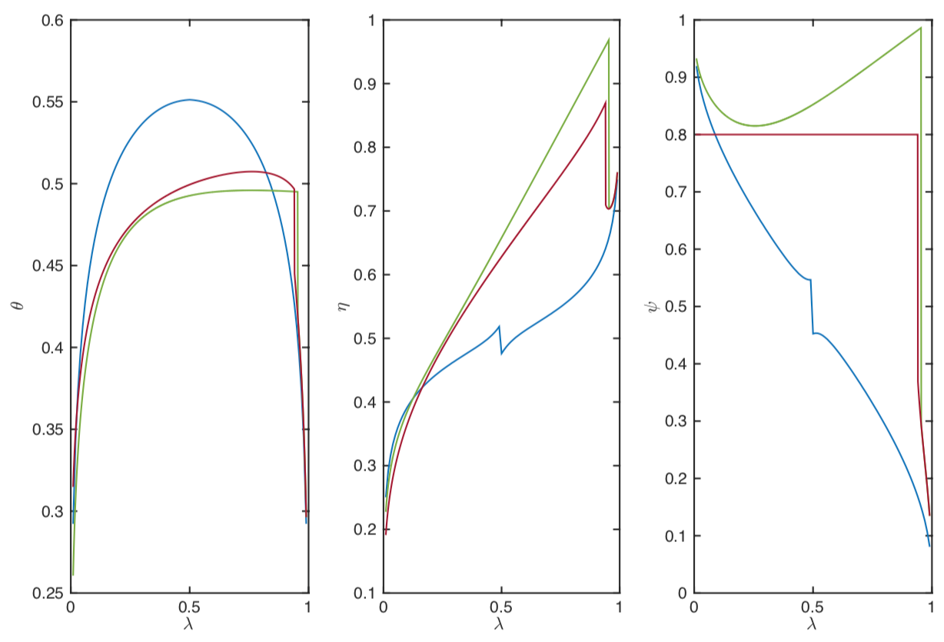
Optimal policy: (1) MoPo + (2) MacroPru
For $φ=0.8$, $\overline{κ}=1,$ and $φ=0.8$, $\overline{κ}=0.8$ Intermediaries given a lot more risk when they can diversify it
$$κ$$

Slide 55
Optimal policy: (1) MoPo + (2) MacroPru
Step 3: Optimal $η$ (given $θ$) - let’s look at terms containing $η$
Same as above
Given $κ$ and $η$, opti$\max_{η}{ \underset{concave, max at η=λ, goes to −∞ at 0 \& 1}{\underbrace{λ\log{η_{t}}+\left(1−λ\right)\log\left(1−η_{t}\right)}}−\frac{{\left(1−θ_{t}\right)}^{2}{\tilde{σ}}^{2}}{2ρ}\underset{concave also, max at \frac{λφ^{2}}{λφ^{2}+1−λ }<λ }{\underbrace{\frac{λ\left(1−λ\right)φ^{2}}{λφ^{2}{\left(1−η\right)}^{2}+\left(1−λ\right)η^{2} }}}}$
Assuming FOC holds uniquely, it is optimal to set $η>λ$
push more risk to intermediaries and they’d take under competitive outcome
relative to previous infinite switching model
it is optimal to give intermediaries more wealth, because they are more efficient at absorbing risk
overall risk is reduced and the value of money is lower (more intermediation)

Slide 56
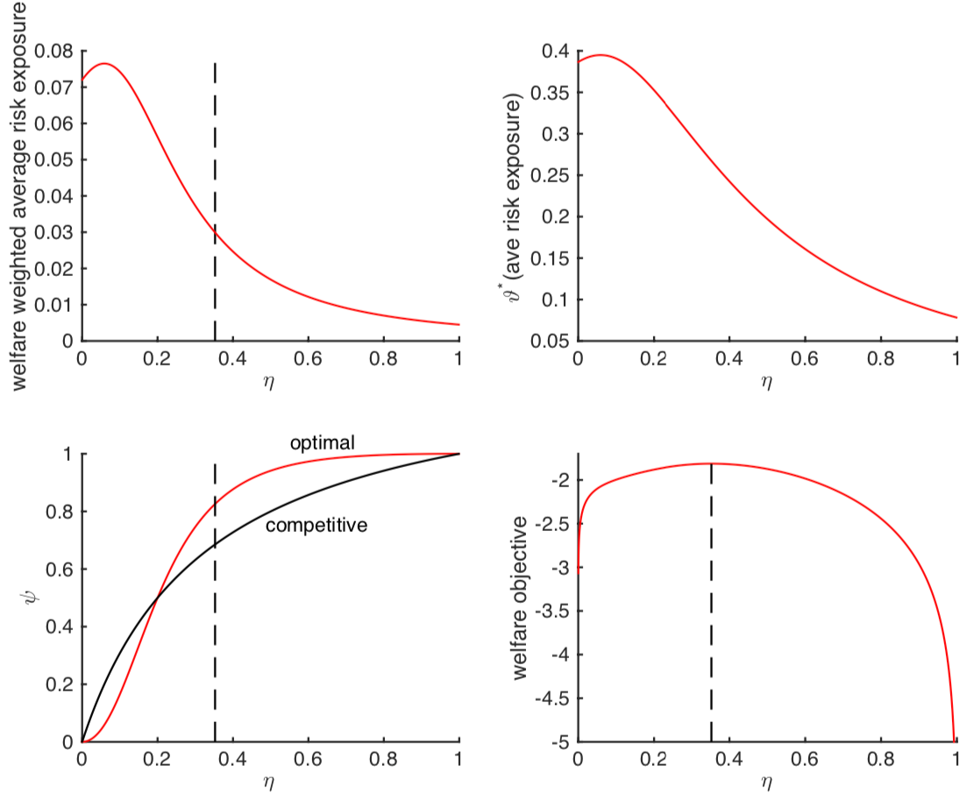
Optimizing over $η$
$$κ$$
$$ρ=.05, φ=2, \tilde{σ}=.3, φ=.5, λ=.2$$

Slide 57
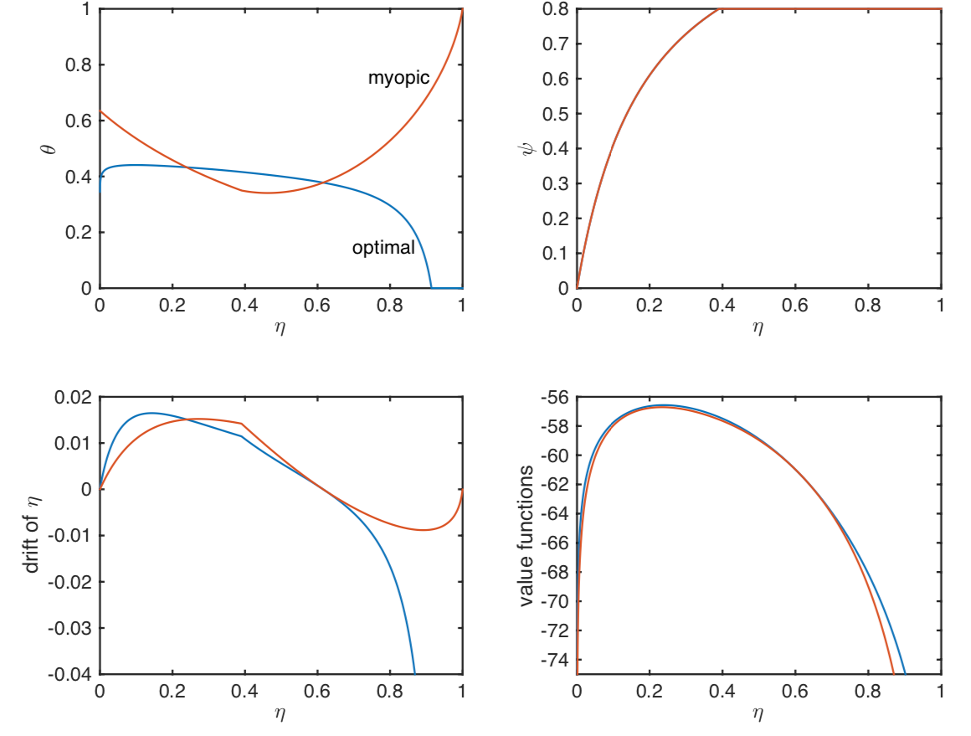
Optimal policy, (1) MoPo only
Using $θ$ to push $η$- Same analytical steps as before
$$ρ=.05, φ=2, \tilde{σ}=.3, φ=.5, λ=.2$$
$$κ$$

Slide 58
Take-aways of Optimal Policy
Baseline (one-sector) model
Trade-off: insurance vs. investment (growth)
Multi-sector model
Allocation of risk/assets
Money is not super-neutral
since it affect portfolio choice, risk allocation
Price of risk (risk premia), $η$-drift
(1) MoPo + (2) MacroPru
Static problem – 3 steps maximization
Always $θ^{∗}\left(⋅\right)$-function
(1) MoPo only
Using screwdriver as hammer to push $η$

Slide 59
Thank you!
markus@princeton.edu

