Slide 1

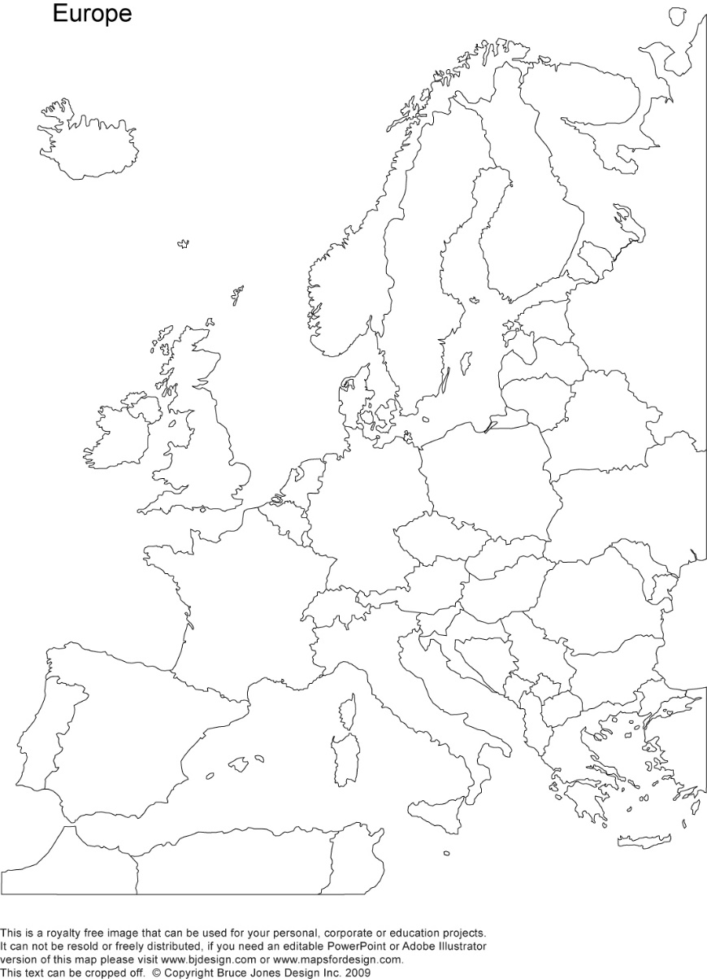
A crash-course on the euro crisis
Markus K. Brunnermeier & Ricardo Reis

Slide 2

Capital inflows and their allocation
Section 2

Slide 3
The run-up to the euro crisis
Optimistic expectations lead to cheap credit and financial markets grow
Large capital flows from savers to borrowers, from developed to developing regions
The housing market booms causing an increase in demand for construction and real estate sectors
A benevolent view: these large capital flows makes financial markets integrate, economies boom and incomes converge

Slide 4
A modern view of capital flows
The focus is on how capital is allocated across sectors and firms
Productivity can fall when capital flows to poorer countries during booms because:
They are worse at allocating capital
They lack depth in financial markets
There may be political inference from taxes, regulation and corruption
Banks and financial markets are unsophisticated in evaluating projects and have governance problems
Increases in capital stock can intensify misallocation as abundant resources make bank managers more lax at screening projects and politicians less eager to implement structural reforms

Slide 5

A model of misallocation
Simple model to illustrate phenomenon of investment booms leading to acute misallocation of capital
We focus on two types of misallocation: between and within sectors
The economy has two sectors which each contains several firms
It has to allocate its scarce capital between the two sectors

Slide 6
Setting up the model
T
Sector T
Efficient equilibrium
Produces goods that are traded in international markets, subject to fierce competition
E.g. manufacturing
Sector N
Produces goods for the domestic market, protected from foreign competition by natural and political barriers
E.g. construction and real estate
A
Preferences
Production frontier
N

Slide 7
Misallocation across sectors
Politics
Sector N protected by local politicians
Given lack of competition can form local cartels
Coordinate political contributions
Finance
Sector N favoured by local bankers
In construction collateral is available and is easy to price.
Large construction companies often have important shareholder stakes in local banks
Rents
Favouring sector N creates rents.
Effort and resources are diverted to capture these rents
Directly lowers the economy’s resources.

Slide 8
Back to model
Favoring N:
Illustrated as a tax on sector T over their output leading to a lower marginal product of capital
The production frontier is now flatter since diverting one unit of capital from N to T gives a lower return
Rent
Production function shifts in
For simplicity, assume all of the taxes on T is lost this way
T
Protecting sector N
A
N

Slide 9
Effects of misallocation
T
Misallocation between sectors
Equilibrium moves from A to B
Ratio of output in T to output in N falls
Economy worse off
A
B
N

Slide 10
Misallocation within sectors
Politics
Without foreign competition, firms can more easily lobby for local regulations to erect barriers to entry and constraints on firms growing
Politicians are receptive to small firms as entrepreneurship is seen as income mobility and small firms employ a large share of the population
Finance
Banks in underdeveloped financial markets lack managerial talent and tools to diversity their credit portfolio
So they are weary of giving large loans to a few firms.

Slide 11

An example of within sector misallocation
Consider a limit on firm size of 1 unit of capital
There are many potential firms to produce good N
Demand for good N is 3 units in an efficient economy
The most productive firm can produce all 3 units using 3 units of capital – thus its productivity is 1
Yet, facing an upper bound it can only produce 1 unit
The next best firm needs 3 units of capital to produce 1 unit
The third firm needs 5 units of capital to produce 1 unit
Hence, 1+3+5=9 units of capital is required to produce 3 units of good N – productivity is 3/9 = 1/3 which is lower without barriers to firm size

Slide 12
In model
T
Effect of firm-size limits
Implication:
Every extra unit produced in sector N takes more capital
More T output is sacrificed for an extra unit of N
And increasingly so, as N production expands
Production frontier
Becomes concave
Start at same vertical intercept
B
N

Slide 13
Effects of misallocation
T
Misallocation within sectors
The distribution of firm size is therefore skewed to smaller firms
Moving the equilibrium from B to C
Economy worse off
C
B
N

Slide 14
Capital inflow
Possible causes
Financial liberalization
Capital market union
Effects
More capital available for production
Production function shifts out
Close-to-efficient economy at start (for simplicity): point A
If efficient economy, move to D
T
Capital inflow boom
D
A
N

Slide 15
With misallocation
The pressure on politicians to make structural reforms is relaxed
Abundant credit makes it harder to distinguish productive projects
Some of the funds get diverted to assets which are inelastically supplied, creates capital gains, augments future expectations and fuels asset bubbles that spurs further credit in inefficient sectors
T
Misallocation between and
within sectors
D
E
N

Slide 16
End result
Economy moves instead to E
Non-tradable sector booms at expense of tradable sector
TFP falls on aggregate
Dispersion of TFP across firms rises as left tail grows
And debt that funded capital flow must eventually be repaid.
T
Misallocation between and within
sectors after a capital inflow boom
E
A
N

Slide 17
The seeds of the euro crisis: the investment boom in Portugal
In 1999, 12 countries of the EU adopted the euro
This eliminated exchange rate risk in the cross-country flow of capital
But sovereign default risk remained as the Maastricht Treaty forbid countries from bailing out troubled sovereigns
The combination of no exchange rate risk and low perceived default risk led to large capital flows from the core to the periphery
But the periphery’s capital markets and political institutions lacked the depth to channel these large capital inflows productively
Construction and wholesale trade sectors boomed at the expense of tradable sectors despite having higher productivity growth in the latter
The dispersion of productivity within sectors rose and aggregate TFP stagnated in the periphery

Slide 18
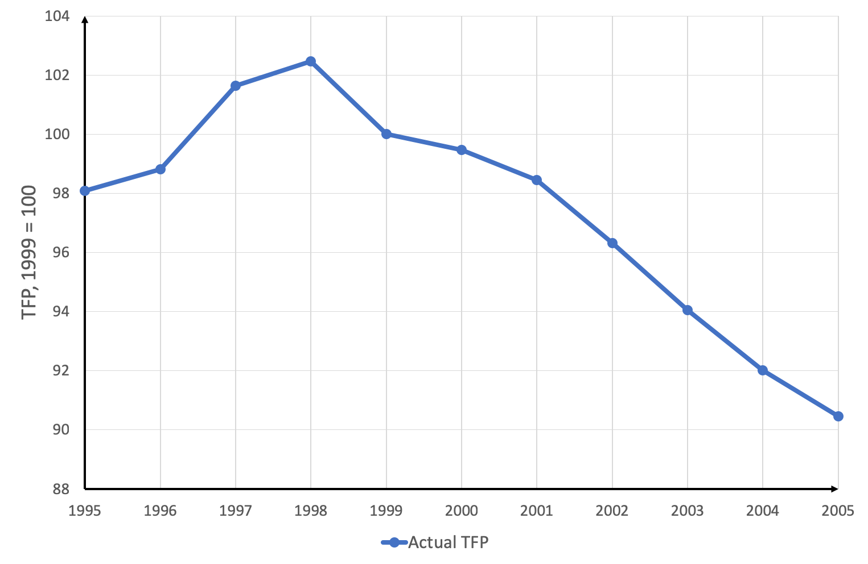
Actual TFP in Portugal
The blue line is actual TFP
Post 1999 it falls
Seemed puzzling: local firms now had capital from abroad to expand, conquer new markets
Same happened in Ireland, Spain, Italy.
Construction and real estate sectors boomed, wages rose.
But productivity fell.

Slide 19
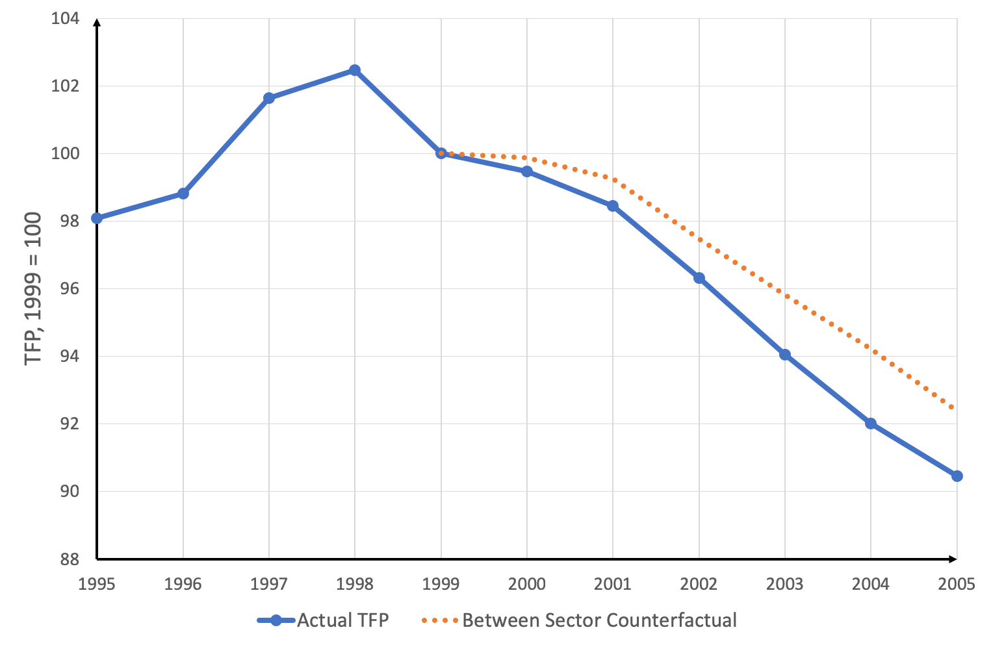
Actual and counterfactual TFP in Portugal
Orange line fixes the relative size of each economic sector at its 1999 level to build a counterfactual TFP
Eliminate possible between-sector misallocation.
Explains some of the decline.

Slide 20
Actual and counterfactual TFP in Portugal
As well as fixing the relative size, the grey line shows the TFP counterfactual if misallocation within sectors also remained at their 1999 levels
Eliminate possible between and within-sector misallocation.
Explains about half the decline
Portugal’s slump in productivity can be partly explained by capital misallocation after the euro in 1999

Slide 21
More euro-area data
Further illustration of this at work in euroarea 2000-07
Capital inflows core periphery
Cross-sector changes in Portugal and others
Dispersion of manufacturing productivity in Spain
The rise in productivity in Spain during the crisis

Slide 22
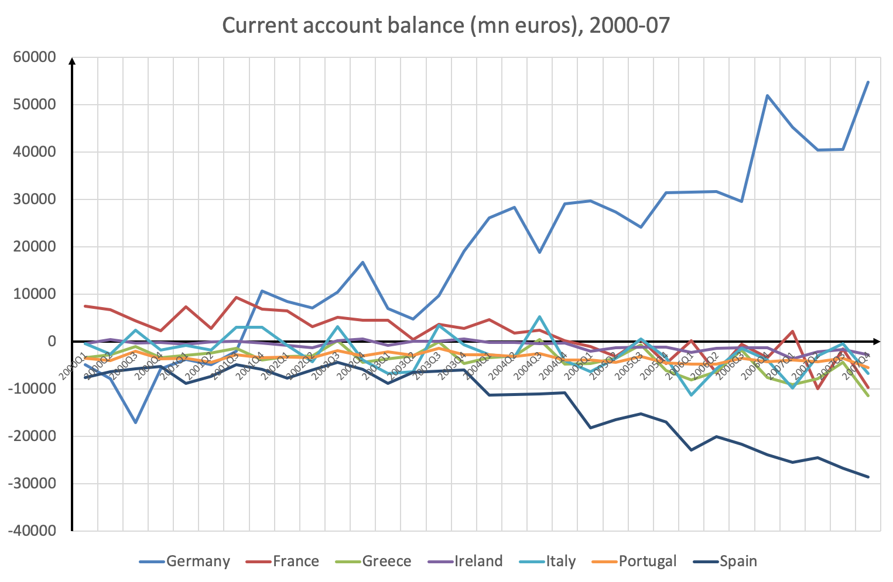
Capital flowing from core to periphery

Slide 23
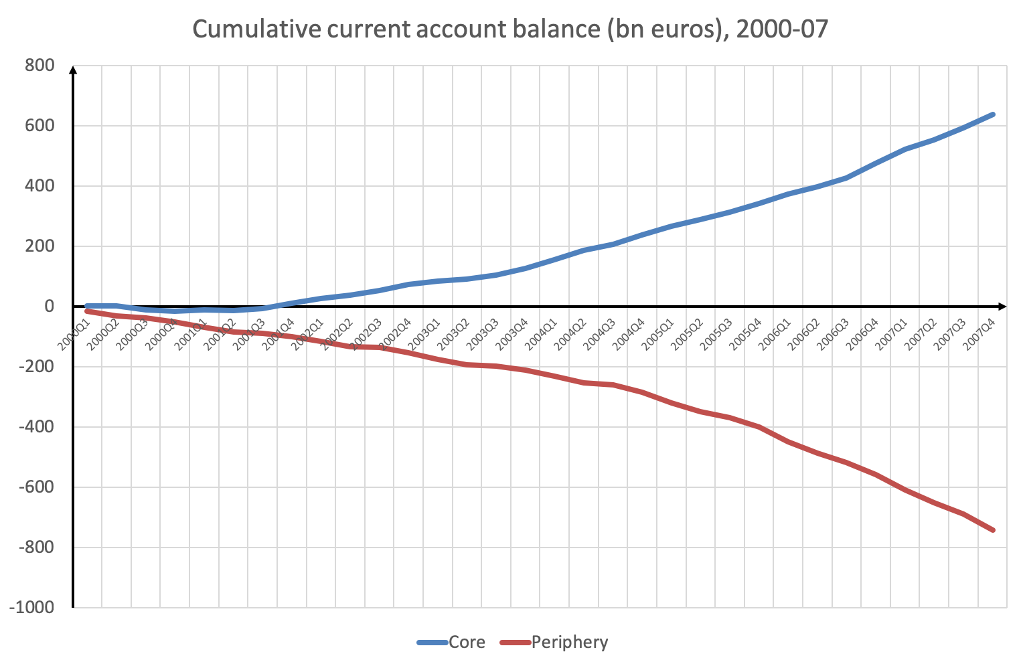
Capital flowing from core to periphery

Slide 24
Current account balances as ratio of GDP
Source: Reis, R. (2012) ”Comment” Brookings Papers on Economic Activity

Slide 25
Total Factor Productivity After Inflows
Source: Dias, C, C Marque and C Richmond (2016) ”Misallocation and productivity in the lead up to the Eurozone crisis”, Journal of Macroeconomics

Slide 26
Across-sector reallocation in Portugal
Source: Reis, R (2013) ”The Portuguese Slump and Crash and the Euro Crisis”, Brookings Papers on Economic Activity.

Slide 27
Across-sector productivity and markups
Source: Reis, R (2013) ”The Portuguese Slump and Crash and the Euro Crisis”, Brookings Papers on Economic Activity.

Slide 28
Across-sector reallocation in Spain
Source: Chen, T (2018) ”TFP declines: misallocation or mismeasurement” Columbia University manuscript.

Slide 29
Across-sector reallocation in periphery countries
Source: Chen, T (2018) ”TFP declines: misallocation or mismeasurement” Columbia University manuscript.

Slide 30
Within-sector reallocation, Spain manufacturing
Source: Gopinath, G, S Kalemli-Ozcan, L Karabarbounis, C Villegas-Sanchez (2018) ”xxx” Quarterly Journal of Economics

Slide 31
Within-sector reallocation, Spain manufacturing
Source: Gopinath, G, S Kalemli-Ozcan, L Karabarbounis, C Villegas-Sanchez (2018) ”xxx” Quarterly Journal of Economics

Slide 32
In crisis, TFP actually rises.
Source: Castillo-Martinez, L. (2018) ”Sudden Stops, Productivity and the Exchnage Rate” LSE manuscript

Slide 33
Within-sector reallocation, Spain manufacturing
Source: Castillo-Martinez, L. (2018) ”Sudden Stops, Productivity and the Exchange Rate” LSE manuscript

Slide 34
Loss of competitiveness of T sector
Source: Reis, R. (2012) ”Comment” Brookings Papers on Economic Activity

Slide 35
Trade deficits in Portugal
Source: Reis, R (2013) ”The Portuguese Slump and Crash and the Euro Crisis”, Brookings Papers on Economic Activity.

Slide 36
Summary
A modern view of capital flows shows how investment booms can actually lower productivity
This leads to capital misallocation in poorer countries as their financial markets lack financial depth
We looked at two types of misallocation: between and within sectors
Productivity slumps accounted for by misallocating capital
This raised the costs of firms in tradable sectors, reducing their international competitiveness and leading to trade deficits

