Slide 1

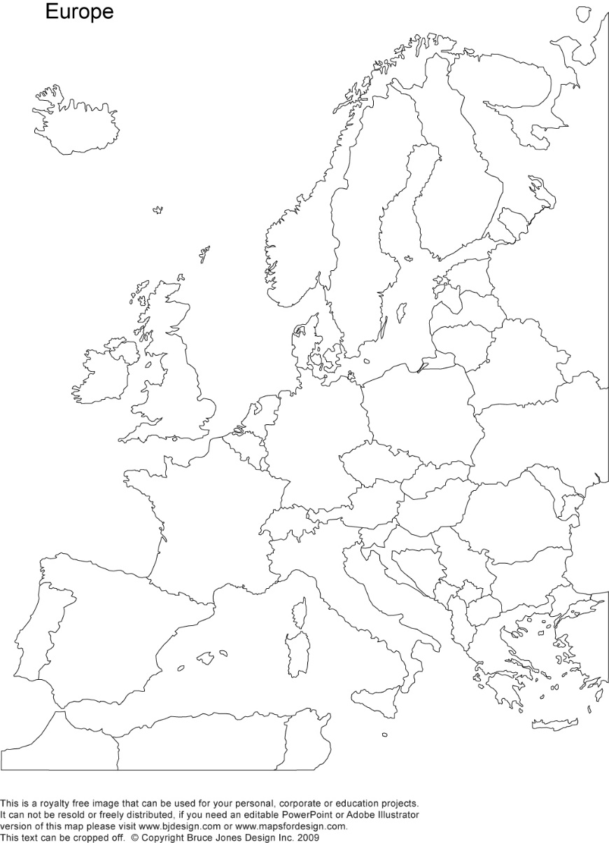
A crash-course on the euro crisis
Markus K. Brunnermeier & Ricardo Reis

Slide 2

The financial crash and systemic risk
Section 4

Slide 3

Strategic complementarities, amplification, multiplicity, and pecuniary externalities
Modern financial markets depend critically on how each individual market participant reacts to the behaviour of others
The combination of capital misallocation, reliance on wholesale funding and the rise of modern banks has led to a financial system that is prone to instability
Adverse feedback loops amplify initial exogenous shocks so seemingly small events can have large changes in credit and asset prices
If these amplifying forces are sufficiently strong, multiple equilibria can arise such that the system self-generates systemic risk

Slide 4
A model of strategic interactions
Choices of one bank as a function of the choices of others
Best response functions for lending
Traditional bank decreases lending whenever others increase their average lending: there are fewer good projects needing financing.
BR curve is downward sloping
Actions are strategic substitutes
Individual bank’s
lending choice
All other banks’
lending choice

Slide 5
Equilibrium
For simplicity, assume all other banks’ lending choice is identical
At O, the individual bank’s BR coincides with the market BR, at the 45º line as all identical
There is an equilibrium in that every single participant chooses to do what the group is also doing
Individual bank’s
lending choice
O
45º
All other banks’
lending choice

Slide 6
After a shock
Shock: banks become better aware of risks or investors give less funding.
Cut lending.
Shift the BR curve downwards
Others cut lending (45º line)
Individual bank’s
lending choice
O
shock
45º
shock
All other banks’
lending choice

Slide 7
After a shock
But now individual bank wants to lend more.
Get attenuation of initial shock
Cobweb: then want to lower, then want to raise it, and so on…
Equilibrium moves from O to H
Both O and H are stable equilibriums and shocks only lead to moderate changes due to attenuation
Individual bank’s
lending choice
O
H
shock
attenuation
45º
shock
All other banks’
lending choice

Slide 8
Modern banks: upward sloping BR curve
Due to rapid growth, modern banks are under-capitalized so their leverage ratio is already at the regulatory limit.
Hence, falls in their tradable asset prices causes them to shrink their balance sheets by shedding assets
When the entire financial sector is selling assets simultaneously, there is little market liquidity. Fire sales
Since each bank anticipates that all other banks will be selling, each will have an incentive to sell first causing fast drops in asset prices
Individual bank’s
lending choice
O
45º
All other banks’
lending choice

Slide 9
Modern banks: upward sloping BR curve
Low asset prices reduce funding liquidity due to two spirals
A losses spiral, where decreases in collateral value lead to cuts in funding and loans
A margins spiral, where a fall in collateral value causes lenders to raise margins in anticipation of a fire sale
These two spirals mean that when average actions increase, the participant chooses a more aggressive action. Actions are now strategic complements
Individual bank’s
lending choice
O
45º
All other banks’
lending choice

Slide 10
Shock with modern banks
At equilibrium O the difference between a downward and upward sloping BR curve is not immediately apparently.
The initial shock shifts the BR down by the same vertical distance
Yet, in a modern system the equilibrium becomes unstable in the presence of a shock
Individual bank’s
lending choice
O
H
shock
45º
shock
All other banks’
lending choice

Slide 11
Amplification and liquidity spirals
Now when one bank cuts lending, the others want to cut lending further.
Leads to further cuts, and so on
Since all the banks’ actions are now strategic complements, it leads to amplification of the initial shock
Equilibrium is now lower at L
Individual bank’s
lending choice
O
H
shock
L
amplification
45º
shock
All other banks’
lending choice

Slide 12
Multiple equilibrium
Shifts in beliefs can lead to a new (stable) equilibrium at a much lower point D
If banks believe that others will cut lending, then they anticipate fire sales and price drops, and the losses and margins spirals
They will cut lending beforehand due to anticipation and thus triggering the depressed-lending equilibrium
Hence, there is multiplicity of equilibrium
Individual bank’s
lending choice
O
H
shock
L
D
multiplicity
amplification
45º
shock
All other banks’
lending choice

Slide 13

Pecuniary externalities and systemic risk
When banks sell assets they exert a pecuniary externality by pushing asset prices down and causing losses of other banks
While strategic complementarities lead to amplification and multiplicity, externalities lead to systemic risk
Losses in some financial institutions can lead to losses across the whole financial system
Systemic crises spread to the real economy through a general-equilibrium propagation of the initial shock

Slide 14
Systemic risk in the Irish banking sector
Summer of 2007: news of bad loans in the US subprime market triggered losses in American investments of some core European banks
This led these banks to cut back on interbank lending as well as their repo purchases of securitized mortgages from the periphery
At the same time, US money market funds, which have rolling over repos to European banks for years, withdrew from this market between 2007-2008 due to the growing US financial crisis
These two forces combined led to a negative shock to the supply of funds in the wholesale and repo markets for bank funding
Irish banks were particularly reliant on this foreign wholesale funding and had also invested in American securities
The shock to funds triggered fire sales and liquidity spirals that led to large falls in lending and house prices
Large losses spilled over to the real economy leading to a systemic banking crisis. The general-equilibrium propagation and the paradox of prudence led to a deep recession in Ireland
Over the previous decade, they had transitioned from traditional to modern banks supplying abundant credit to real estate

Slide 15
Individual risk and systemic risk
Value-at-risk (VaR)
Measures how individually risky a bank is
Calculate the size of the losses in the value of its equity in the worst 5% of the weeks during a two-year period.
∆CoVaR
Measures systemic risk of banking sector
Calculate by how much the value at risk of the banking sector changes when one particular bank is under distress.

Slide 16
The transition from traditional to modern banking in Ireland increased the VaR in 2 of the major banks. ∆CoVaR increased in all 3 banks. And see how positively associated they are

Slide 17
Irish banks and housing
Strategic complementarities amplified the financial shock from abroad causing credit to construction and housing sectors to fall by 48% between 2008-2010
Propagation to the real economy led to a fall in residential property prices in Dublin of 35%
By early 2009, the private equity of all 3 banks had been almost wiped out

Slide 18
What can policy do?
To attenuate the amplification if the externalities involved are large.
Central bank lending to banks. Requires collateral
Government bail out banks through loans or recapitalizations that more or less explicitly nationalize the banks. Requires trust that banks remain economically solvent.

Slide 19
More euro-area data
Credit boom as all banks lend more
House prices rise and fall quickly

Slide 20
The credit boom in Spain
Source: Santos, T. (2012) The Spanish Banking Crisis

Slide 21
House prices in Spain
Source: Santos, T. (2012) The Spanish Banking Crisis

Slide 22
House prices in periphery
Source: Baldwin Giavazzi (2015) “The Eurozone Crisis: A Consensus View of the Causes and a Few Possible Remedies” CEPR Press

Slide 23
Credit boom
Source: Meghir, Pissarides, Vayanos, Vettas (201x) Beyond Austerity: Reforming the Greek Economy, MIT Press

Slide 24
Run on Greek deposits
Source: Meghir, Pissarides, Vayanos, Vettas (201x) Beyond Austerity: Reforming the Greek Economy, MIT Press

Slide 25
Bad loans and fire sales
Source: Meghir, Pissarides, Vayanos, Vettas (201x) Beyond Austerity: Reforming the Greek Economy, MIT Press

Slide 26
Summary
The actions of traditional banks are strategic substitutes with a downwards sloping BR curve. Hence, there is attenuation after an initial shock to the financial system
Modern banks, on the other hand, have upwards sloping BR curves. Fire sales and liquidity spirals cause their lending choices to be strategic complements
Multiplicity can move the economy to a stable depressed-lending equilibrium
The Irish banking sector is an example of systemic risk where the crisis spilled over into the real economy through a general-equilibrium propagation of the initial shock
This led to large falls in Ireland’s lending and house prices and causing a deep recession

