Slide 1
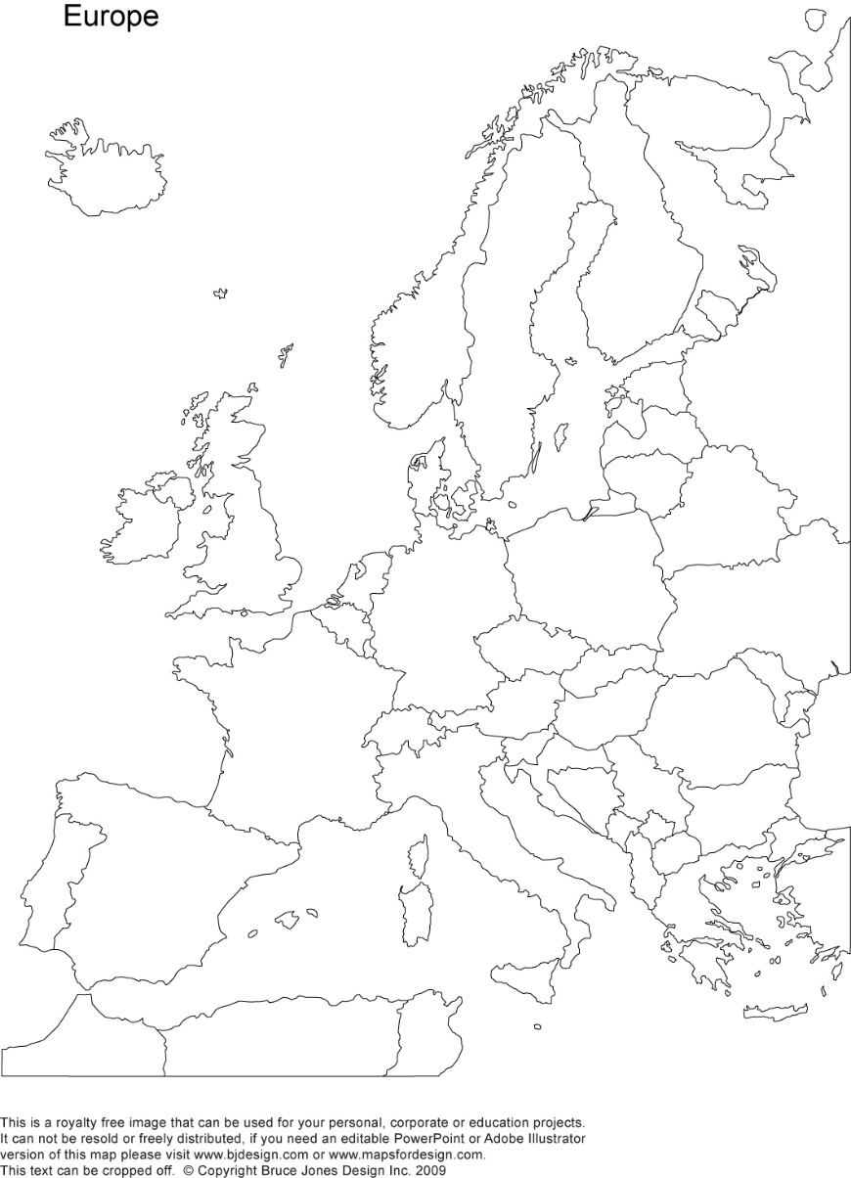
A crash-course on the euro crisis
Markus K. Brunnermeier & Ricardo Reis

Slide 2
Solvency versus Liquidity
Section 5

Slide 3
Debt and the challenging illiquidity-insolvency distinction
Debt contracts: allow lenders to exert some discipline on borrowers because they must be rolled over with some frequency, and they save the lender the need to collect information on the exact payoffs of the borrower beyond their ability to meet the payments.
Solvency: whether the debtor has revenues in the present and in the future with which to repay the debt
Modern banks: high leverage means may have negative equity and so appear insolvent, but remain economically solvent by relying on future revenues to pay for the present debts
Sovereigns: only economic solvency is relevant as future tax and other fiscal revenues can be used to gradually pay down public debt.

Slide 4
Solvency and the interest rate
Solvency: whether the debtor has revenues in the present and in the future with which to repay the debt
The interest rate used to discount future cash flows is tightly associated on evaluating solvency
An economic institution with future revenues and debt will be insolvent for a high enough interest rate
With perfect and complete markets, there is a single interest rate which is relevant to determine solvency

Slide 5
Financial frictions and illiquidity
In the presence of financial frictions, there may be multiple interest rates consistent with the institution being solvent
For some interest rates, the institution can keep to its repayment schedule but for some others it does not have enough to pay the interest. Hence, they are solvent but illiquid
Interest rate spikes, in spite of unchanged fundamentals, can prevent institution from being able to roll over and keep servicing their debt.
The key diagnosis of a crisis is being able to distinguish between an insolvent and an illiquid institution

Slide 6
A simple model of debt, solvency and liquidity
Institution needs q to finance a project with a future payoff of z
The net return is then z/q – 1
However, z is uncertain. Take any valiue between 0 and 1.
Expected value is 1/2 and the expected return is 1/2q – 1
With perfect markets, as long as the interest rate charged is below 1/2q – 1 then the institution is solvent
$$z$$
0
1

Slide 7
A simple model of debt, solvency and liquidity
Debt contract: creditor gives q today, gets F in the future
If z > F, then repayment. Only F is paid and the rest is kept as profits
If z < F, then default. Creditor seizes all of z.
Promised payment
at t = 2
$$F$$
$$F_{low}$$
$45$°
$$z$$
0
1
Default $z<F_{low}$
Repayment of $F_{low}$

Slide 8
Expected payment of debt
If the promised payment is $F_{low}$ the payoff if the solid blue line
When z < $F_{low}$, the payoff is the 45$°$ line as the debt-holders get paid the whole residual value of the project, which is below what was promised
If z > $F_{low}$, then the payoff is the horizontal blue line
The expected payment is $\left(1−F\right)F+\frac{F^{2}}{2}$, or the sum of the shaded rectangle plus the triangle on its left
Promised payment
at t = 2
$$F$$
$$F_{low}$$
$$z$$
0
1
Cash flow
at t = 2
Default $z<F_{low}$
Repayment of $F_{low}$

Slide 9
Face value and expected payoff
Higher face value of debt
For $F_{high}$ the payoff is the solid purple line
Payment is higher when get paid
But get paid less often since default probability is greater
Expected payment rises with face value.
Maximum at F=1, expected payment ½ (In this extreme case, debtholder becomes de facto a equity holder)
Promised payment
at t = 2
$$F$$
$$F_{high}$$
$$F_{low}$$
$45$°
$$z$$
0
1
Default $z<F_{low}$
Repayment of $F_{low}$
Default $z<F_{high}$
Repayment of $F_{high}$

Slide 10
Financial frictions
When a firm defaults, value is lost in that some of the payoff from the project disappears
A creditor seizing the asset cannot generate as much cash flow as the entrepreneur.
Insolvency is a costly process:
Lawyers
Bankruptcy court fees
Disgruntled borrowers tearing down the project before it is seized

Slide 11
Financial frictions
Consider the extreme example where triggering default always leads to losing the whole value of the project.
Now when $z<F$ both lender and borrower receive nothing.
Expected payoff is given by only the shaded rectangles $\left(1−F\right)F$
Both debt contracts now have the same expected payoff
Extreme contract with F=1 is worthless since always default.
$$F$$
$$F_{high}$$
$$F_{low}$$
$45$°
$$z$$
0
1
Cash flow
at t = 2
Default $z<F_{low}$
Repayment of $F_{low}$
Default $z<F_{high}$
Repayment of $F_{high}$

Slide 12
Plot now borrowing (q) against debt (F)
Without financial frictions first
Higher F, more expected payoff, can borrow more.
(For simplicity assume that creditors discount future at rate 0, so expected payoff and amount borrowed are the same.)
For amount of borrowing q’
F/q’ is the yield on the debt, so interest rate is slope of ray from the origin
Without frictions, as long as q’<1/2, institution is solvent
$$F$$
Without frictions
$$1$$
$$1+i$$
1/2
q
$$q′$$
Borrowing
at t = 1

Slide 13
With financial frictions
Now have a parabola. The institution is insolvent if it needs to borrow more than 1/4.
Promised payment
at t = 2
With frictions
$$F$$
$$F$$
$$F_{high}$$
$$1/2$$
$$F_{low}$$
$45$°
$$z$$
q
0
1
Cash flow
at t = 2
1/4
Borrowing
at t = 1
Default $z<F_{low}$
Repayment of $F_{low}$
Default $z<F_{high}$
Repayment of $F_{high}$

Slide 14
Liquidity crisis
If the interest rate is low at $i_{low}$ then by promising to pay $F_{low}$ the institution can obtain q’
If the interest rate is at $i_{high}$ then it can still finance itself by promising $x_{high}$
Can enter a liquidity crisis
Investors think the risk of default is high and thus require a higher interest rate to compensate them for lending
The institution then promises a higher payoff which also has a higher probability of default
With frictions
$$F$$
$$1+i_{high}$$
$$1+i_{low}$$
q
$$q′$$
Borrowing
at t = 1

Slide 15
Losses from insolvency
The borrower (and society) is worse off with higher interest rates as it is more likely for the social costs of default to materialize
Horizontal difference between the green and orange curve in the second figure is equal to area of triangles lost in previous figure
Measures the expected costs of default
Higher with $i_{high}$
$$F$$
Without frictions
Loss
$$1+i_{high}$$
$$1+i_{low}$$
Loss
q
$$q′$$
1/4
Borrowing
at t = 1

Slide 16
Full analysis
Promised payment
at t = 2
With frictions
$$F$$
$$F$$
$$1+i_{high}$$
$$F_{high}$$
Without frictions
$$1/2$$
$$F_{low}$$
$$1+i_{low}$$
$45$°
$$z$$
q
0
1
Cash flow
at t = 2
$$q′$$
1/4
Borrowing
at t = 1
Default $z<F_{low}$
Repayment of $F_{low}$
Default $z<F_{high}$
Repayment of $F_{high}$

Slide 17
The solvency of sovereigns and the IMF
Solvency is hard to ascertain for countries since it depends on fiscal surpluses and commitment of politicians to pay their debts.
Countries are therefore prone to liquidity crises as hard to ascertain where curve is, or what is causing rise in interest rates.
A small negative shock can push a country to insolvency if it was already close to the peak and thus justifying charging a higher interest rate
But also shifts in market sentiments or beliefs can move the economy to high-interest rate equilibrium, thus raising the default probability
Sovereign default comes with great social costs
A commitment from a foreign institution like the IMF to lend at a fixed rate can be enough to eliminate the crisis and remain on the good equilibrium

Slide 18
The Greek sovereign debt crisis
In 2009, Greece admitted to have been under-reporting their level of public debt and deficits
The perceived capacity of the Greek government to pay its debts is now lower, and this publicity triggered a revision in the beliefs of the creditors
In 2010, the 10-year Greek sovereign debt was 4.5%. By 2012, it was 26%.

Slide 19
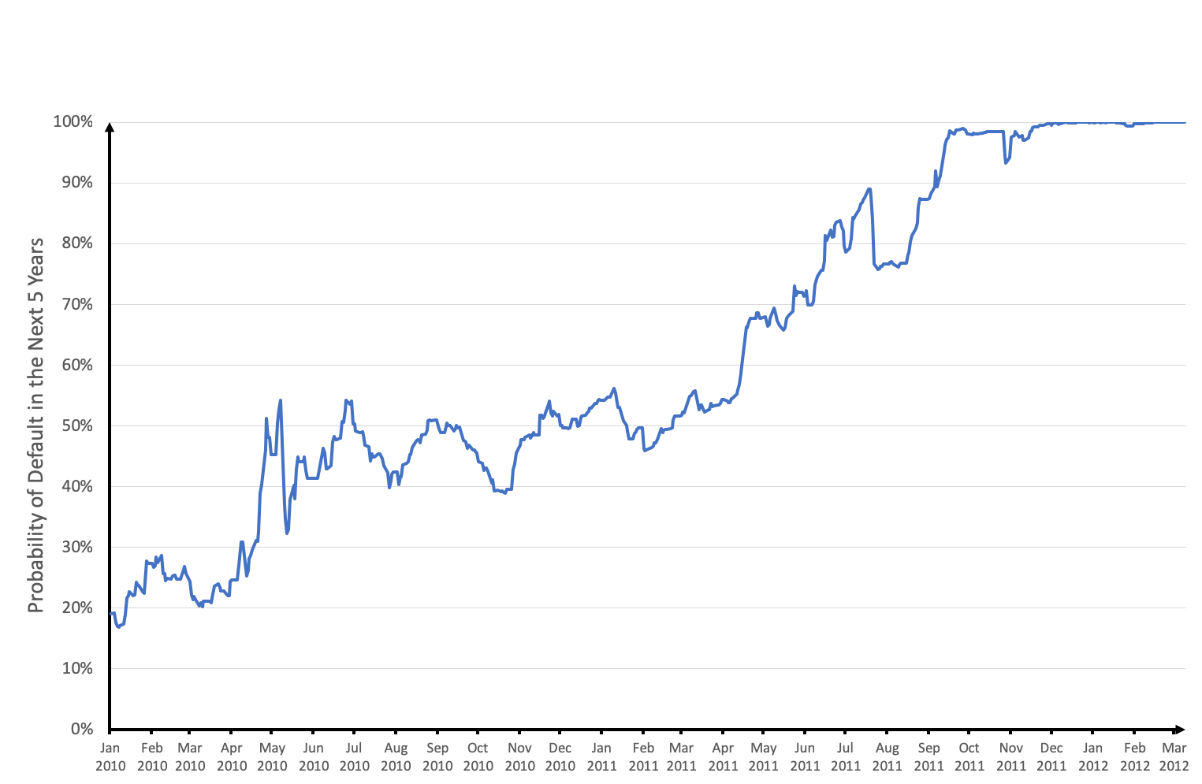
The perceived insolvency probability of Greek sovereign bonds

Slide 20
The Greek sovereign debt crisis
In 2009, Greece admitted to have been under-reporting their level of public debt and deficits
The perceived capacity of the Greek government to pay its debts is now lower, and this publicity triggered a revision in the beliefs of the creditors
In 2010, the 10-year Greek sovereign debt was 4.5%. By 2012, it was 26%.
In 2010, the IMF and EU announced a 3-year rescue package as well as the creation of the EFSF and SMP
Consequently, interest rates fell, consistent with the policies eliminating the bad equilibrium
But perceptions of insolvency remained high. When Greek bonds were downgraded to “junk” status in 2011, the default probability reached 70%
In February 2012, Greece defaulted on its bonds and creditors took a haircut of 64.6% on €177 bn worth of bonds
In hindsight, Greece may have been insolvent from the start.

Slide 21
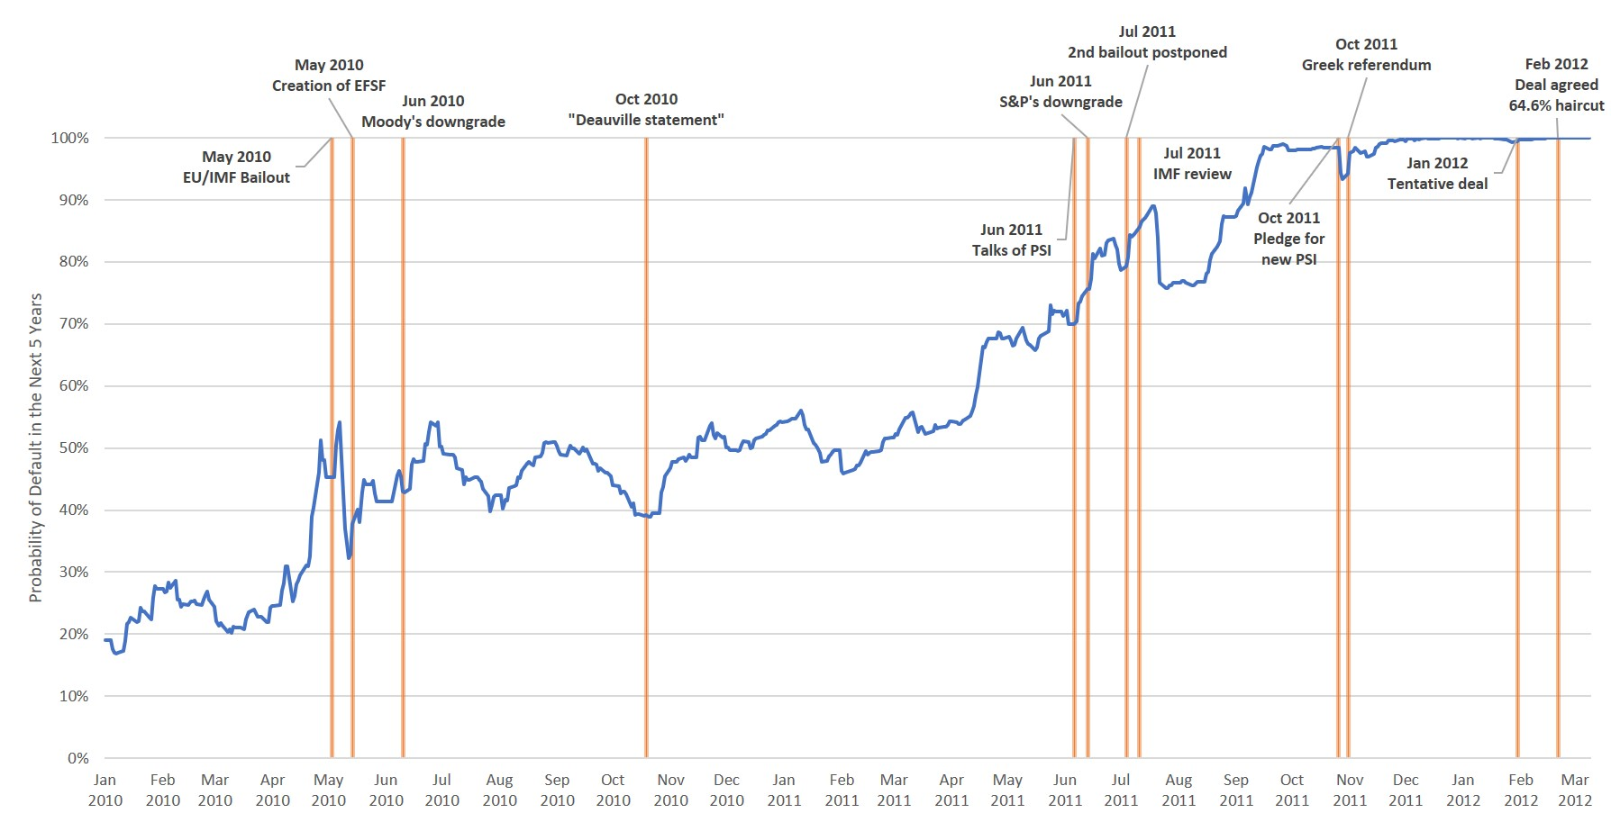
The perceived insolvency probability of Greek sovereign bonds

Slide 22
Insolvency and illiquidity in practice
At the same time, similar capital flows and spikes in interest rates happened in Italy, Portugal, and Spain.
None of them defaulted on their debt and, after only a few years of public capital inflows, they were able to return to relatively lower interest rates.
Were they solvent but illiquid, unlike Greece?
Maybe but, at the start of 2010, in comparison to Greece, Portugal had twice as high net external debt, Italy’s GDP per capita had grown 45% less in the previous ten years, and Spain’s banks were in worse shape.
The more general lesson is that in real time, distinguishing insolvency and illiquidity is an almost-impossible task.

Slide 23
Summary
With perfect and complete markets, there is a single interest rate which is relevant to determine solvency
However, with financial frictions, there may be multiple interest rates consistent with the institution remaining solvent
A change of beliefs, causing a move from the low to high-interest rate equilibrium, can cause a liquidity crisis
It is difficult to distinguish whether an institution is insolvent or just illiquid
Greece appeared to be illiquid and thus spurring the IMF and EU to intervene with rescue packages when it indeed does default in 2012

