Slide 1

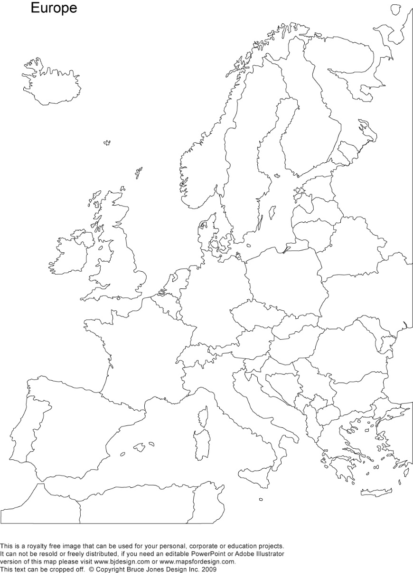
A crash-course on the euro crisis
Markus K. Brunnermeier & Ricardo Reis

Slide 2

The nexus between the private and public sectors
Section 6

Slide 3
Why banks hold government debt?
Regulation forces banks to hold a fraction of their assets in safe securities. Government debt is treated as riskless and when the probability of default is high, the interest rate is higher and therefore becomes an attractive investment
01
By holding government bonds as assets, banks will have access to central bank liquidity. They do this especially during fiscal crises, exchanging risky government bonds for safe deposits at a central bank
02
In public debt markets, banks buy bonds first after public issuance and then resell them over time. Banks are the primary dealers of government bonds and often take time to find buyers
03
The government must find buyers for its risky debt and thus uses "moral suasion" to pressure banks into buying their bonds beyond their risk-return
04

Slide 4

The diabolic loop
This concentration of national bonds held by national banks and government guarantees to banks creates a diabolic loop
Consider a liquidity crisis causing investors to raise their perceived risk of default on government bonds
This rise in the interest rate of new bonds means that the old bonds are now worth less
This loss gets amplified by the liquidity spirals and thus leading to further cuts in lending
Less lending lowers economic activity which lowers tax revenues and raises spending through automatic stabilisers
Government finances deteriorate whilst bank equity drops and thus raising the likelihood of triggering government guarantees

Slide 5
Diabolic loop between sovereign risk and financial risk

Slide 6
European banks and their sovereigns
In Europe, banks were more likely to hold national sovereign bonds across all four motives
These sovereign bonds were treated as fully safe by regulators throughout the crisis even if the country was near insolvency
In the absence of a euro-wide safe bond, the ECB accepted sovereign bonds of every country in exchange for reserves
Public debt markets were not very liquid and relied heavily on banks as primary dealers
Banks were often very large, with assets crossing borders, such that their sovereign committing to bail them out was not credible
The diabolic loop was therefore particularly acute during the European crisis

Slide 7
Sovereign and banks CDS spreads
This figure measures default risk for Irish and Greek sovereigns and banks
Large Irish banks suffered losses in 2007-2008 due to losses in the US sub-prime market which were amplified by funding spirals
In September 2008, Ireland issued a guarantee to banks worsening the diabolic loop
At the same time, Greece had trouble borrowing and Greek banks were large holders of Greek debt

Slide 8
Correlation between sovereign and bank risk
This figure plots the monthly averages of the default risk of banks against that of the sovereigns
The correlation is strong for Greece and Ireland
Italy in the more recent 2014-2017 is also included and despite having low default risk, the correlation is still high
The diabolic loop is an unsolved problem in the euro area

Slide 9
More euro-area data
On the diabolic loop
And the concentration of sovereign bonds in bank balance sheets

Slide 10
Sovereign holdings of banks
Source: Brunnermeier, Langfield, Pagano, Reis, Van Nieuwerburgh, Vayanos (2017) “ESBies: Safety in the Tranches”, Economic Policy

Slide 11
Sovereign holdings of banks
Source: Corsetti et al (2016)

Slide 12
One example of the diabolic loop at play

Slide 13
During crisis, diabolic loop gets worse
Source: Altavilla et al (2016)

Slide 14
During crisis, diabolic loop gets worse
Source: IMF report on Spain (2012)

Slide 15
Holders of Portuguese debt
Source: Reis (2015) “Gerir a Dívida Pública”

Slide 16
Summary
Due to the four reasons mentioned, banks are large holders of government debt
Combined with government guarantees to banks, this creates a diabolic loop
In a diabolic loop, a higher default risk leads to lower lending and thus worsening government finances and bank equity causing prices to fall further
This was particularly evident in the European crisis where sovereign risk and bank risk were strongly correlated

