Slide 1

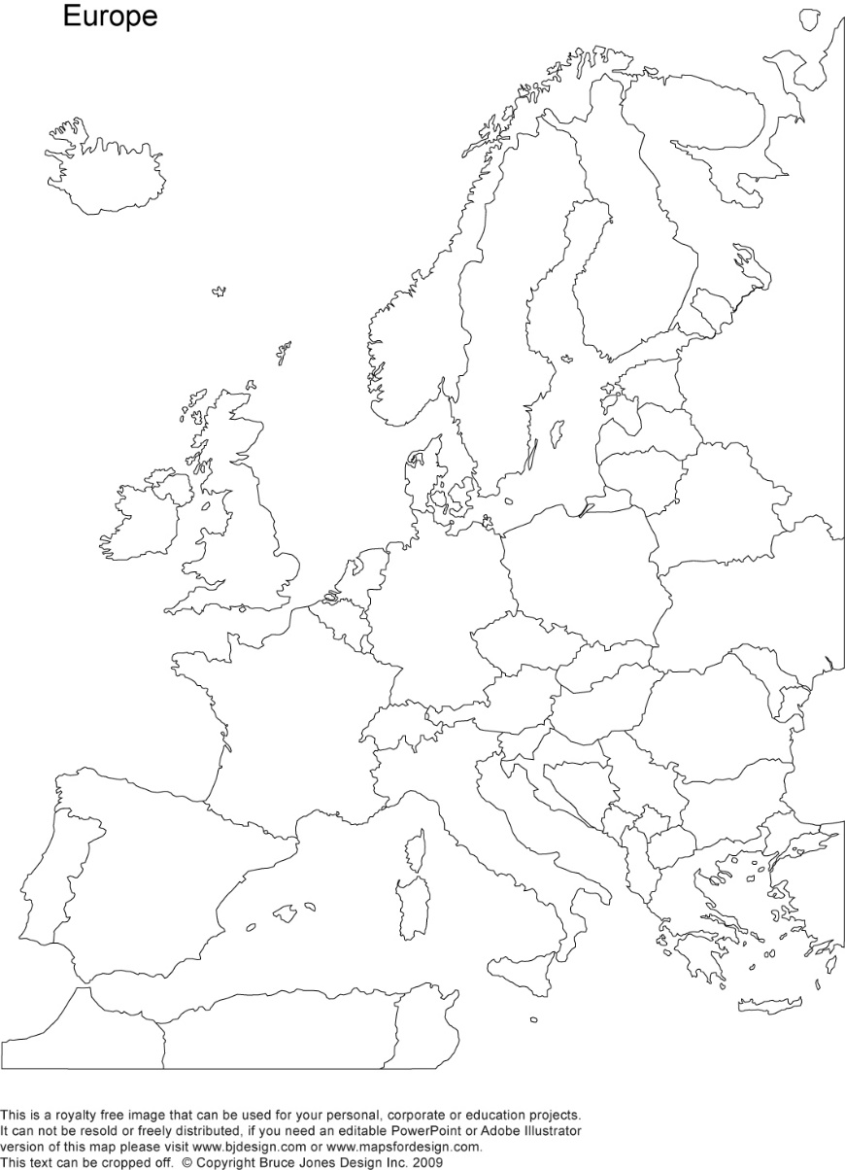
A crash-course on the euro crisis
Markus K. Brunnermeier & Ricardo Reis

Slide 2

Unconventional monetary policy
Section 8

Slide 3
From previous lectures, a central bank can help attenuate a crisis by:
Buying government bonds to shift beliefs and fight liquidity crises
Revert capital flows across regions using its balance sheet
Lending to banks to replace missing funding from wholesale interbank markets

Slide 4
Conventional central banking
Dual mandate: stabilize inflation and business cycle
If recession: lower interest rates, to spur aggregate demand, stabilizing output and inflation.
In recession driven by financial crises, answer appears to be the same
But policy tools are very different…

Slide 5

New central banking: reserve satiation and quantitative easing
Reserve satiation
Targeting long-term interest rates

Slide 6

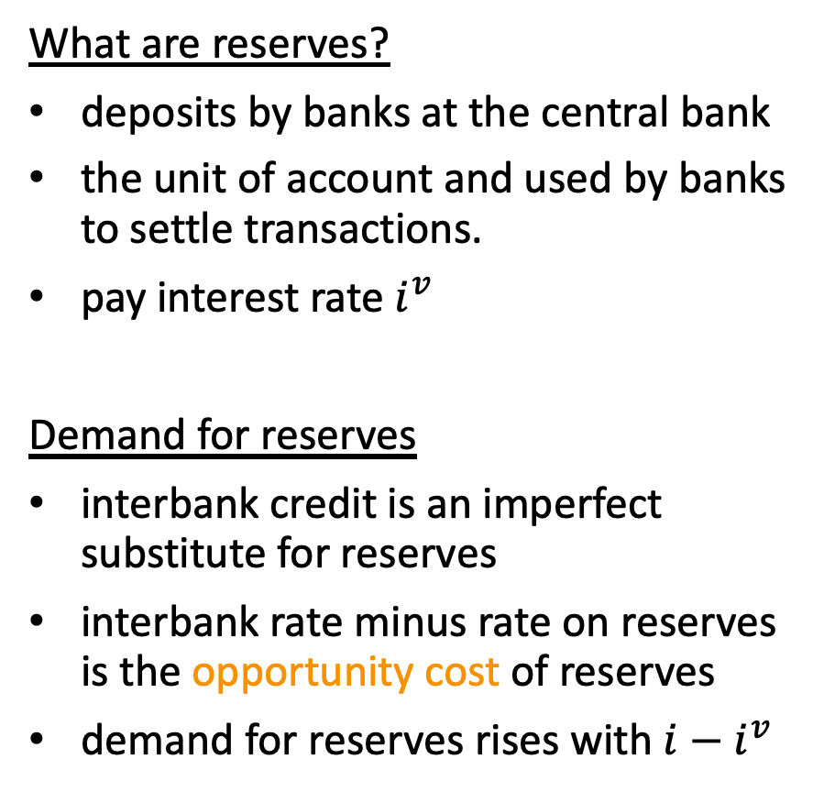

The market for reserves
What are reserves?
deposits by banks at the central bank
the unit of account and used by banks to settle transactions.
pay interest rate $i^{v}$
Demand for reserves
interbank credit is an imperfect substitute for reserves
interbank rate minus rate on reserves is the opportunity cost of reserves
demand for reserves rises with ${i−i}^{v}$
$$i$$
Demand
for reserves
by banks
$$iv$$
Quantity
of reserves

Slide 7


Controlling interest rates: conventional
Supply of reserves
controlled by central bank
vertical line, can shift to the right
$$i$$
Conventional
supply
$$i_{before}$$
A
Demand
for reserves
by banks
$$iv$$
Quantity
of reserves

Slide 8
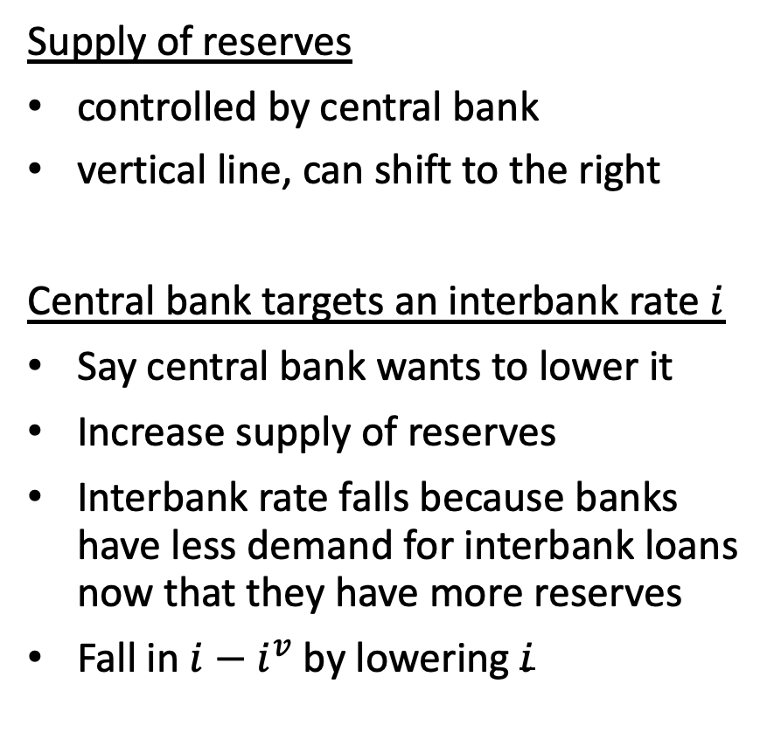

Controlling interest rates: conventional
Supply of reserves
controlled by central bank
vertical line, can shift to the right
Central bank targets an interbank rate $i$
Say central bank wants to lower it
Increase supply of reserves
Interbank rate falls because banks have less demand for interbank loans now that they have more reserves
Fall in ${i−i}^{v}$ by lowering $i$
$$i$$
Conventional
supply
$$i_{before}$$
A
$$i_{after}$$
B
Demand
for reserves
by banks
$$iv$$
Quantity
of reserves

Slide 9





Controlling interest rates: better option
$$i$$
Lower $i^{v}$.
Interest on reserves as the effective policy tool
Conventional
supply
A
$$i_{before}$$
$$i_{after}$$
B
Demand
for reserves
by banks
$$i_{before}^{v}$$
$$i_{after}^{v}$$
Quantity
of reserves

Slide 10

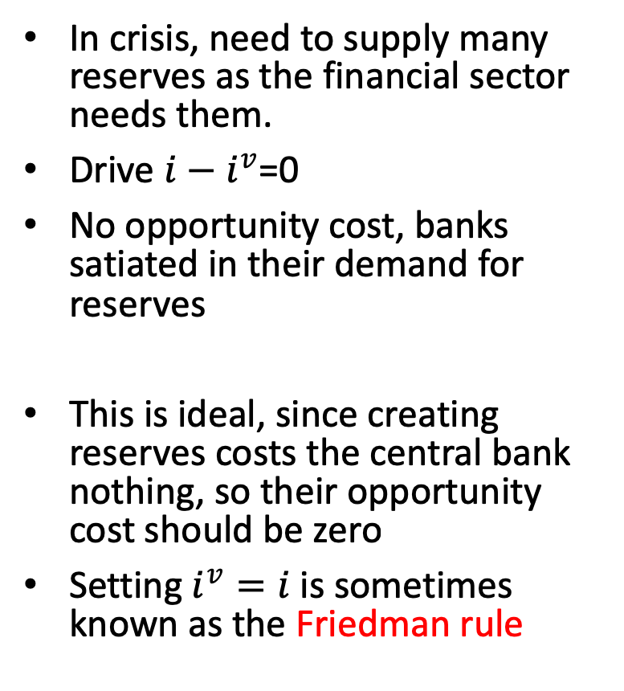

Reserve satiation
$$i$$
In crisis, need to supply many reserves as the financial sector needs them.
Drive ${i−i}^{v}$=0
No opportunity cost, banks satiated in their demand for reserves
This is ideal, since creating reserves costs the central bank nothing, so their opportunity cost should be zero
Setting $i^{v}=i$ is sometimes known as the Friedman rule
Conventional
supply
Supply in
response
to crisis
A
Demand
for reserves
by banks
B
$$iv$$
satiation
point
Quantity
of reserves

Slide 11
Targeting long-term interest rates
The interest on reserves is an overnight rate
During financial crises, it may not be enough to stimulate inflation and real activity by lowering the overnight rate to zero
For many investments and savings decisions, the relevant rates are those in months and years
Hence, central banks want to lower these long-term maturity interest rates in order to maximize stimulus
Unconventional monetary policy: going long

Slide 12

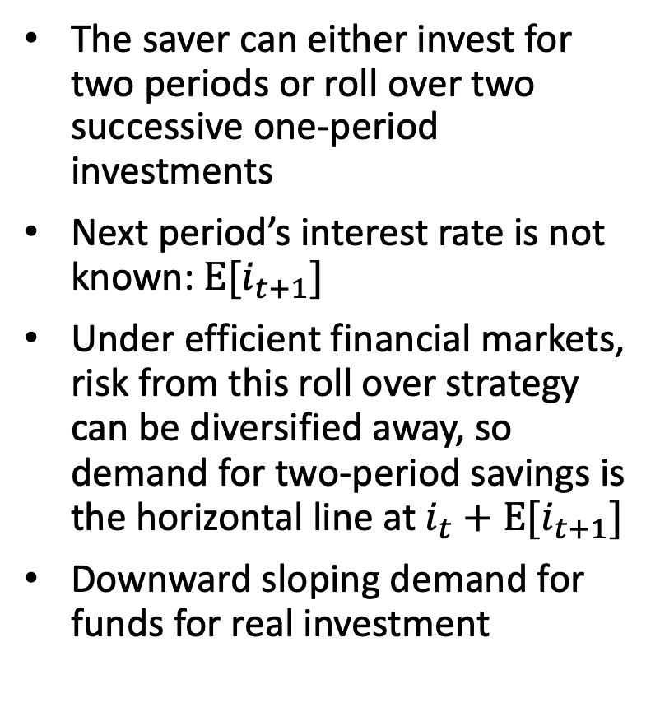
Model of savings and investment
$it$⁽²⁾
The saver can either invest for two periods or roll over two successive one-period investments
Next period’s interest rate is not known: $Ε[i_{t+1}]$
Under efficient financial markets, risk from this roll over strategy can be diversified away, so demand for two-period savings is the horizontal line at$i_{t}+Ε[i_{t+1}]$
Downward sloping demand for funds for real investment
Savings
A
i_{t}+E(i_{t+1})
Investment
Q_{before}
Quantity of
long-term
investment

Slide 13

Forward guidance
$it$⁽²⁾
Making announcements on future policy interest rates and committing to them
This lowers the Ε[𝑖_(𝑡+1)] perceived by investors.
Shifts the demand curve downwards
Increases investment, stimulates economy.
Savings
A
i_{t}+E(i_{t+1})
Forward
guidance
B
i_{t}+E(i_{t+1})
Savings
after policy
Investment
Q_{before}
Q_{after}
Quantity of
long-term
investment

Slide 14

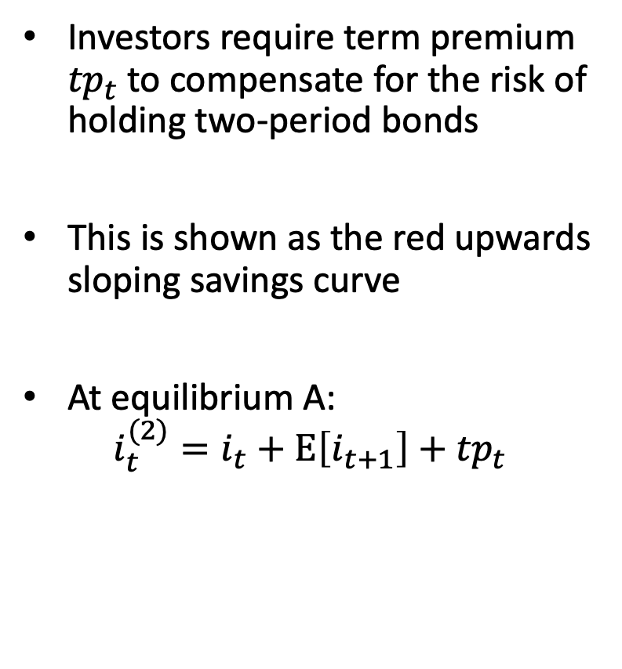
Imperfect financial markets
Investors require term premium ${tp}_{t}$ to compensate for the risk of holding two-period bonds
This is shown as the red upwards sloping savings curve
At equilibrium A:
${i_{t}^{(2)}=i}_{t}+Ε\left[i_{t+1}\right]+{tp}_{t}$
$it$⁽²⁾
Savings
A
i_{t}+E(i_{t+1})
Investment
Q_{before}
Quantity of
long-term
investment

Slide 15
Quantitative easing
Use newly issued reserves to buy government bonds of longer maturities
Increasing the demand for longer-maturity bonds
Raises their price and lowers the compensation for liquidity or risk and thus reduces 〖𝑡𝑝〗_𝑡
Combines with forward guidance, go to point B
Savings
Savings
after policy
A
Forward
guidance
+
Quantitative
easing
i_{t}+E(i_{t+1})
B
Forward
guidance
i_{t}+E(i_{t+1})
Investment
Q_{before}
Q_{after}
Quantity of
long-term
investment

Slide 16
Consequence of unconventional policy
Balance sheet of a central bank looks different
Reserve satiation requires it to grow, since reserves are liabilities of central bank
Quantitative easing requires it to develop a maturity mismatch between the overnight reserves in the liabilities side and the long-term bonds in the asset side.
One side effect:
Changes in i⁽²⁾−i now affect the net income flow earned or lost by central bank.
Central bank generates or loses significant resources
Fiscal support becomes more relevant, putting strains on the independence of the central bank.

Slide 17
The euro area yield curve during the crisis
In 2005, the yield curve is upward-sloping as the euro area is expanding at a regular pace and the opportunity cost of reserves is high
In 2008, the US financial crisis caused funding problems for European banks. The ECB responded by increasing the deposit rate from 1% to 3%
But it did little to its normal interest rate policy. Hence, the entire yield curve was just shifted upwards with little change in the slope
By 2010, the yield curve steepened as the ECB employed conventional tools by cutting short-term rates to boost stimulus
Due to the sovereign debt crisis in 2010, the ECB created the LTRO and signalled that future interest rates would remain low causing a parallel shift downwards by 2012
In 2012, the ECB announced the OMT program and explicitly pursued forward guidance by November 2013
From 2015 onwards, the ECB implemented large scale asset purchases and bought assets from across the euro area and thus flattening the yield curve
The ECB's balance sheet grew through the satiation of reserves from 1.2 trillion in 2007 to 4.5 trillion by 2017

Slide 18
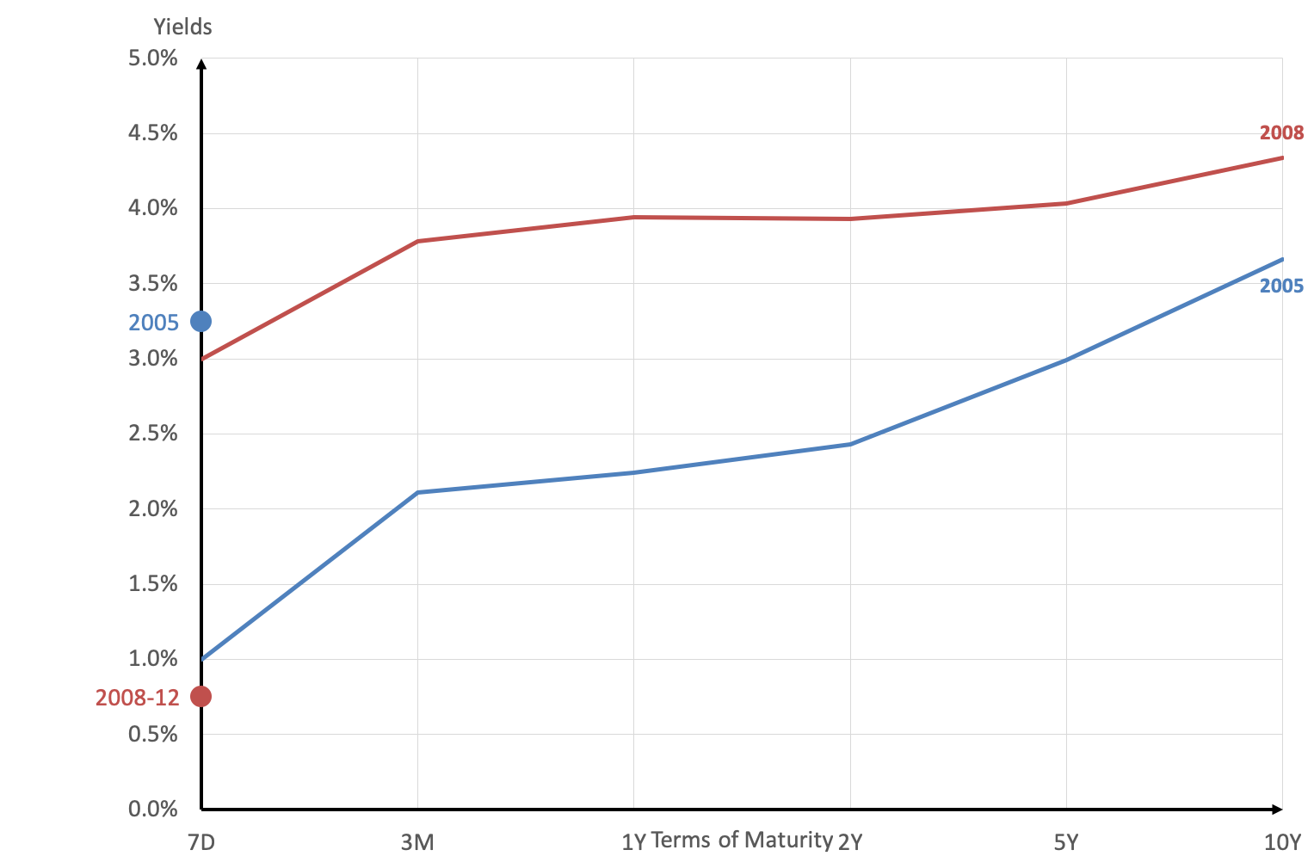
The euro area yield curve

Slide 19
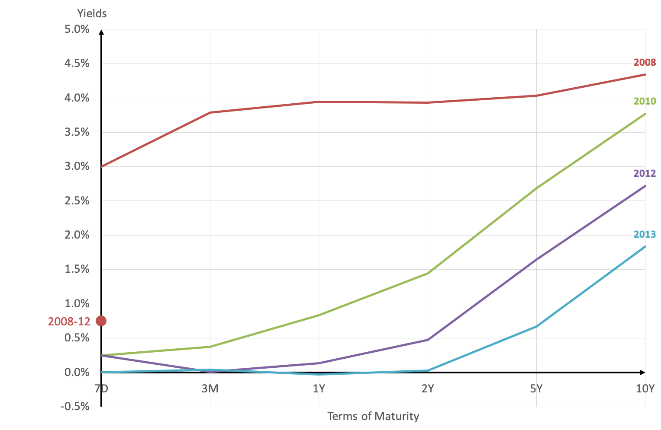
The euro area yield curve

Slide 20
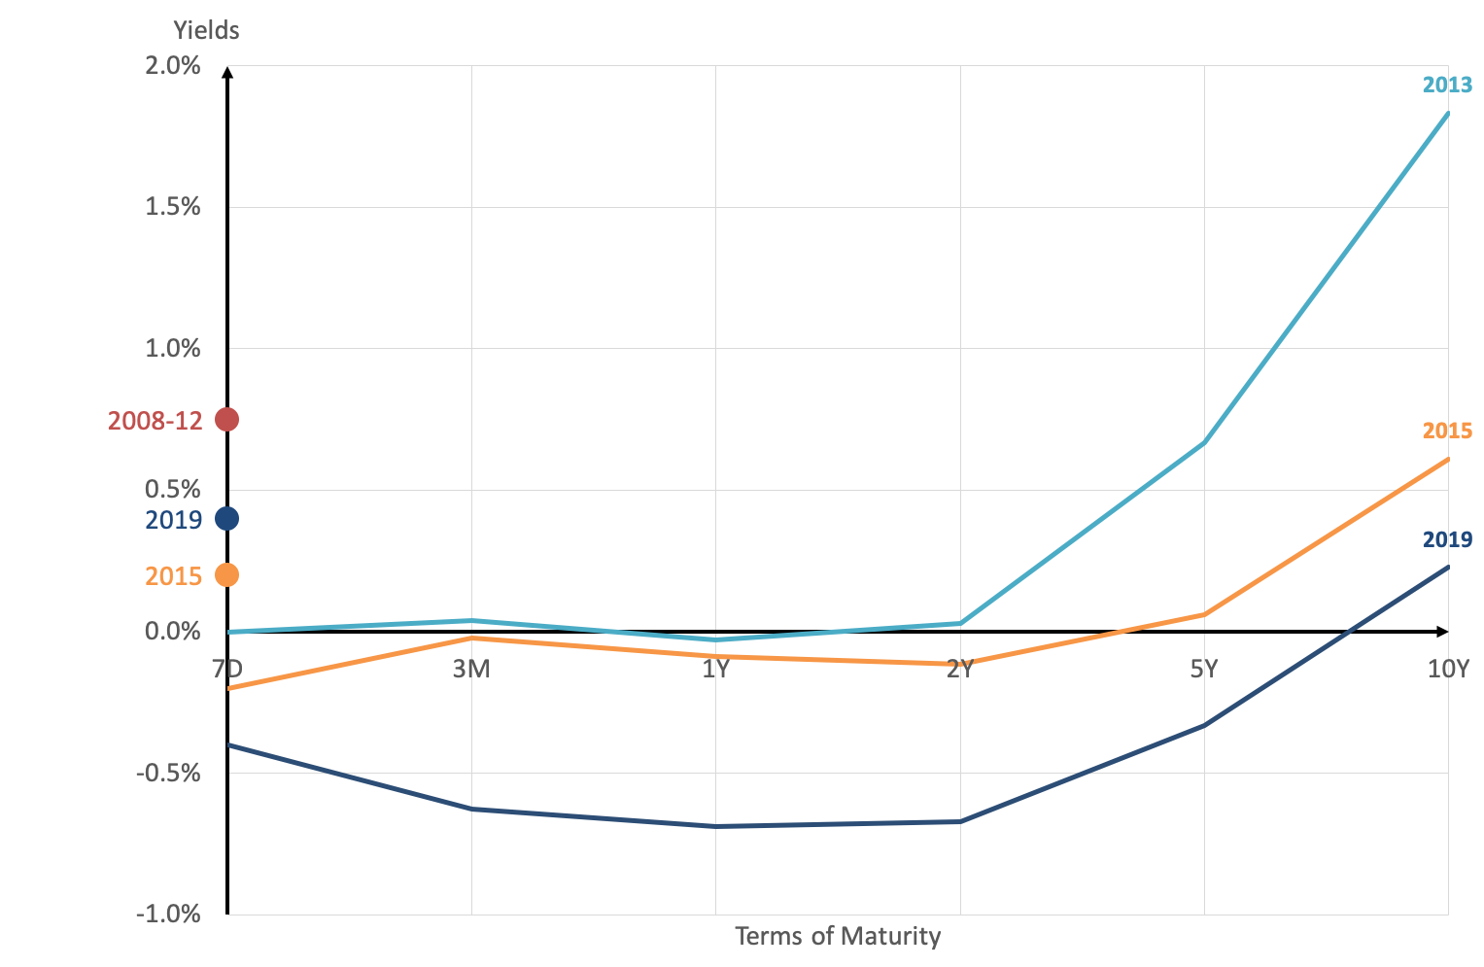
The euro area yield curve

Slide 21
Altogether

Slide 22
More euro-area data
Eurosystem’s balance sheet

Slide 23
Eurosystem balance sheet
Source: Reis (2015) “Funding Quantitative Easing to Target Inflation”

Slide 24
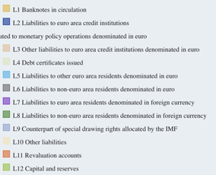
Growth in reserves at the ECB
Source: www.ecb.int

Slide 25
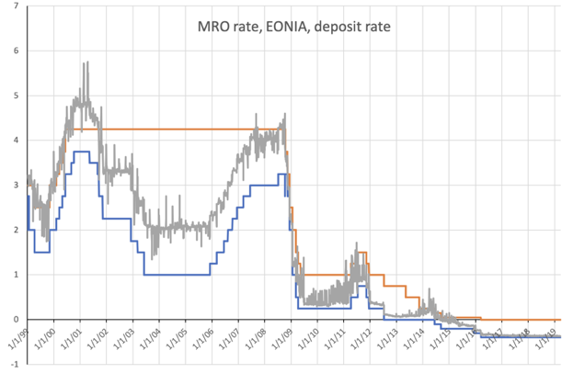
Satiation of reserves in Euroarea
Source: www.ecb.int

Slide 26

Summary
Central banks can set the interest rate on reserves to reach reserve satiation
The Friedman rule is setting $i^{v}=i$ to eliminate the opportunity cost of reserves
To stimulate the real economy, central banks may use unconventional tools such as forward guidance and quantitative easing
This raises the demand for longer-maturity bonds, pushes up their prices and lowers their term premium and thus flattening the yield curve
The euro area yield curve during the US and euro crises shows the ECB’s transformation from conventional to unconventional strategies

