Slide 1

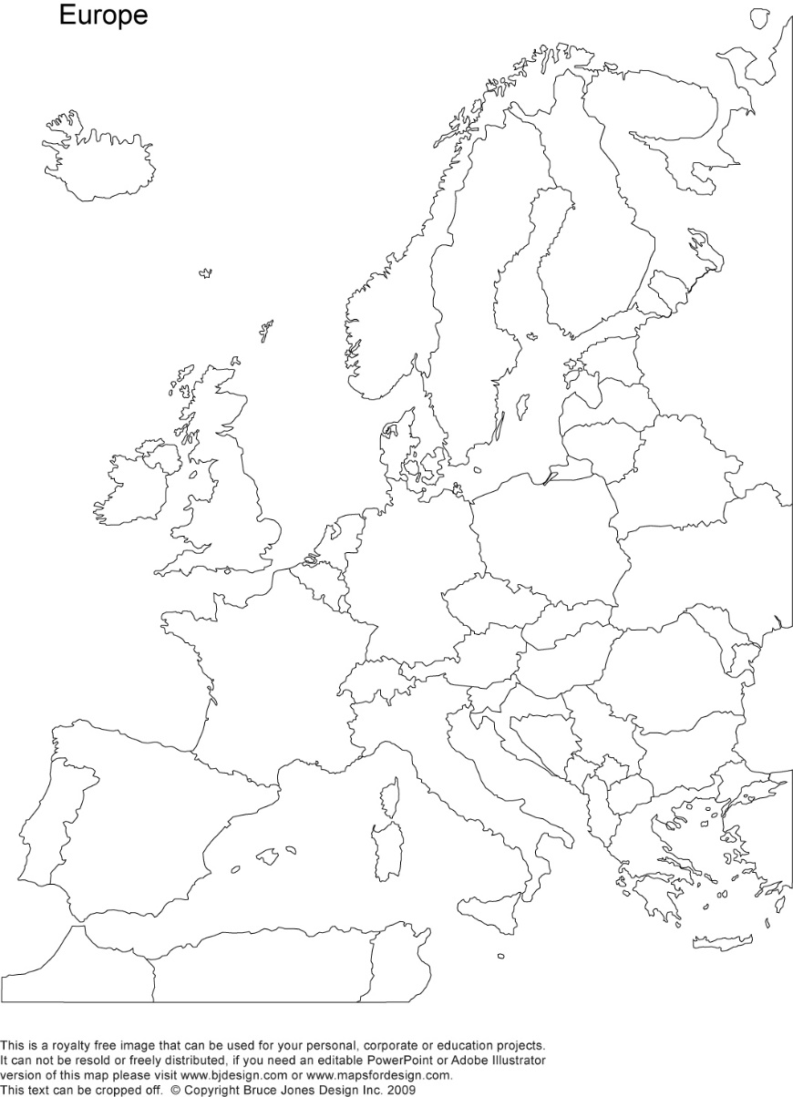
A crash-course on the euro crisis
Markus K. Brunnermeier & Ricardo Reis

Slide 2

The flight to safety
Section 7

Slide 3
Cross-country capital flows
Even as interest rates increase, the interest rate in some asset classes or regions can be unusually low
As investors shift their portfolios away from assets they deem to be risky and towards those that they deem to be safe, the price of the latter rise
In the absence of a euro-wide government bond to serve as a safe haven, safety capital flowed across countries
In the European crisis, German bonds were perceived to be safe whilst Greece’s were not

Slide 4
A safe asset has three properties
It has limited risk by giving the holder the same payoff across a variety of future scenarios. It is easy to sell across people with different beliefs and tastes about risk
01
During times of crisis, it's low risk and high liquidity are particularly valuable in insulating the holder from risk
02
An asset is safe if it is considered by all to be safe which makes trading very liquid and implies that the price will not fall
03

Slide 5

Shifts in safe asset status in an asymmetric currency union

Slide 6

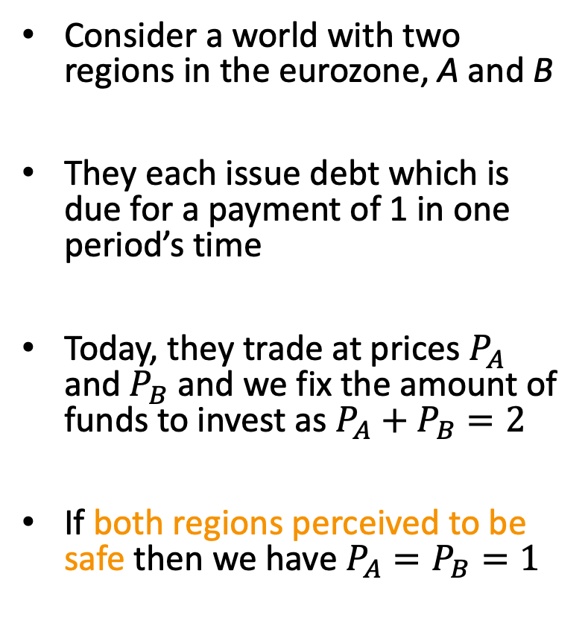



Simple model of flight to safety
Consider a world with two regions in the eurozone, A and B
They each issue debt which is due for a payment of 1 in one period’s time
Today, they trade at prices $P_{A}$ and $P_{B}$ and we fix the amount of funds to invest as $P_{A}+P_{B}=2$
If both regions perceived to be safe then we have $P_{A}=P_{B}=1$
$$2$$
$$P^{B}$$
$$1$$
$$P^{A}$$

Slide 7



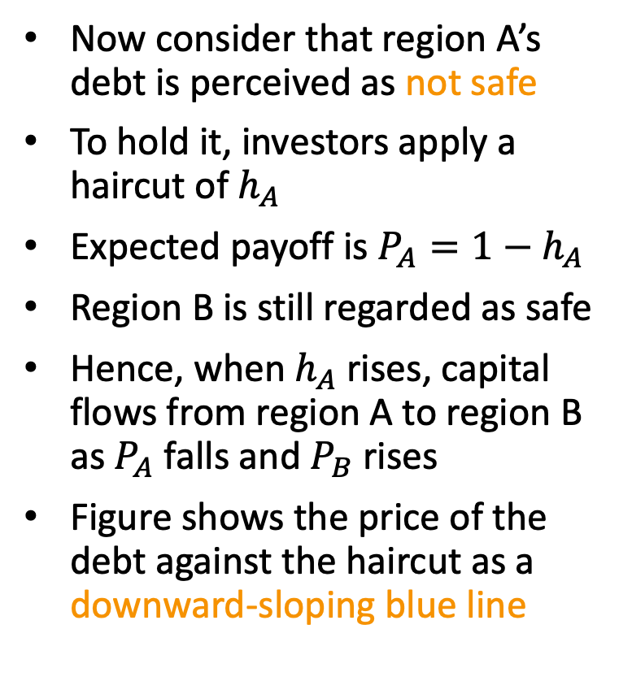



Haircuts
Now consider that region A’s debt is perceived as not safe
To hold it, investors apply a haircut of $h_{A}$
Expected payoff is $P_{A}={1−h}_{A}$
Region B is still regarded as safe
Hence, when $h_{A}$ rises, capital flows from region A to region B as $P_{A}$ falls and $P_{B}$ rises
Figure shows the price of the debt against the haircut as a downward-sloping blue line
$$2$$
$$P^{B}$$
$$1$$
$$P^{A}$$
$$P^{A}=\left(1−h^{A}\right)$$
$$h^{A}$$

Slide 8


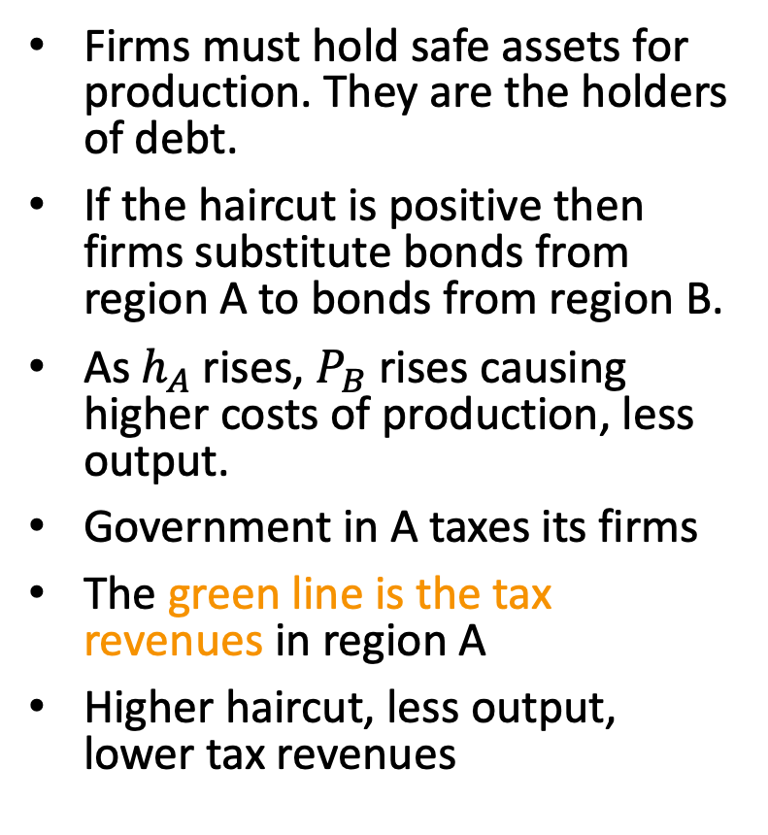

Tax revenues
Firms must hold safe assets for production. They are the holders of debt.
If the haircut is positive then firms substitute bonds from region A to bonds from region B.
As $h_{A}$ rises, $P_{B}$ rises causing higher costs of production, less output.
Government in A taxes its firms
The green line is the tax revenues in region A
Higher haircut, less output, lower tax revenues
$$2$$
$$P^{B}$$
$$1$$
Tax revenues
in region $A$
$$P^{A}$$
$$h^{A}$$

Slide 9


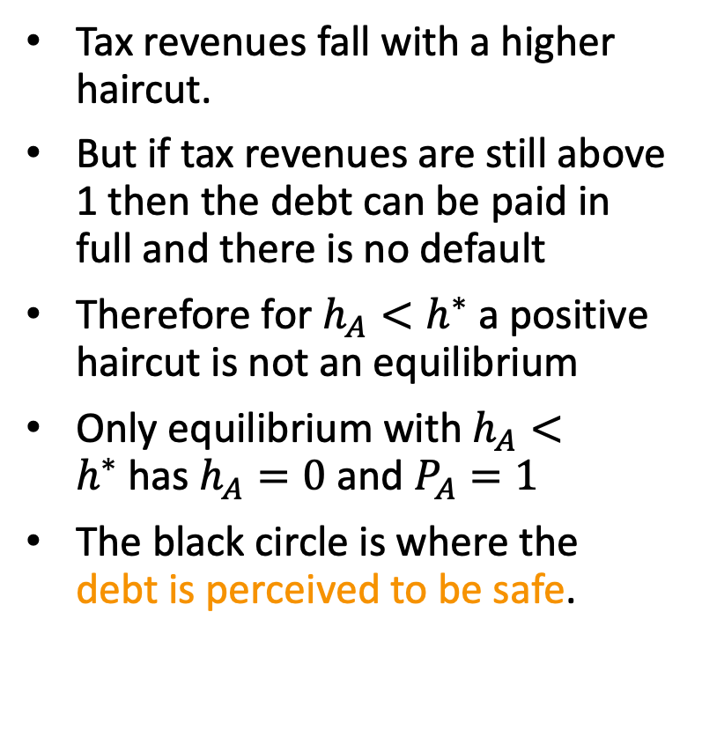



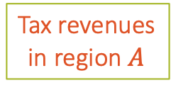

The safe-debt equilibrium
Tax revenues fall with a higher haircut.
But if tax revenues are still above 1 then the debt can be paid in full and there is no default
Therefore for $h_{A}<h^{∗}$ a positive haircut is not an equilibrium
Only equilibrium with $h_{A}<h^{∗}$has $h_{A}=0$ and $P_{A}=1$
The black circle is where the debt is perceived to be safe.
$$2$$
$$P^{B}$$
Tax revenues
in region $A$
$$1$$
$$P^{A}$$
$$P^{A}=\left(1−h^{A}\right)$$
$$h^{∗}$$
$$h^{A}$$

Slide 10








The flight to safety
If the green line falls below 1 then for these high haircuts, output and tax revenues fall so much that the government defaults
There is another equilibrium: orange circle.
Region A loses safe debt status
Haircuts are high, capital flows to region B, yield in region B falls (or price of bonds rises).
Tax revenues in A falls, government A defaults, justifying belief that they are not safe.
$$2$$
$$P^{B}$$
$$1$$
Tax revenues
in region $A$
$$P^{A}=\left(1−h^{A}\right)$$
$$P^{A}$$
$$h^{∗}$$
$$h^{A}$$

Slide 11









Asymmetry is source of problem
The two regions are identical.
There is a third equilibrium where it is region B’s bonds that lose their safe status, and it is region A that benefits from the flight to safety.
Key source of the problem is the asymmetry in the supply of the safe asset across the two regions.
$$2$$
$$P^{B}$$
$$P^{B}$$
$$1$$
Tax revenues
in region $A$
$$P^{A}$$
$$P^{A}=\left(1−h^{A}\right)$$
$$P^{A}$$
$$h^{∗}$$
$$h^{A}$$

Slide 12
The European sovereign debt crisis
Before the crisis, the yield on sovereign bonds on all the eurozone countries were approximately the same suggesting that all could e safe assets
Between 2010 and 2012, the gap in yields between the core and the periphery increased significantly
These sharp increases in interest rates came with large capital flows from the periphery to the core and deep recessions in the periphery

Slide 13
What causes gap in sovereign interest rates?
Exchange rate risk
Default risk
The exchange rate of the periphery currency can depreciate relative to the core
But the introduction of the euro eliminated the perception of exchange rate risk
However, this re-emerged as “denomination risk” where debt in euros could be redenominated into new national currencies worth less than the euro
The periphery was more likely to default than the core
The Maastricht Treaty imposed a bail-out clause that made it formally illegal for other European institutions to bail out countries
This eliminated inflation risk
But periphery bonds were not safe as they kept neither their payments across circumstances nor their safety during a crisis

Slide 14
Spread between 10-year sovereign yields in the periphery and core
This figure plots the sovereign yield of the core and periphery
Before the crisis, both yields were approximately the same suggesting that all were safe assets
During 2010-2012, the two series diverged as beliefs changed
There were large capital flows from the periphery to the core

Slide 15
Solutions?
Fiscal-sharing mechanism
Fiscal fund transferred from the core to the periphery, lower and raise their green lines, respectively.
Common Euro-wide bond
Solves the problem from the start because it imposes a single equilibrium with no cross- region flights to safety.
Such a bond can be designed without one country having to guarantee for the other country’s debt (ESBies or SBBS).

Slide 16
More euro-area data
Shift in capital flows,
Partly offset by public flows in opposite direction,
From ECB via TARGET II and with official support from troika.
ESBies to provide symmetric safe asset

Slide 17
Public and private capital flows
Source: Merler, S, and J. Pisani-Ferry (2012) “Sudden Stops in the Euro Area”

Slide 18
Flows away from banks
Source: IMF report (2012)

Slide 19
Greece debt replaced by official credit
Source: Reinhart Trebesch (2016) Brookings Papers on Economic Activity

Slide 20
Capital Flows and Target II Balances

Slide 21
Solving the lack of safe asset that is euro-wide
Source: Brunnermeier, Langfield, Pagano, Reis, Van Nieuwerburgh, Vayanos (2017) “ESBies: Safety in the Tranches”, Economic Policy

Slide 22
Summary
A feature of modern financial crises is that at even as interest rates spike up, the interest rate in some regions or asset classes become unusually low
Asymmetric perceptions of safety in a currency union can lead to capital flowing to the safe region
Higher default risk raises haircuts which in turn lowers output and tax revenues and thus increasing the likelihood of default
The asymmetries in supply, and thus the bad equilibrium, can be eliminated if countries could issue a joint bond and have a single haircut
During the European crisis, the interest rate gap widened considerably as a result of capital flowing from the periphery to the core due to exchange rate risk and default risk

