Slide 1

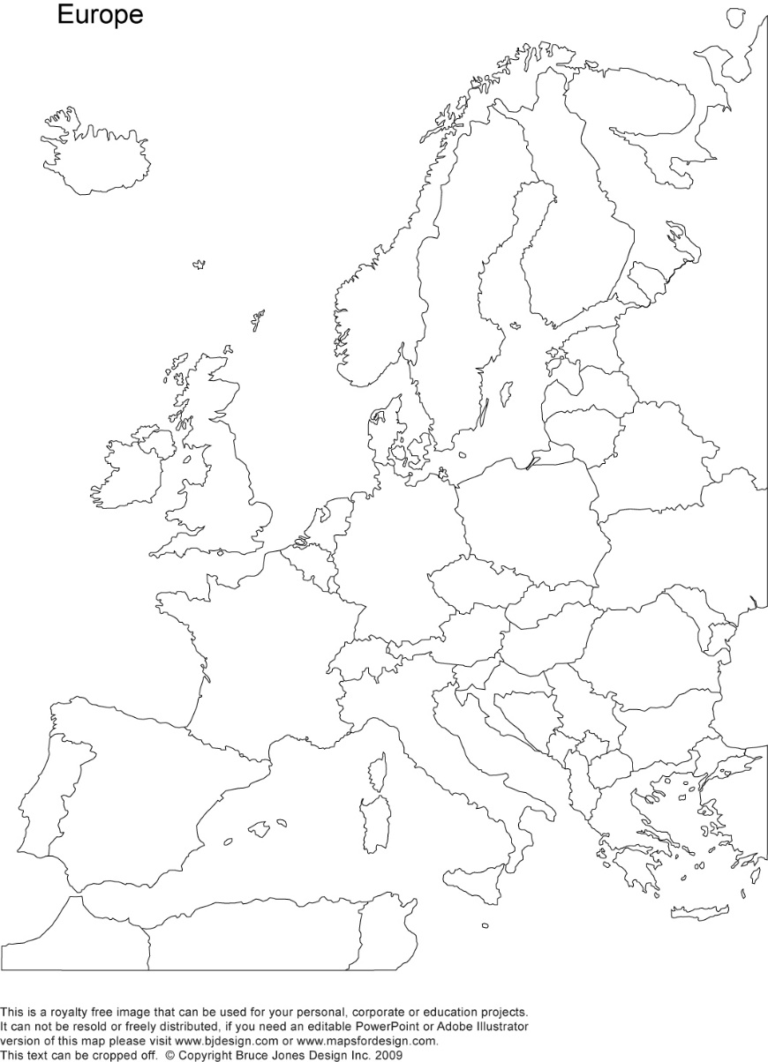
A crash-course on the euro crisis
Markus K. Brunnermeier & Ricardo Reis

Slide 2

Channels of funding and the role of (shadow) banks
Section 3

Slide 3
The traditional bank
On the asset side are holdings of mortgages, business loans, and financial assets which are mostly government bonds
On the liabilities side are demand deposits from individual households
Banks monitor domestic borrowers to reduce chances of default as well as transforming from liquid liabilities to illiquid assets
However this transformation of maturity and liquidity exposes the banks to runs

Slide 4
The traditional bank

Slide 5
Bank runs
If all depositors demanded to withdraw their deposits at the same time then the bank would not be able to liquidate its assets to honour its promises
If one depositor expects a bank run then she would want to run as well to be ahead of the line to withdraw
Policy such as deposit insurance backed by fiscal authorities or lender of last resort by monetary authorities can eliminate the incentive to run

Slide 6

Modern and shadow banks
ASSETS
Securitization
LIABILITIES
Wholesale funding

Slide 7
Securitization of assets
Pool mortgages to remove idiosyncratic risk
01
Sell future revenue stream in exchange for payment today
02
Previously hard-to-trade mortgages are now tradable securities
03

Slide 8
Modern and shadow banks
Wholesale funding market for liabilities
Borrow from other financial institutions
01
Short-term borrowing in the unsecured interbank market.
02
Borow through repos where securities are temporarily sold to other financial institutions to be later repurchased at a pre-agreed price. Collateralized and short-term so effectively senior to depositors.
03

Slide 10
Consequences
Securitization
Share of traded assets that are constantly marked-to-market is now considerably larger
The modern bank can quickly realize losses and relies on markets working to sell these securities
Wholesale funding
Unlike depositors, financial institutions are well-informed and quick to withdraw loans. Inertia can no longer be counted on to prevent runs.
New funding risk form repos not being rolled over.
Both allow banks to grow quickly

Slide 11
Modern banks are riskier: size
Because they grow quickly supported on wholesale borrowing,
The share of net worth that funds assets is lower.
Hence, incentives for banks to exert effort to monitor the quality of their loans become weaker.

Slide 12
Modern banks are riskier: funding risk
Funding liquidity risk is higher
Lenders of wholesale funding are quick to exit at the first sign of trouble.
Some institutions do not take deposits at all and so avoid the government regulation that comes with them.
These “shadow banks” are prone to classic bank runs

Slide 13
Modern banks are riskier: asset-price cycles
Modern banks amplify asset-price cycles.
When house prices rise, the marked-to-market assets increase immediately which makes it easier to obtain wholesale funding in the repo market.
This enables further lending, lower mortgage costs, more demand for houses and therefore leading to further appreciation

Slide 14
The build-up towards the crisis:
Spanish credit boom and the Cajas
From 2002, when Spanish banks start to expand small local savings and loan banks, “Cajas”, also started to grow despite little growth in deposits
The new ability to securitise, sell mortgages and access the wholesale market enabled them to become modern banks and grow quickly
Hence, the Cajas were able to fund credit to real estate at a much faster rate than other banks

Slide 15
Spanish banks v. Cajas

Slide 16
The Spanish new banking landscape
By 2007, the Cajas accounted for 52% of all loans to the Spanish private sector and its loans to real estate grew by a factor of 4.9
In 2017, all the Cajas has been dismantled or absorbed by other banks as a result of their high losses and mismanagement

Slide 17
European banks are special because
Size of bank credit relative to total GDP is very large. Bank financing is dominant in Europe.
Concentrated within countries. Largest few banks in each European country are very large relative to their countries, with total assets often in excess of annual GDP. Any individual country has trouble bailing out its banks.
Flows of capital happened across multiple regions in Europe, involving countries with different deposit insurance mechanisms, different resolution authorities for troubled banks, and different fiscal authorities and legal systems behind these. Sovereign safety net of the financial sector was unreliable.

Slide 18
More modern banks data

Slide 19
Capital flows core-periphery through banks
Source: Bank for International Settlements

Slide 20
Capital flows core-periphery through banks
Source: Shin, H (2012) “The Euro Crisis Through the Lens of Capital Flow Reversals”

Slide 21
From German to Spanish banks
Source: Shin, H (2012) “The Euro Crisis Through the Lens of Capital Flow Reversals”

Slide 22
Capital flows intermediated by banks
Source: Rey, H (2012)

Slide 23
Banks and government borrowed from abroad
Source: Chen, Milesi-Ferreti, Tressel (2012)

Slide 24
Europe’s huge banks

Slide 25
Countries borrowing through banks
Source: Baldwin Giavazzi (2015) “The Eurozone Crisis: A Consensus View of the Causes and a Few Possible Remedies” CEPR Press

Slide 26
The growth of securitization in Europe
Source: Shin, H (2012) “The Euro Crisis Through the Lens of Capital Flow Reversals”

Slide 27
Securitization in Spain
Source: Shin, H (2012) “The Euro Crisis Through the Lens of Capital Flow Reversals”

Slide 28
Greek banks growth in loans from other banks
Source: Meghir, Pissarides, Vayanos, Vettas (201x) Beyond Austerity: Reforming the Greek Economy, MIT Press

Slide 29
Summary
Traditional banks have a simple balance sheet: mortgages, business loans and government bonds as assets and demand deposits as liabilities
The transformation from illiquid liabilities to liquid assets expose banks to runs. However, policy in the form of deposit insurance or lender of last resort can eliminate the incentive to run
Modern banks, however, have a much larger share of traded assets that are constantly marked-to-market and grow very quickly
Funding liquidity risk is higher and modern banks amplify asset-price cycles
The Cajas expanded rapidly from 2002 despite little growth in deposits. They became modern banks and funded credit to real estate and spurring misallocation between sectors

